Slide 1
Brazil SOTP
WW2
Tess Lambert
2/17/19

Slide 2
Review concepts relating to Dan 11:40
2 parts - 2 ToE 1798 1989
Deadly wound, begins to fall until you mark the death = brings interesting conclusion. First to remind us of the war - prior to this history there is a war between KN and KS. One has begun to be wounded. There is wounding throughout this history. But it’s different at this waymark. This is where the wound is mortal - from this pint death is inevitable. In both histories, where you see the damage done is prior. If we were going to bring this from the counterfeit to the true, we consider that the papacy was scattered in 1798. In Bible prophecy what are you scattered for? Apostasy. When Isaiah describes God’s people doing this, he describes it as sickness.
Isaiah 1:5 Why should ye be stricken any more? ye will revolt more and more: the whole head is sick, and the whole heart faint.
1773
1798
1799
scattered
apostasy
resurrect
1798
1799
mortal
resurrect
When we bring the concept of a scattering in this history, we can also apply this to 1798. And apostasy in 1773.
You can also see this is a sickness. Once you se the symptoms, you’ve already been sick for sometime. When we say mortal wound or symptoms of this disease and then we talk about death it’s not disconnected to the previous history. If we compare and contrast, our question was did the USSR actually die after 1991? We know that the KN died in 1799.
Dan 11:10 - when it says ‘to his fortress’ the concept is you have your country (in vs 10 this is Egypt) — it came all the way to the borders. All the other territory has been taken but key country is not. Can we see that as a actual defeat? That’s what happened in this history. Everything taken up to the border of USSR itself. We use that logic to say we misunderstood these verses. We say we got Dan 11:40 wrong. First thing we say is KS wasn’t actually defeated. The reason it wasn’t defeated - because we say USSR was not KS - but Russia was KS. What do we do now? It’s the USSR that died. We know KS will resurrect and will look different. The 5th/7th head - has a different form. The other evidence for that verse - we’ll go through more thoroughly.

Slide 3
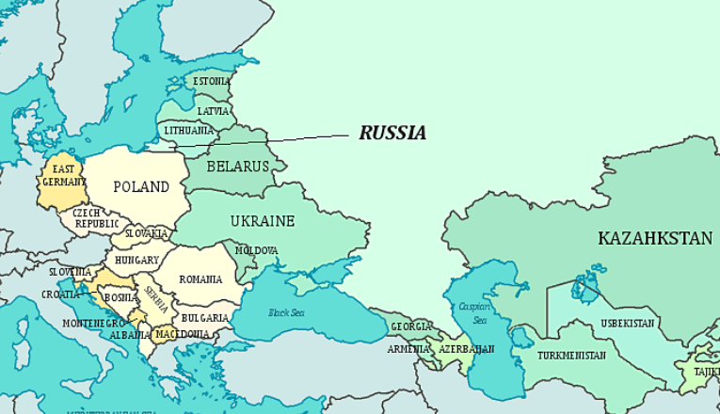
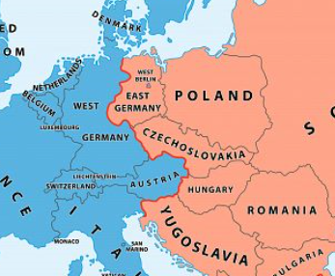
Spheres of influence for protection
Spheres of Influence
You want to have some control of countries around you to protect from impact
Churchill and Roosevelt allowed Stalin to have some supervision over E Europe. Stalin set up puppet Communist governments
The Iron Curtain was the name for the non-physical boundary dividing Europe into two separate areas from the end of World War II in 1945 until the end of the Cold War in 1991. The term symbolizes the efforts by the Soviet Union (USSR) to block itself and its satellite states from open contact with the West and its allied states. On the east side of the Iron Curtain were the countries that were connected to or influenced by the Soviet Union, while on the west side were the countries that were allied to the United States or nominally neutral. Separate international economic and military alliances were developed on each side of the Iron Curtain.

Slide 4
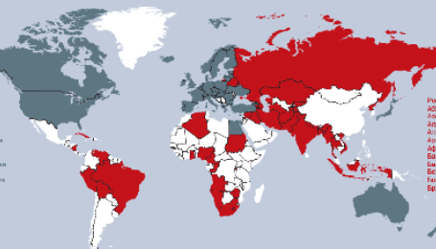
Spheres of Influence: Russia
China
Serbia
Iran
The annexation of Crimea by Russia was supported by: Zimbabwe, Venezuela, Syria, Cuba, Nicaragua, Sudan, Belarus, Armenia, North Korea and Bolivia.
Iran mainly supports Russia due to its Military Power. It also makes it stronger in the Middle East as its main opponent in the nation is Saudi Arabia, a US ally.
Other Nations that support Russia include,
North Korea, Brazil, South Africa, Syria, Belarus, etc
I won’t say about India as India is quite neutral about its international policy although India and Russia have great relations in business.

Slide 5
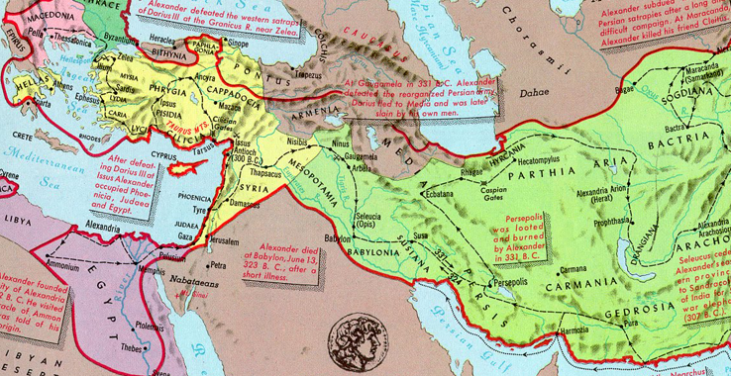
When we talk about the Battle of Panium, we know that is a complete defeat. We understand all those Syrian wars - if we consider Egypt and realm of Seleucus —- they’re fighting over Coele-Syria. Even when you get to the battle of Panium it’s another state that’s taken. A satellite state they’re both fighting over. Seleucus never takes Egypt - KS can be fully defeated without taking of his own country. We should consider this more seriously, the implications of that. If we consider what they were fighting over, it was never to take down each others countries. The reason he did not take down Egypt - when he had the opportunity after Panium - is that Rome stepped in and said your economy will collapse. People are suggesting the the Russian Federation began in 1991 and it will end at Panium. I’d like to understand how we even suggest the Russian Federation even ends.
What they’re fighting for is global influence, not something so destabilizing as taking down each others counties. Which makes the whole warfare so much more subtle. It also makes us consider - the smaller things like who’s fighting in Syria or Afghanistan, whether or not Trump withdraws from those fights, his relationship with Nato and his allies - if it’s a fight over global influence those things become much more important. Perhaps we need to reconsider what we’re expecting to see. We will go through these verses in history in more detail

Slide 6
Cold war - both powers have nuclear weapons:
If America was to take on the USSR, and they pressed the nuclear button, or something that was open war, in a few minutes they could hve an atomic bomb heade for them - both countries would be destroyed. Open warfare in time of nuclear weapons would be madness. After 1999, Russian economy is reconstructed. How? What type of economy is it? Capitalist structured economy. In 1991 Russian economy collapsed - turns capitalists - biggest businesses are privatized. All their businesses now open to the world to invest/trade in. With globalization billions and billions of Russian money comes out of Russia. Much of Russia’s money now is tied to the west. Now we have MAED (E Economic)
Cold War
46 years
46 years
1899
1945
1991
M = Mutually
A = Assured
E = Economic
D = Destruction

Slide 7
If we’re expecting Putin to actually attack the west, in any truly destabilizing way, it would be national suicide economically. What Putin must do in a clever way is regain his global influence and defeat US without destroying the country or destabilizing the economy. His personal net worth is between $200-$500 billion. Much of that is tied up in the west - tied also with US sanctions. Even having US against him he’s losing money. It changes how he needs to fight. If we consider what happens in Daniel 11 - they're fighting because each wants to be the dominate super power. Not to destroy other countries. I would suggest that is what Putin has to do. He wants global influence - he doesn’t want to lose Syria, his control with oil over Europe, Iran - this is what they’re fighting over - global influence and removal of sanctions. Anything antagonistic that doesn’t further that end would be madness. He would lose his country and his own finances.
When you put sanctions on something, you can hurt yourself to. Now Trump has sanctions on Iran - that isn’t hurting US - but really hurting Europe. That’s damaging more than ever the relationship between Trump and his allies. The world is so interconnected now. You start shutting down Russia economically - can you imagine oil prices in Europe? Then it’s your allies turning against you because they can’t afford to heat their homes.

Slide 8
Pyrrhus = KS 323bc Alexander dies
When he dies he leaves dozens of generals - fighting over the kingdom. 4 Diodochi wars - one long continuing war that the historians have seen points to separate.
The end of the 4th Diodochi war is Ipsus in 301bc
This is where we have 4 generals : C, L, S, P
22 years of history.
In Daniel 8 & 11 he skips 22 years + 4 wars to take us to the point of 4 generals. You can go back to around 317bc and you have 5 for about 16 years. Under inspiration those 16 years are overlooked as well. Daniel takes us from 323bc to Ipsus (4th D war). There are 4 generals for 4 years before Cassander dies. We skip 22 years just to highlight this tiny piece of history. Daniel is ‘cherry picking’
22 years
Ipsus
301bc
323bc
Pyrrhus
1
2
3
4
4
cause
effect
317
N
5
4
W
E
S

Slide 9
Pyrrhus gets involved in the 4th D war. The 3rd & 4th have peculiar characteristics. The 1st & 2nd have dozens of generals, during the 3rd & 4th you just have the 5. You have our allies by the time you get to Ipsus - Seleucas gets his empire
Antigonus was the most powerful general. By the time we get to the 3rd D war, the combined forces of all 4 allies are only equal to Antigonus. 3rd D war ends with peace treaty because the 4 united together could not defeat Antigonus.
1
2
5 generals
Antigonus vs
Demetrius
3
Cassander
Lysimichus
Ptolemy
Seleucus (only a general)
4

Slide 10
22 years
Ipsus
301bc
323bc
Pyrrhus
1
2
3
4
4
cause
effect
317
311
Peace
treaty
N
They sign peace treaty around 311bc ending the 3rd D war.
5
4
W
E
S
Diodochi Wars
1
2
3
Cassander
Lysimichus
Ptolemy
Seleucus (only a general)
vs
Antigonus Demetrius
4

Slide 11
History of the 4th Diodochi War:
It begins when Demetrius invades Athens
317bc Cassander placed a dictator in Athens. This is a very strategic area. One they had a rivalry over. 307bc Demetrius frees Athens. We can mark a 10 year period leading up to Demetrius taking this territory from Cassander. This marked the 4th D war because it breaks the peace treaty they went into. Where do we mark a 10 year struggle on our reform line?
(1979-1989 - TOE ‘89) the freeing of a strategic location from a dictator. And we can mark the 4th D war as we did in Acts 27
In 307bc this war starts again. In 303bc Pyrrhus enters the world scene and goes into an alliance with Demetrius. He was born 319bc in Epirus — Alexander’s mother was princes of Epirus. He’s a relative of Alexander. He’s about 15 or 16 years old when he enters the world scene as a general of Demetrius. His sister marries Demetrius, cementing the alliance. And begins to act as a general. This alliance was 1st tested 2 years later at the Battle of Ipsus that ended the 4th D war. It’s at this battle they are in alliance - and the only time we see them on the same side.
10 years
4th D war
TOE
Ipsus
301
317
307
303
Athens
Cassander places dictator in Athens
Demetrius frees
Athens
Pyrrhus & Demetrius
In alliance
Antigonus defeated by 3 allies

Slide 12
These 4 generals decided it was time to defeat Antigonus. They combined their forces and met at Ipsus. The face off against Antigonus and Demetrius and fighting for Demetrius was a young Pyrrhus (his 1st battle). They looked evenly matched, but Seleucas just returned from his campaign from the east and brought to this war 400 war elephants. It was going well for Antigonus and Demetrius. They became separated, they made a mistake and ventured too far from each other. When they tried to get their 2 armies to reconnect, Seleucus drove his elephants between them and split the army. Demetrius tried to reach Antigonus but couldn’t get through the elephants. Antigonus was isolated, fought to the last but whole army plus himself were destroyed. Demetrius and Pyrrhus fled. With that battle in 301bc the last general who was powerful enough to unite the empire was defeated. Now you can mark 4 that are fairly evenly matched.
Alexander’s empire will never be united again. When seeing how much history is skipped, I’m not suggesting this is not a significant date - when Antigonus is defeated. He was about 80 years old.
Ipsus - Antigonus is defeated by combination of 3 allies and we see activities of Pyrrhus.
elephants
1
2
Antigonus Demetrius
N
vs
4
3
W
E
4
S

Slide 13
10 years
Afghan War
TOE
1979
1989
2014
2016
KS
KN
10 years
4th D war
TOE
Ipsus
301
317
307
303
Athens
Cassander places dictator in Athens
Demetrius frees
Athens
Pyrrhus & Demetrius
In alliance
Antigonus defeated by 3 allies
Making application
Our TOE is 1989. Prior to that history we mark a 10 year war. After this in 303bc we see an alliance between Pyrrhus and Demetrius.
Pyrrhus = Putin KS Stalin
Demetrius = Trump KN Hitler
From 301bc forward hey become desperate enemies. While they begin an alliance as we get further along we’ll see they’re actually enemies. Trump has been involved in Russia many years. 303bc I’m marking as around 2013-2104. It’s in 2013 Putin begins to interfere with election or preparing to do that work. The only time we see them on the same side is 2016 election.

Slide 14
The 3 allies = C L S / who Demetrius and Pyrrhus are fighting. See how it lines up with WW2. This is the application we’re looking at. We understood with our kings that Pyrrhus = Putin and Putin—Stalin. Putin is 1st typified by Stalin. Go back to history of Stalin. We’ve considered where Pyrrhus entered world stage - consider where Stalin enters the world stage.
I don’t want to consider where USSR begins in 1917 because in those 1st years it’s engulfed in civil war. We’ll consider when it becomes involved in world politics, when it enters the world stage. That began with the Spanish Civil War. In 1939 there’s this growing conflict in Europe - 2 sides being drawn up. Many countries threatened with civil war. The 2 sides that want to fight are those that support a fascist type of government and those that want a communist style government. This becomes a struggle between Fascism and Communism. Few significant countries have been leaning toward fascism. Around 1936 Spain is heading in that direction. It erupts into civil war in 1936. France calls for all countries in Europe not to intervene. They draw up and sign a non-intervention agreement - signed by 27 countries. Spanish Civil War is the nationalists government vs General Franco—Fascist. Stalin becomes worried. By 1936 he’s seen fascist governments arrive in Italy and Germany. He knows that Franco and Fascists are being supported by Germany.
Hitler is sending aid to General Franco as is Mussolini in Italy.
Cold War
46 years
46 years
1899
1945
1991
Fascism vs Communism
10 years
Ipsus
301
317
307
303
Athens
Pyrrhus & Demetrius
In alliance
10 years
April 1, 1939
1929
Proxy war
Spanish Civil War

Slide 15
By 1936 2 battle lines being drawn up. The USSR begins to supply military aid to the Spanish government. They send so much military supplies that at the beginning of the war Spain had 4th largest reserves of gold. By the end of the ward 2/3 of that was sent to USSR to pay for the military supplies.
It’s said that the Spanish Civil War was the 2nd WW in training. Like a playoff game before the champion match. In this war we understand Franco won - now you have a 3rd major Fascist government in Spain. Increasingly through this history those fascists governments were supported by the Pope - Mussolini, Hitler, Franco.
By the time we get to 1946, Europe is divided into 2 spheres. A struggle between Fascism and Communism.
We understand that Stalin killed millions of his own people. He did some terrible things. Putin’s excuse for Stalin is that he faced some difficult times. Putin says Stalin had no choice. In the 1930s the USSR had 2 major threats—Putin says those threats was the rise of these fascists governments and the Spanish Civil War. Which was a proxy war between Fascism and Communism—or between Hitler and Stalin. It’s interesting when you read the chapters on the Spanish civil war— -
Fascists
Communism
Mussolini (Italy)
Hitler (Germany)
Send aid to Franco
Stalin (USSR)
Send aid to Spanish
government

Slide 16
Hitler’s Pope. By John Cornwell — he was a dedicated Catholic. He started hearing rumors that Pope Pius X1I had supported Hitler in WW2. He wished to defend the Papacy against such an accusation. So he went to the Vatican and asked to investigate. They gave him access to the Vatican archives—that no one had access to, outside their close inner circle. He spent many months in this Vatican basement pouring through the material on WW2. By the time he was done he wrote this book, Hitler’s Pope. He came to the conclusions while doing that work that the accusations were worse than he could have imagined. Even though he was a dedicated Catholic and wrote the book anyway and uncovered a lot of material. I would suggest if we want to understand this alpha history of the papacy it’s essential reading. In this on page 223 the talks of the Spanish Civil War—and how by this stage the Papacy was supporting Franco. It says “he had sent a telegram of congratulation to Franco for Spain’s ‘Catholic victory’.” By the time WW2 ended, you would have the thousands of people come under the balcony at the Vatican. Pope Pius XII would come to address them. He liked to at the end of his speeches call out to any of the pilgrims from Spain, he would shout out the Pope is for Spain and they would shout back and Spain is for the Pope. So by this stage you can see the fascism and the Papacy combining. Mussolini had signed the Lateran Treaty and he was now known by the church as the new Constantine. Mussolini and Hitler are now in alliance with the Papacy. This proxy war ended on April 1, 1939. You can mark a 10 year period, in this history we mark a proxy war. And if we mark a 10 it takes us back to 1929. In 1929 we mark the Lateran Treaty. The LT is where the papacy got it’s territory back—it’s also where you see Hitler start to rise. You can also mark the great depression. You can mark some significant events in 1929.
10 years
Ipsus
301
317
307
303
Athens
Pyrrhus & Demetrius
In alliance
10 years
April 1, 1939
1929
Proxy war
Lateran
Treaty
Spanish Civil War

Slide 17
10 years
You can see how Europe is divided into this huge struggle between fascism and communism. And on April 17, Pope XII states that once more the hand of divine providence has manifested itself over Spain. So he’s praising God for the victory of Franco. So you can imagine the world’s shock when on Aug 23, 4 1/2 months later there is a pact or alliance between Hitler and Stalin—the Molotov Ribbentrop Pact. Molotov and Ribbentrop were the 2 men that met both foreign ministers of Germany and the USSR. By the time we get to August, Hitler has his heart set on taking Poland. He knows if he takes Poland that Britain and France would go to war with him. Hitler fought in WW1. He knows why they lost. What was the significant disadvantage Germany had in WW1?
2 fronts. He didn’t want to fight on 2 fronts.
Ipsus
301
317
307
303
Athens
Pyrrhus & Demetrius
In alliance
10 years
April 1, 1939
Aug 23,
1939
1929
Proxy war
Lateran
Treaty
Spanish Civil War
Molotov
Ribbentrop Pact

Slide 18
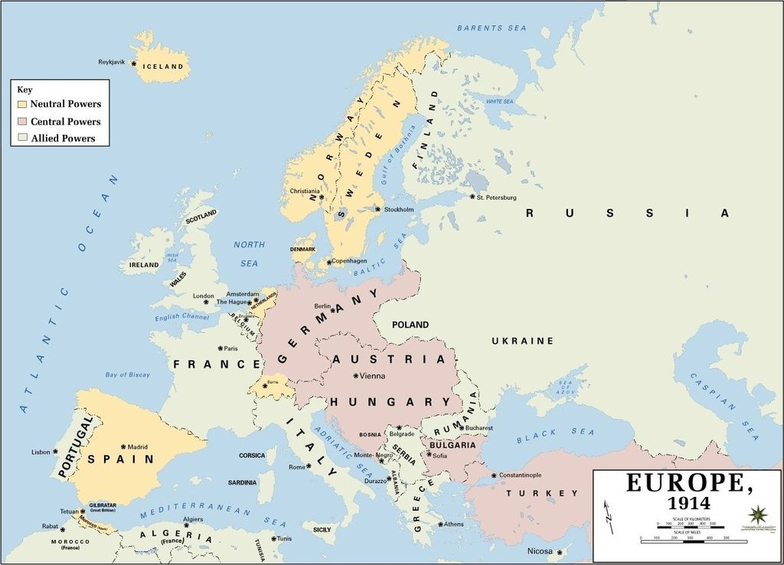
2 fronts—eastern and western. They must split their army all their supplies and resources between 2 borders. Hitler knows how that impacted them in WW1. Now he wants to take Poland. He knows if he does that he’s at war with the west. He knows he isn’t strong enough to face a war on 2 fronts. Stalin is his natural enemy. He’s afraid Stalin will take advantage of his weakness and invade. If he’s going to take Poland he has to make sure that he has peace with Stalin. This Pact is to enable him to go to war with the west. If he doesn’t have it he can not go to war with the west, beginning with the invasion of Poland. This is why these 2 natural enemies united. It was said at that time the whole course of world politics suddenly changed. When news of that alliance hit the press, the world began preparing for war. They understood that it was now WW2.
Eastern front
Western front

Slide 19
Just to remind us of what we’re doing—we understand there is an alpha and omega history. We’re suggesting that there is an alpha battle with the KS and an omega battle. But one is with Stalin vs Hitler. And one is with Putin vs Trump. So when we look at the history of WW2 we’re tracing the alpha history. And if the beginning defines the end. Then it will teach us about the omega history today. In the history of Pyrrhus, we find this alpha history. It’s the story of these 2 generals, or kings, that begin by going into an alliance, and then turn on each other. That’s the history of Stalin and Hitler. They are natural enemies—the strife between fascism and communism. They’ll never be peace between the 2. But to achieve a common goal, they go into a temporary alliance.
Stalin vs Hitler
Ω
Putin vs Trump

