Slide 1
Brazil SOTP
WW2
Tess Lambert
2/18/19

Slide 2
a
KS ªKN
Daniel 11:40 we’re building a structure
We need to understand why WW2 is significant. We’re going to repeat our logic—we’re taking Daniel 11:40 as a compare and contrast. We have 2 TOE
This is our first structure that we’ve built. Daniel 11:40 - first we see a deadly wound of the KN then a death; then a deadly wound for the KS then a death.
We know that we can compare and contrast the KN and KS based on what model?
KN - KS we can overlay over the compass using the “geography’ model
war
1798
1799
resurrection
Deadly wound
Pope captive
Dies
b
KN ªKS
war
1989
Ω
1991
resurrection
Deadly wound
Dies

Slide 3
Acts 27 we had the east wind. What country is that? For the E & W we don’t have clarity. But when it comes to the N & S you can locate them on a map. If I asked you to take me to absolute east - you would have no idea where to take me. It’s the same with the west. We would be spinning around the globe. If I asked you to take me N or S we would end up at a pole. A geographically precise location. When we bring the idea of poles, we then know these are polar opposites. If they’re polar opposites, then you can compare and contrast them, because they’re going to have similarities and differences. Both are covered in ice. One has a land mass and one doesn’t. One has polar bears and one doesn’t. There are differences but we have to recognize there are similarities. When we consider geography we know we can compare and contrast N & S. Which makes you wonder - the KN is church over state. What is the KS? Compare/contrast: KS = state over church. There is a church there as well, but there’s a switch in relationship. You can learn a lot from compare/contrast. We compared/contrasted part (a) & (b) - then created another structure.
The deadly wound would heal, a resurrection of the KN, so there would be a resurrection of the KS. This is our first structure. Then we created another structure separate to this.
Church over state
N
W
E
State over church
S

Slide 4
Structure 2
We said if this is the KN (1798-1799 ➔ resurrection) or Babylon, we know that what resurrects at the end of the world is modern Babylon. Now, instead of comparing the KN & KS, we’re going to compare modern Babylon with modern Israel. Modern Babylon comes in 2 histories. There’s an alpha and an omega. So instead of comparing the KN & KS, we’re going to compare modern Babylon with modern Israel. When it resurrects it must have an alpha and an omega. We can see that this is 2 separate structures.
Modern Israel
Modern Babylon
Miller
=
a
KS ªKN
Structure 1
Ω
Ω
war
1798
1799
resurrection
144
Deadly wound
Pope captive
Dies
b
KN ªKS
war
1989
Ω
1991
resurrection
Deadly wound
Dies

Slide 5
Structure 2
What is modern Babylon? What is it formed from?
Counterfeit. Now instead of comparing the N & S, we’re comparing the True and counterfeit.
This is our second structure. Now when we look at the resurrection of the KN, we know there must be an alpha and omega. How do we know the KS must then resurrect in 2 steps? Or is it going to resurrect in 2 steps?
The KN is going to resurrect. We understand that takes place in 2 histories. We had the Millerites and 144 - do you consider the KS will resurrect in 2 steps? (we can’t compare the KS with modern Israel)
Modern Israel
Modern Babylon
Miller
=
Ω
Ω
144
The question is, we’ve compared and contrasted the KN with the KS, but the KN is a counterfeit of something: the Truth. So we know we can contrast the True and the counterfeit of modern Israel and modern Babylon. This separate structure will tell us more about modern Babylon. The KS is not a counterfeit of modern Israel, or God’s people. We have no license to compare the KS with modern Israel. We’re unable to see the KS would resurrect in an alpha and omega history.

Slide 6
We’re reviewing the 2 structures that we’ve been developing. Two separate structures - we can compare and contrast the KN & KS. But when we compare and contrast modern Israel and modern Babylon, we can’t include the KS.
Compare and contrast compare and contrast
KN & KS KN & modern Israel
=
Counterfeit True
Not: KS ≠ modern Israel
Not a counterfeit
We have to see our story on different levels.
Example: † = Lion † Lion
† = Lamb † Lamb
Same ≠ not the same

Slide 7
We need to come to 2 conclusions:
1st we can see the KS will resurrect
2nd when the KN resurrects it will come in an alpha and omega
Again, when we construct the model of the KN & KS we have 2 story options: we can say as we have when the KS died 1989/1991, when we say the KS was not the USSR, but Russia - that it didn’t die, it may have faked it’s own death, and it’s just simmering waiting to boil up again, it’s still there waiting for an opportunity to strike back. - that’s one story. The other story is that the USSR was the KS. It received a deadly wound and literally died as the KS. Later it would resurrect.
a
KS ªKN
war
1798
1799
resurrection
Structure 1
Deadly wound
Pope captive
Dies
b
KN ªKS
war
1989
Ω
1991
resurrection
Deadly wound
Dies

Slide 8
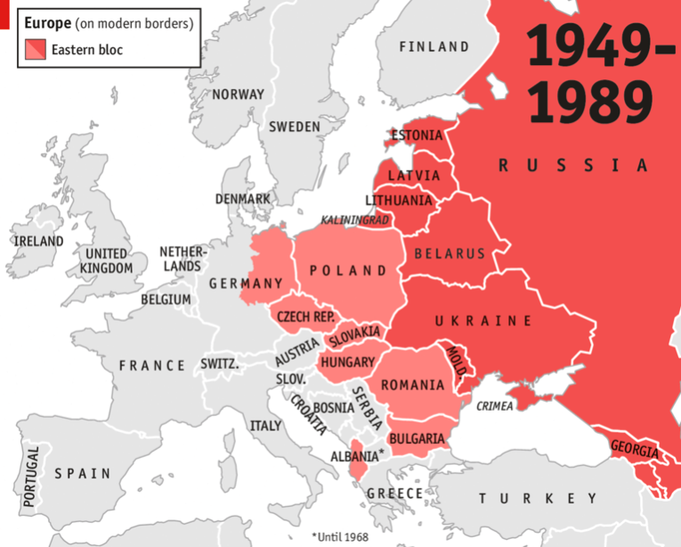
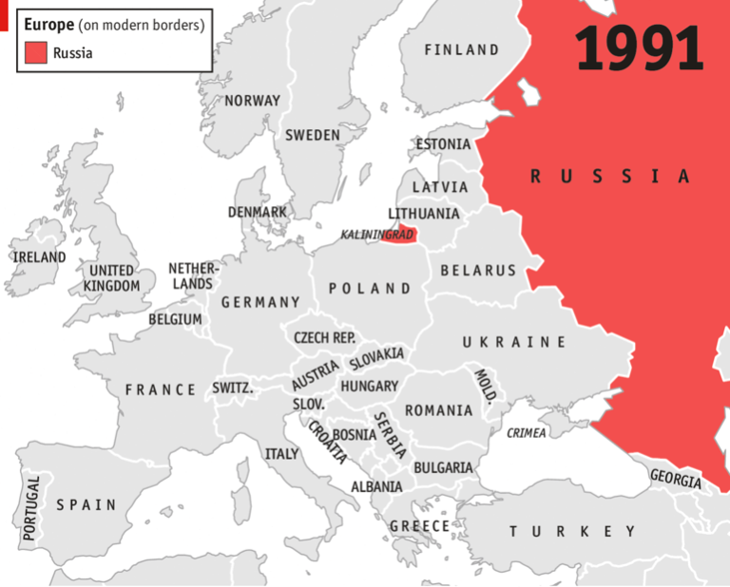
Compare and contrast Daniel 11:40 a/b -
the KS died as the USSR
The KS resurrects as Russia
USSR satellite states
One is Russia—seat of government
We say in 1991 all these satellite states are taken away - but Russia carried on through, that somehow it survived 1989/91, the deadly wound and death. The problem with that logic is that we connect a king with a kingdom. In 1798 who received a deadly wound? Pius VI, died in 1799. In 1991 what happened to him (KS)? He died. So who received the deadly wound in 1989? Gorbachev. What is he the king of? USSR. So when 1991 comes who falls? Gorbachev and the USSR— king and kingdom. He’s not the general secretary of Russia. He’s the general secretary of the USSR.

Slide 9
Part of the problem we face is we expect history to look different when we project that history into the future. So in the back of our mind we’re thinking Panium, SL. We don’t expect it to look like this where the nation can continue through. We want to see the US come in and take over. We want the death to look a little bit more obvious. I’m suggesting that it didn’t back then but it actually died.
1798 the pope is taken captive because the papacy is still opposing in some way Napoleon. In 1809 what happened? That pope isn’t falling into line. So Napoleon walks in and takes him captive. If we dig into these histories they’re not so simple or obvious. We’re directed to know what’s happening based on prophecy. Otherwise someone might ask you why you’re even marking 1798 because 1796 was the battle between the papacy and France. Then in 1809 there’s another pope taken captive. But prophecy directs us what to look at.
a
KS ªKN
war
1798
1799
1809
resurrection
Deadly wound
Pope captive
Dies
Pope
captive
b
KN ªKS
war
1989
Ω
1991
resurrection
Deadly wound
Dies

Slide 10
The KN resurrects in 2 histories. Both histories a resurrection - separate and distinct from each other. It’s like the Millerites and 144K and I’m marking in this history 1917, which is a preparation for a battle in this history—a war between the KN and KS.
When we look at modern Israel we say Millerites is the history of the 1st angels message and the 144 is the history of the 3rd angel. Where do you see the history of the 2nd? In both. They both contain the 2nd angel’s message.
When we consider Fatima, WW1 and WW2 are 1 war with a short break for peace in the middle. But it’s one war with the same players. Our history we call WW3. But in both histories you can place the 2nd message of Fatima. And their 2nd angel’s message is to defeat the KS.
Modern Babylon
1917
war

Slide 11
So that preparation began in 1917, the war with the KS and that is repeated in our history. WW1 and WW2 take on extra significance. We have different histories to show us what war looks like. And that typifies war between the N & S.
But when we consider modern Israel, if we need a reference point to know what it looks like, where do we go? - our alpha—the Millerite history. So if we want to know what this war looks like between the KN and KS, we want to know what the omega looks like, we go to the alpha - WW2. It becomes more significant than just 1 typification. I would suggest it’s necessary to understand WW2.
Modern Israel
Modern Babylon
Miller
=
War - KS
Ω
Ω
144
War - KS

Slide 12
We understand what the world looks like back then in the history of Pyrrhus. In 323bc, Alexander the Great dies, then you have 22 years of fighting. The 4 Diodochi wars. We pick up the 3rd and 4th. What’s happening in the 3rd and 4th war? You have 5 generals
WW1 & 2 were 1 war with an armistice in the middle. The 3rd & 4th Diodochi wars are 1 war with an armistice in the middle. But in these wars you find the same players, uur allies against Antigonus and his son Demetrius. There’s been a peace treaty at the of the 3rd war. There’s this period of peace where they prepare to fight again. When is that peace broken? When Demetrius liberates Athens from a dictator. Who placed that dictator? Cassander in 317bc (10 years previously). We mark a 10 year period and there’s strife in Greece over whether those city states will align themselves with the allies or Antigonus. And in 307bc, Demetrius liberates Athens from a dictator that Cassander placed there 10 years before. This begins the 4th Diodochi war.
Cassander
Lysimichus
Ptolemy
Seleucus (only a general)
Antigonus Demetrius
⬆
Pyrrhus
3
vs
4

Slide 13
Breaking their peace treaty, 4th Diodochi War
We know before the TOE we can mark a 10 year history. There’s a war that goes on for 10 years and they’re fighting for influence in the middle east. So Demetrius liberates Athens, they go to war and a few years later, 303bc we see Pyrrhus enter the scene. He’s about 15 years of age and he wants to be a general for Demetrius. So he’s working for Demetrius, training. Demetrius and Pyrrhus go int an alliance. Pyrrhus’ sister Diodmea marries Demetrius to reinforce this alliance. This 4th war all leads up to the battle of Ipsus in 301bc. This is the culmination where we see our allies now facing off against Antigonus and Demetrius — who is aided by Pyrrhus, if we could see the rest of this story. But to begin with we’re just dealing with this history 317bc-301bc. If we carried on we would recognize that Pyrrhus and Demetrius are enemies for the rest of this history. Before they go to war, they’re first allies. This is the one battle they fight as allies where Pyrrhus is fighting for the same cause as Demetrius.
This alliance between the KN and KS is 2014 and all leads up to one battle where they're on the same side, same course. That’s the 2016 election.
10 years
TOE
Ipsus
301
317
307
303
Athens
Cassander
Demetrius
Liberates Athens
Pyrrhus & Demetrius
In alliance
10 years
1979
Afghan
war
1989
2014
2016
proxy

Slide 14
317bc - 307bc you have a 10 year period and also is a proxy war fighting for influence in these key city states, and also marking the #4
317bc - 307bc is not clearly a proxy war. We need to consider a proxy war. If we used Afghanistan, what’s happening there? You have 2 parties fighting - one the government, the other the rebels
Why is Trump wanting to pull troops out of Syria? We call it a proxy war - why do we have troops in Syria? They are there and reinforcing opposite sides, but it’s still a proxy war.
We understand there was war in Heaven, Satan and his angels were thrown out and force down here on earth. That war continues here on earth in the form of a proxy, seed of satan and woman— which is human beings to human beings. If we’re going to define proxy that the originators of that war, like Russia and the US, where do you find a proxy where they don’t get their hands dirty? We would have to ask ourselves what Daniel 10 is or other passages in Scripture where those higher powers directly interject in this war. Just like what is happening in Syria today. It’s not about being flexible in our definition of proxy. It’s about being accurate in our definition of proxy. Proxy doesn’t just mean pawns upon a chess board because there’s a hand that’s picking those pieces up and pushing the pawns that are killed over. Rather that it being an anomaly that Russia or America are on the ground, it’s actually par of what a proxy actually is.
USA (these 2 not fighting) USSR
rebels
government
Syria
That would be the same dynamic we see in Athens - Cassander has a government he placed - Demetrius has a government he wants to place. The fact that he goes in and pushes for the overthrow of that government or that dictator changes that definition.
We’ve marked a 10 years and a proxy war that lead us to a TOE.

Slide 15
Breaking their peace treaty, 4th Diodochi War
10 years
TOE
We’ve marked a 10 years and a proxy war that lead us to a TOE.
We considered Putin - we understand that he is the KS. Who typifies Putin? Stalin. So we should be able to see Stalin in this history. The war that is fought between the KN and KS we know from when we did those lines of the kings that the KS is Stalin. We want to trace his involvement.
When did he become involved in world affairs? We find when he becomes involved, it’s in another proxy war. What proxy war was that? The Spanish Civil War— and that ended in 1939. WE mark 10 years prior, marking a proxy war here. This proxy war didn’t go for 10 years, but we can still mark a 10 year period. It takes us to a very significant date - 1929 when Hitler begins to rise to power. Some commentators, journalists and some experts in their field on foreign affairs, (I think it was the former head of the CIA) identified that America - is living through the history of 1933. When we consider what’s going on externally, there are elements we also need to lay on top of that in 1933.
Ipsus
301
317
307
303
Athens
Cassander
Demetrius
Liberates Athens
Pyrrhus & Demetrius
In alliance
1939
1929
Spanish Civil War
10 years
1979
Afghan
war
1989
2014
2016
proxy

Slide 16
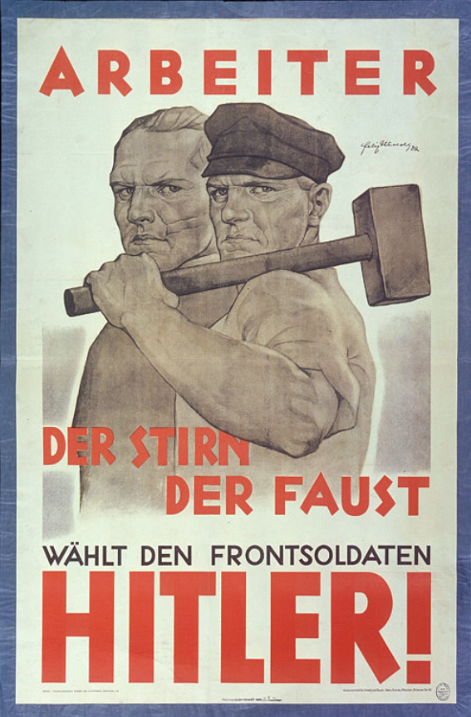
When we consider our history, we’re seeing war between the KN and KS. We’re also seeing Trump rise to power. Some very intelligent worldly people are identifying that we’re repeating the history of 1933. Hitler’s rise to power. That began in 1929. After WW1, Germany was forced to make payments to the countries it had lost to. They couldn’t afford to make those payments so they took out loans from the US to pay. In 1929 the stock market crashed on Wall Street and America wanted that loan/money paid. So Germany was particularly badly hit. This was a perfect time for a new leader to promise to make Germany great again. He learned all the phrases he needed to speak to harness all of that fear in Germany and he ran on one slogan that was placed on those banners.
His argument why he should lead the country was the argument that he wasn’t a politician like everyone else— but he was a soldier. He wasn’t a part of the establishment. The same argument Trump used, Not that he was a soldier, but he was a businessman. He’s used the exact same tactics as Hitler. If we talk about learning from history, then there’s at least one significant country that does not know their history. They fell for it worse than Germany. As did this movement. So we can mark a 10 year history 1929-1939. Also, considering the Lateran Treaty.
Poster: "Workers of the Mind, of the Fist, Vote for the Front Soldier / HITLER!"
Nazi propagandists distinguished themselves from their leftist opponents by reaching out to both industrial workers "of the fist" and white-collar workers "of the mind." This 1932 presidential election poster also highlights the patriotic appeal of Hitler's status as a World War I veteran. Felix Albrecht, artist; 1932

Slide 17
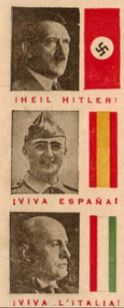
The Spanish Civil War was where you see Stalin begin to be involved. Because when the KS transitions, or Russia transitioned into the KS, they were too busy internally to be involved. They had years of Civil War. Stalin had to consolidate power. He begins to be involved in the Spanish Civil War.
The reason for that is that he has seen these fascist governments rise all over Europe. First of all he saw Hitler, Mussolini, and now he sees General Franco. And now in many countries sin Europe they have political parties that are allied to either Communism or Fascism.
It’s turning into this strife within each country. Stalin is now worried there's too many fascist governments in Europe. So Spain descends into civil war. On one side of the civil war you have Stalin. He sent over so much military supplies to support the government of Spain against Franco that he ended up taking 2/3 of Spain’s gold reserves. At the beginning of the war Spain had the world’s 4th largest reserves of gold.
On the other side with General Franco - was Hitler (Germany), Mussolini (Italy) and the Vatican - so the papacy, Germany and Italy - all on the same side. At the end of the Spanish Civil War, Pius XII praised God for Franco’s victory.
Because once again, God’s hand showed itself over Spain. During that Civil War, the Catholic Church turned it into some type of holy war or crusade. To save Spain from the Marxist cord. To save Spain from Communism.
Fascists
Communism
Mussolini (Italy)
Hitler (Germany)
Send aid to Franco
Stalin (USSR)
Send aid to Spanish
government

Slide 18
Fascism
Communism
Soon after the Spanish Civil War ends on 23 August, a few months later, these 2 enemies had just fought a proxy war, go into an alliance.
Germany and the USSR—you can imagine the shock. This is called the Molotov Ribbentrop Pact. There were 2 parts to this pact. One of them was a non-aggression pact, and this is where Stalin promises Hitler that if Hitler went to war with the west, Stalin would not take advantage of his weakness and attack him as well. So if you were fighting someone— ‘I’m not going to attack you while you’re fighting someone else’. Hitler had to have this non-aggression pact to invade Poland, which he does about 9 days after the pact was signed. He was waiting on this before he would enter war with the west.
Hitler
Mussolini
Franco
Republican Government
1
Stalin/USSR
General Franco
Hitler, Mussolini, Vatican
2
Hitler, Mussolini, Vatican

Slide 19
The 2nd part is the division of spheres of influence. This is where they carved up Eastern Europe. The non-aggression pact was open, everyone knew about it. The 2nd, the division into spheres of influence, was secret.
On Sept 1, Hitler invaded Poland. This began war on the western front.
Poland invasion
1939
Aug 23,
1939
Sept 1, 1939
1929
Spanish Civil War
Hitler/Stalin
In alliance
WW2
Western Front

Slide 20
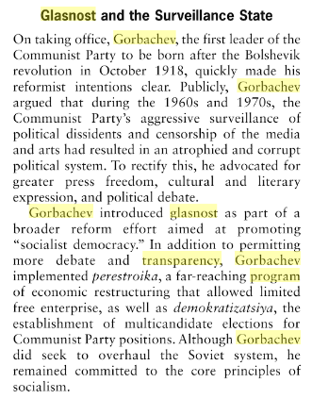
Hitler’s issue wasn’t Poland. It was the way he invaded Poland. Poland had some very powerful allies - France and Britain. It didn’t take him long to take Poland by force. But where he’s now fighting on that western front is Britain and France. Who declared war on him because of the invasion.
*article: Los Angeles Times, Aug. 19, 1989 - placing us in a significant history. The USSR is beginning to crumble. Gorbachev has begun his transparency program glasnost - meant to show them as being more open. This is the first time the USSR admits to a secret pact with Germany. Because if these satellite states of the USSR knew that they’d been given to Russia by Hitler, that would weaken the Soviets control over them. So the USSR had never admitted that they had this pact. And after decades of denying it, in 1989 they admit this pact for the first time. A member of the government of the USSR admitted that there was this pact and he says there was, with no doubt, collusion between the USSR and Nazi Germany. It’s not a coincidence that the first word used when the USSR admitted to this pact was ‘collusion’. Collusion: Trump and Putin
The effect of this pact on the world - a Romanian author wrote: the whole course of world politics changed in a moment and Britain began preparing for war.
They cleared their hospitals, put blue lights in their railway stations, they packed sand bags, evacuated (museums?), sent children into the countries, taped their windows. All because of this pact: division of spheres of influence. Now they knew there would be another WW.
On Sept 1, 8 days after the signing of the pact, Hitler invades Poland. This is what this pact was designed for — and invasion where they would both be on the same side.
Glasnost and Gorbachev
Glasnost was taken to mean increased openness and transparency in government institutions and activities in the Soviet Union (USSR). Glasnost apparently reflected a commitment to getting Soviet citizens to discuss publicly the problems of their system and seek solutions.

