Slide 1
Brazil SOTP
Pyrrhus in Italy
Tess Lambert
2/26/19

Slide 2
We’ve been through World War II and we're going to do a little review the history of the Cold War
From the Office of the Historian, a website run by the US Department of State — They say ithat this period of working together in World War II was one of the highest points in the relationship between Stalin and Hitler. It's not the highest point between the United States and the Soviet Union because they were forced to work as allies. Then World War II ended and they agreed to a couple of things with Stalin. Churchill from Britain, Roosevelt from the United States agreed to a couple of things with Stalin that he wanted. They granted territory in Eastern Europe and the division of Germany. One reason they were so generous to Stalin, as we’ve been studying the war in Europe, is that there was still Japan. Roosevelt and Churchill wanted Stalin's help in Japan. They were willing to grant him much of what he wanted in Eastern Europe. They agreed to these things at a number of conferences, particularly the Yalta Conference.
https://history.state.gov/historicaldocuments/frus1940v03/subch1
https://history.state.gov/historicaldocuments/frus1941v01

Slide 3
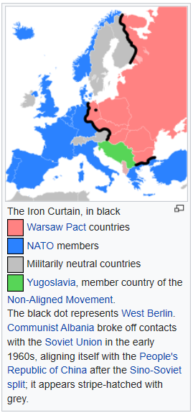
On May 8th 1945 the allied troops and the Soviet troops invaded from east and west and they met on the Elbe River. In Germany the allies and the Soviets met here and shook hands, showing that all of Germany had been won. On the west were the allies, mainly the United States and on the east was by the USSR. One held the portion of Germany west of the river and the Soviet Union held the east side of the river. Each of taking a portion, Germany remained divided. When The war ended Stalin began to set up puppet governments that were communist. The Iron Curtain fell across Eastern Europe where it became isolated from the West. Stalin had a problem, the conditions were not so good in East Germany as in they were in West Germany, people were just leaving. Thousands of people would just walk across the border. So they built the Berlin Wall, it wasn't just a wall but it was two walls between a long period of sand. They had guards that were armed and their job was to shoot. He created a high border through Germany, especially through Berlin. That is what came down in 1989. The Iron Curtain was actually a fence that covered the rest of the border while the Berlin Wall was only in Berlin. But the whole city of Berlin was on the side of the Soviet Union and Stalin had promised half of that city would stay allied to the West. The United States made it clear that if he was to take West Berlin it would be war. Not only was Germany divided, but Berlin itself was also divided with the Iron Curtain but also the wall through Berlin itself. At one stage he cut off supplies to West Berlin and essentially placed it under siege. The United States had to fly and airdrop in supplies. Germany itself particularly, was where there was tension between the East and the West.
Allies
W
USSR
E
The Iron Curtain was in the first place a non-physical boundary dividing Europe into two separate areas from the end of World War II in 1945 until the end of the Cold War in 1991. The term symbolizes the efforts by the Soviet Union (USSR) to block itself and its satellite states from open contact with the West and its allied states. On the east side of the Iron Curtain were the countries that were connected to or influenced by the Soviet Union, while on the west side were the countries that were allied to the United States or nominally neutral. Separate international economic and military alliances were developed on each side of the Iron Curtain.
Secondly, it refers to the 7.000 km. long physical barrier of fences, walls, minefields and watchtowers (an "Iron Curtain") that divided the "east" and "west". The Berlin Wall also was part of this physical barrier.
https://en.wikipedia.org/wiki/Iron_Curtain

Slide 4
From the website American Foreign Relations - after World War II the Soviet Union and the United States emerged as the two World superpowers and this began a period of tension between the Soviet Union and the United States or the Eastern Bloc in the Western Bloc.
In 1948 the United States began a campaign of sanctions. Just three years after the war ended the United States was beginning to isolate the Soviet Union. They used a couple strategies in the Cold War, one was sanctions and another was the defense buildup that was designed to make it too expensive for the Soviet Union to keep up with them. The one we want to make note of was their use of Radio Liberty and the Voice of America. This is what they used to encourage unrest inside Poland with the solidarity movement. Why we want to note these radio stations is that the funding behind them is the same part of the US government that's also funding the Deep Web. The same actions are happening today but they have different tools. It's moved from Radio to internet. By this course of sanctions, economic isolation, the defense build up, especially the Star Wars program, and providing financial aid to satellite states, the Warsaw Pact Nations, that is what really brought down the Soviet Union. It's a slow process of working from inside your enemies country using economics and propaganda. When the Soviet Union fell, how did it fall? It fell from the inside and unless you knew what the United States had been doing, you could come to 1989 and the fall of the wall and have no knowledge or understanding that this could be a battle between the King of the North and the King of the South. When we come to our time it's something that we need to understand and remember that in Daniel 11:40 part b as it shown in 1989 - 1991, by the time we get to what you would call the battle, it falls from the inside. You don't necessarily see the other country's involvement.
This completed the study of the alpha history, the first portion of Pyrrhus’s life and the King of the South under Stalin. Now we're going to look at the second part of Pyrrhus’s his career. The first part being Macedonian and now we'll discuss his campaign in Italy.
The Strategic Defense Initiative (SDI) was a proposed missile defense system intended to protect the United States from attack by ballistic strategic nuclear weapons (intercontinental ballistic missiles and submarine-launched ballistic missiles). The concept was first announced publicly by President Ronald Reagan on 23 March 1983.^{[1]} Reagan was a vocal critic of the doctrine of mutual assured destruction (MAD), which he described as a "suicide pact", and he called upon the scientists and engineers of the United States to develop a system that would render nuclear weapons obsolete.
The Strategic Defense Initiative Organization (SDIO) was set up in 1984 within the United States Department of Defense to oversee development. A wide array of advanced weapon concepts, including lasers,^{[2][3]} particle beam weapons and ground- and space-based missile systems were studied, along with various sensor, command and control, and high-performance computer systems that would be needed to control a system consisting of hundreds of combat centers and satellites spanning the entire globe and involved in a battle that would last only minutes. A number of these concepts were tested through the late 1980s, and follow-on efforts and spin-offs continue to this day.

Slide 5
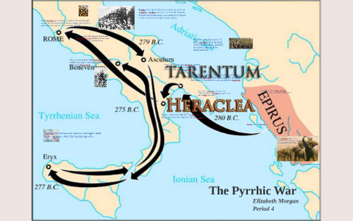
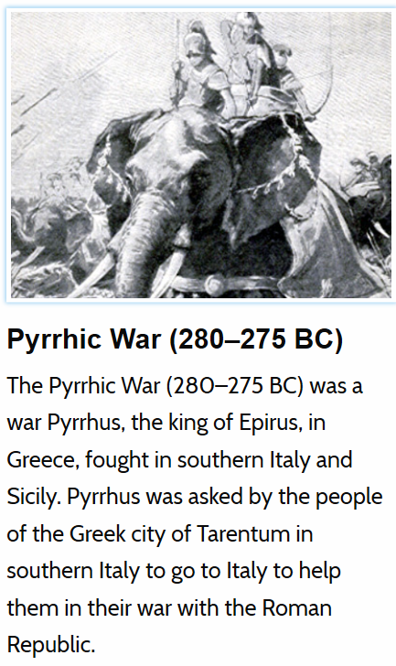
In 285 BC Pyrrhus leaves everything but Epirus itself and he never threatens Lysimachus again, so he is totally defeated. If he wants to strike back it won't be in Macedonia, it will be a different location. As all of this is happening in 285 BC, there is stirring in Italy, a build-up for a new war. We began to discuss this when we began Pyrrhus. What was happening inside Italy at this time? We see on the map of Epirus, he's lost all but the borders so he comes home and he’s stationed in Epirus in 285 BC. Leading up to this date there's been increasing tension in Italy, Rome has slowly taken over the North and now it controls all of northern Italy except a few tribes at the very far north. In southern Italy it was different to northern Italy. In the north there are tribes, but in the south are Greek city-states. We considered the Greeks in the south to be their relatives. They weren't extremely powerful on their own and if they needed help they would write back to Greece and send ambassadors. Over these city states there's one powerful one that considers all of the others to be under its spheres of influence. Tarentum, is on the east side and on the west side is another city call Thurri. In many of these city-states they had internal division, two political parties both fighting the other for control of the cities. One were the democrats and the other the aristocrats. As we pick up from their name, what the Democrats wanted was to keep the Greeks united. When Thurri came under threat from Barbarian tribe the democrats wanted Tarentum to protect them. They recognize that Tarentum was their relative or ally even though Tarentum could act like a dictator. It was better to stay under control of your family. The Democrats wanted to ally with their Greek relatives. The aristocrats however as we pick up from their name, were more interested in trade and opportunity, so instead of staying connected to their family they wanted to be able to trade with Rome. They saw opportunities for wealth. Inside Thurri are these two divisions both vying for power. In the Great Empires of Bible prophecy A T Jones said that this is where Rome comes into history and they begin to interfere with a southern Greeks. There had been a war previously about 50 years before the dates we’re talking about - around 334 BC. What happened then was these southern states had gone to war with some hostile tribes. These southern states had asked Epirus to fight for them, this was before Pyrrhus was born and it was the King Alexander of Epirus that fought for them. In that war they had gone into a treaty with Rome, particularly Rome had this treaty. Rome would promise not to sail into the Gulf of Tarentum. Rome had honored that for the next 40 years, until 285 BC. Thurri is now under threat.

Slide 6
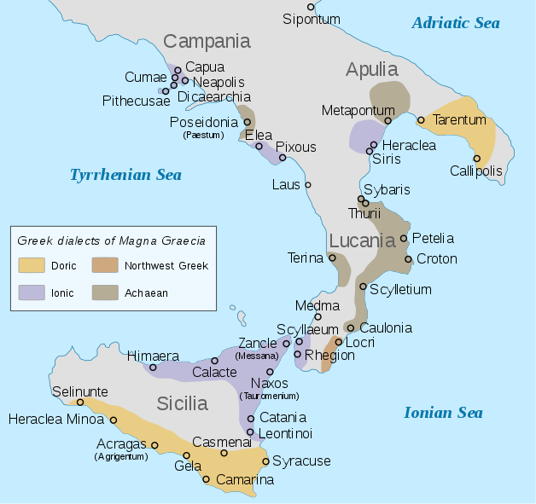
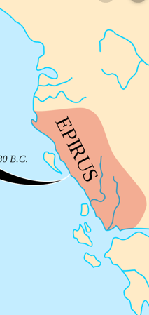
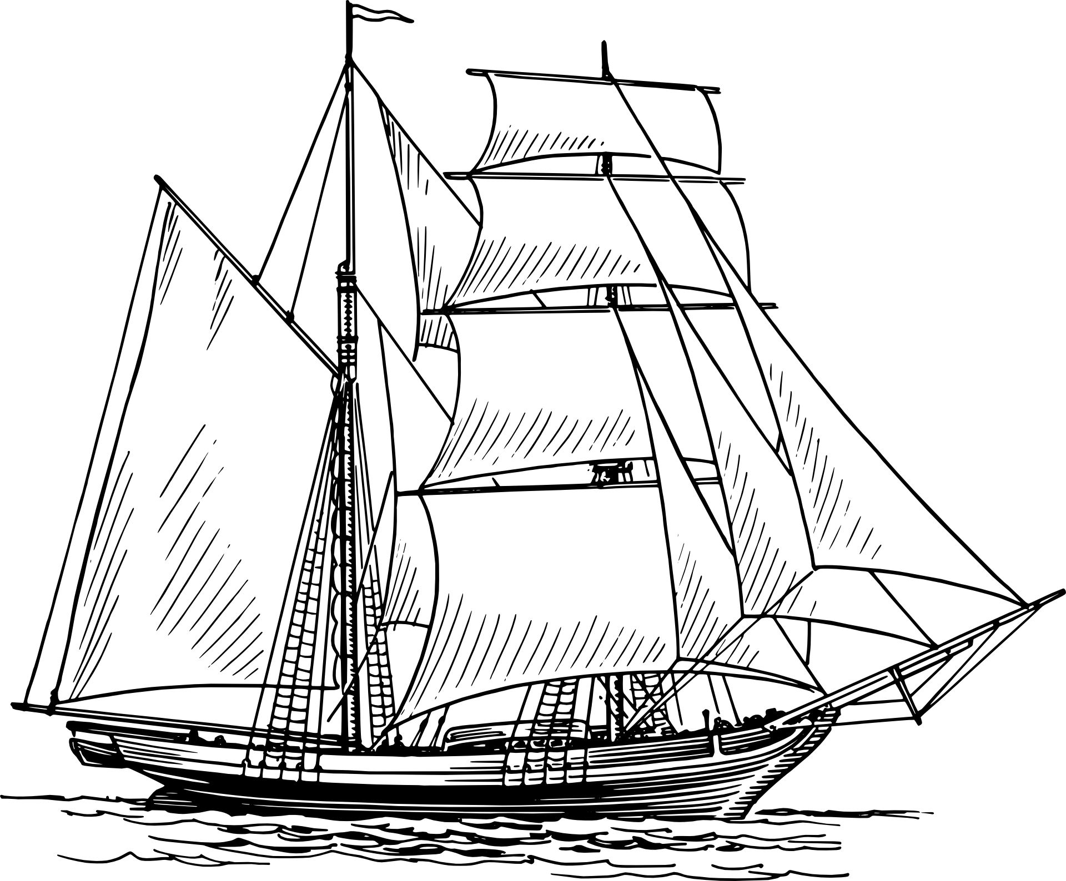
In 285 Pyrrhus is leaving Macedonia but we see Thurri appeal to Rome for help. The reason they appealed to Rome is that in this internal struggle the democrats have lost and aristocrats have taken power and now the government of Thurri wanted to change their allegiance from their traditional protector from Tarentum to Rome. When they appealed to Rome, and there's not a record if Rome immediately responds, but Thurri appealed again.
In 282 BC Thurri is freed, or their enemies were defeated . Between 285 and 282 there is an alliance between Rome and Thurri. Rome comes down and defeats Thurri’s enemies, and in protecting Thurri they sail ships into the Gulf of Tarentum and they leave a Garrison inside Thurri. Tarentum has felt threatened by Rome for quite a while and now not only is Rome stationing a Garrison straight across the waters, now also it's sailing it's Navy into the Gulf. Tarentum can see that this is just the beginning, that Rome will take over the satellite states. Tarentum attacks Thurri and expels the Garrison.
285bc
Pyrrhus
After Rome does its work for Thurri, Tarentum attacks Thurri and the Roman ships in the Gulf. Because of this provocation Rome declares war on Tarentum. Who was at fault if that history? It depends on what historians we read because their papers were as biased as ours. Rome is made to appear quite good and peace-loving, so we need to be cautious in that history how we understand the historians, the perspective their writing from.
-285
-282
Thurri appeals to Rome
Tarentum
attacks Thurri

Slide 7
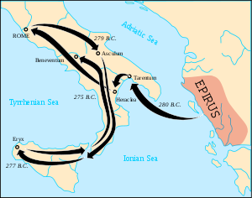
Heraclea
Asculum
-285
-282
-280
-279
elephants
Thurri appeals to Rome
Tarentum
attacks Thurri
Pyrrhus sails to Tarentum
Thurri appeals to Rome
When Rome declares war on Tarentum, Tarentum knows that it's not strong enough to withstand them. They sent ambassadors to Epirus and ask Pyrrhus to come and fight for them. Since Pyrrhus had no involvement now in Macedonia, he's open to venturing elsewhere.
In 280 BC he set sail from Epirus and arrives in Tarentum and begins preparing it for war. He had come over in ships and some of those ships with his army hadn't arrived yet. When he hears that Rome is marching on him he's really not ready for battle and he doesn't want to fight. But Rome won't wait, they want to fight immediately. So they march out and fight later in the year 280 BC. This is the first battle between Pyrrhus and Rome and it is known as the battle of Heraclea. In this battle when he comes against Rome he has one thing they don't have, one thing they've never seen before and that is on those ships they had brought over 20 war elephants. Compared to the battles following, this is only a small battle about half the size of the following one. When we study the battles in the Diodochi Wars, even though we've understood that in Ipsus they played s special role, everyone had elephants and they all used elephants to larger or smaller degrees. We don’t find in any battle in that history someone came with 500 all the way from India like Seleucus did. That was unique what happened to Ipsus. But they were all used to fighting with elephants, and they all had them. But Rome didn't, they had been isolated in Italy and actually had never seen an elephant before. When they march into battle and see 20 war elephants charging they are afraid and this is what really wins the battle for Pyrrhus, these 20 war elephants. The Roman soldiers are so afraid of them and they do so much damage. So in this first smaller battle Pyrrhus wins and he begins to march on Rome. He's done so well he thinks if he just pushes he can take Rome. His army begins to arrive and these other satellite states begin to join him. He comes close to Rome but winter sets in before he can fight for Rome. He goes back south and both spend the winter preparing for war. The following spring they meet in another battle. Over this time period, over winter, what Rome did was prepare anti elephant cart. These carts were designed to kill the elephants. They recognized the threat so they built 300 of these with spikes designed to pierce the elephants, and they had men on them with flamethrowers and they thought three hundred of these against 20 elephants would protect them.

Slide 8
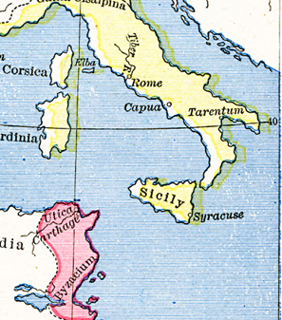
Heraclea
Asculum
-285
-282
-280
-280
-279
-
Dictator
temple
elephants
Armistice
Thurri appeals to Rome
Tarentum
attacks Thurri
Pyrrhus arrives in Tarentum
Pyrrhus R
Pyrrhus R
They meet the following spring in 279bc, this is the battle of Asculum and it's twice the size of the battle before, Heraclea. Pyrrhus wins again because of his elephants. The carts are just broken up. This is a difficult victory for Pyrrhus, he loses a lot of men as he did at Heraclea. So both of these are difficult victories, but both of them he wins because of his elephants. He attempts to enter into an Armistice with Rome and Rome is it very compliant. Asculum and Heraclea are a victory for Pyrrhus. But the problem Pyrrhus has is Rome has access to so much resources. Pyrrhus’s main army is what he brought over on ships from Epirus. Even though some of these city-states have joined him he doesn't have many people to draw from or resources. When he fights and he losses for example four thousand men, Rome loses 6000. But Rome is able to bring that many men back into their army again very quickly. Pyrrhus can't replenish his army so easily. By the time he wins the second battle he says the phrase that he is known for, and that is that if he wins once more against Rome he will be ruined. These victories are also at a loss. He goes into an Armistice with Rome after Asculum. He wants to have a break from fighting so he can build back his strength. South of Rome is the island of Sicily. Sicily is under persecution because under Sicily is Carthage, and Carthage has taken over Sicily. The men of Sicily come to Pyrrhus and ask him to leave his efforts in Italy and come to Sicily and protect them and expel Carthage from Sicily. Pyrrhus agrees, he sees a new plan. Instead of taking Rome, he knows he's too weak at the moment to do that, he thinks if he takes Sicily then due to their location or geography, that they are navy builders and they will build him ships. He plans to take over Sicily, build many ships and then with the strength of that Navy come and defeat Carthage. Once he has Sicily and Carthage, he can sail back around to Greece. Then he can meet the three surviving generals, he can defeat them and take Greece and go up and take Macedonia, and then you can circle back around and take Rome and Italy. He still has this grand plan but his focus is changed from Italy to Sicily and Carthage. He sails over to Sicily and frees it from Carthage, all except for one city is freed. Then he begins to put Sicily to work with building this Navy. The people had not expected them to use them in this way so they begin to rebel against his dictatorship. Because they are rebelling, he takes over Sicily very much as a dictator, using Carthage as his excuse. He puts garrisons in the cities, begins killing their politicians, or replacing them with his own men. He really shows himself as a dictator in Sicily. While he's in Sicily he also comes under financial pressure, he's running out of money to build this navy. What he does, he hears word that there's a temple, and underneath this temple to this goddess is this huge amount of wealth. He decides to take all that gold, he raids the temple, he places it all on ships and sends it back to Tarentum to fund his war effort. There’s two different stories of two temples - one in Sicily and one up in Italy. Most historians tell the story of it being in Sicily and one historian tells of it being in Italy. Wherever it was, most of the gold ends up in the bottom of the ocean.

Slide 9
While they're sailing back to Tarentum there is a storm and they were wrecked on the shore. Pyrrhus panicked, he thought it was judgment from the goddess. He gathered up all the gold that he could of it and put it back in the temple. By this stage things were so bad in Sicily that they write to Carthage and asked them to free them from Pyrrhus. They realize that their old dictators were better than their new one. Around this time Pyrrhus is hearing word that Rome is marching down to Tarentum. He knows that he's under threat in Italy. They've broken the armistice, Sicily has not gone according to plan, so he sails back to Tarentum. As he's leaving Carthage attacks him and he barely makes it away from the island. He meets Rome one last time at the Battle of Beneventum. In this battle he again comes to it with his 20 war elephants. In this battle he's defeated. What happens in that battle, this story is told: you have the army of Rome and the army of Pyrrhus and the elephants are charging towards Rome but one of those elephants, it’s believed that she heard her calf wounded as Rome attacked a younger elephant. The mother of this elephant heard its cries and panics, she turned around and when she did that she led all of the others, they all followed her and charged back over Pyrrhus’s his own troops. This is what lost him the battle. However that happened, the elephant's turned around and charged over Pyrrhus. Even by his own elephants we can see that elephants still decided that battle. Pyrrhus is so weakened that he immediately flees back to are Epirus.
Heraclea
Asculum
Beneventum
-285
-282
-280
-280
-279
-275
Dictator
temple
elephants
Armistice
Thurri appeals to Rome
Tarentum
attacks Thurri
Pyrrhus arrives in Tarentum
Pyrrhus R
Pyrrhus R
Pyrrhus ý
Cassius Dio also related the story of the wounded cub. He wrote that Pyrrhus was put to flight because "a young elephant had been wounded, and shaking off its riders, wandered about in search of its mother, whereupon the latter became excited and the other elephants grew turbulent, so that everything was thrown into dire confusion. Finally, the Romans won the day, killing many men and capturing eight elephants, and they occupied the enemy's entrenchments."
https://en.wikipedia.org/wiki/Battle_of_Beneventum_(275_BC)

Slide 10
Heraclea
Asculum
Beneventum
Benevento became the center of witchcraft in Italy. The tribe of the Lombards brought tree worship to that area and it merged with a cult that worships the snake in a tree. This also combined with the worship of the goat god. It said that hear the trigender would meet. Trigender is the Italian word for 300. We can mark a 300 at Beneventum but this is witchcraft. It said that among their customs they would meet on a Saturday night around a large walnut tree and undertake a ritual that was designed to give birth to their Sabbath, which being undertaken on a Saturday night was designed to bring in the Sunday. There’s a great deal of symbology that we can look into it Beneventum. Beneventum is known as the Italian version of Salem.
It's name is interesting because when we see the King of the South defeated, what battle do we first associate that with? Panium. There's several studies out seeing the symbology of the name Panium, particularly when it comes to the word ‘pan’ which is tied to the occult. It's not a coincidence that you can tie Panium to Beneventum.
This is where we come full circle. This is the history of Pyrrhus that has brought us all the way back to 273 BC. This is the history we've spoken about, with Pyrrhus in Rome.
-285
-282
-280
-280
-279
-275
-272
Dictator
temple
-273
elephants
Armistice
Thurri appeals to Rome
Tarentum
attacks Thurri
Pyrrhus arrives in Tarentum
Pyrrhus R
Pyrrhus R
Pyrrhus ý
At the Battle of Beneventum it's over for Pyrrhus in Italy, he flees back to Epirus. We just want to mark a few things about the name Beneventum. At the time this battle was fought it was not called Beneventum. That is because of suspicion that the Romans had but after a couple of victories there they changed its name to Beneventum from the name Maleventum. Maleventum means bad event or omen. Being suspicious they thought that this was like a bad prophecy, so they changed its name from bad event to good event - from Maleventum to Beneventum.
Beneventum was a Roman colony located along the Via Appia[1]. Originally called Maleventum, when the Samnite city was conquered by the Romans[2]. and made into a colony in 271B.C.[3]. the name was changed to Beneventum, meaning “well come” from the older Maleventum meaning “badly come”[4]. Its location along several important highways meant Beneventum was an important center for communications in the Roman empire[5]. http://beneventum.weebly.com/

Slide 11
The chief physician of Benevento, Pietro Piperno, in his essay On the Superstitious Walnut Tree of Benevento (1639, translated from his original Latin De Nuce Maga Beneventana), traced the roots of the witch legend back to the seventh century. At that time Benevento was the capital of a Lombard duchy. The invaders, although formally converted to Catholicism, did not renounce their traditional pagan religion. Under Duke Romuald I they worshiped a golden viper (perhaps winged, or with two heads), which probably had some connection with the cult of Isis, since the goddess was able to control serpents. They began to develop a singular rite near the Sabato river, which the Lombards celebrated in honor of Wotan, father of the gods: the hide of a goat was hung on a sacred tree. The warriors earned the favor of the god by rushing frantically around the tree on horseback and striking the hide with their lances, with the intent of tearing off shreds, which they then ate. In this ritual can be recognized the practice of diasparagmos, the god sacrificed and torn to pieces, which became the ritual meal of the devotees.
https://en.wikipedia.org/wiki/Witches_of_Benevento
Through the Pyrrhic war is where Rome became famous as we read in earlier studies. We went for Acts 27 to the 273 representing the Levites. In Acts 27 what waymarks did we place the 273 between? Where was it on our reform line? We had the ship, the 273 is the number given of those on board the ship, around the time that Paul was feeding them. What happened soon after? They're on board the ship we're given the number, Paul feeds them, they begin to prepare. What are they preparing for? They're preparing for the shipwreck, and what way Mark was that? At the Sunday law. The number 273 is between Panium and the Sunday law which is shipwreck. Acts 27:27 a Pentium, a doubling. So it was here that we we’re able to calculate those that were on the ship. We went from the history of Acts 27 and took this number 273 equals Levites.
Panium
27:27
Sunday law
shipwreck
27-37

Slide 12
Heraclea
Asculum
Beneventum
-285
-282
-280
-280
-279
-275
-272
Dictator
temple
-273
elephants
Armistice
Thurri appeals to Rome
Tarentum
attacks Thurri
Pyrrhus arrives in Tarentum
Pyrrhus R
Pyrrhus R
Pyrrhus ý
What is happening to the Levites between Panium and the Sunday law? It's the harvest for the Levites, they're being cut out. They’re marked between Panium and Sunday law for a specific reason. When we took that number to 273 BC, we placed it between Panium and what way mark? 272 BC. What happened in 272 bc? We have two subjects, a king and a kingdom, Pyrrhus and Tarentum. In this history the King of the South for Italy is Tarentum and then 275 bc -between 275 and 272, Pyrrhus is still alive and Tarentum is still holding out against Rome. Rome has besieged it but Tarentum is still independent to Rome. Pyrrhus is still alive. From 275 to 272. In 272 Pyrrhus is fighting in another city, he makes some bad mistakes in this battle. In the battle before his eldest son is killed. He is not thinking clearly. He engages in a battle with the city of Argos, down in Greece. Instead of fighting outside the city, through some bad decisions, he ends up fighting inside the city, in the alleyways or streets. His army is scattered through the city and it's hand-to-hand combat in close quarters. In this combat, he finds himself down an alleyway fighting a soldier, and the soldier’s mother is above him in a higher story of the building. She's looking out the window and watching her son fight Pyrrhus. She begins to take tiles off the roof and throw them at Pyrrhus. She strikes him across the head and he falls stunned, falls from his horse, he was on horseback. And the soldier killed him. Cut off his head. So in 272 BC Pyrrhus is killed. At the same time, in 272 possibly as a result o hearing of the death of Pyrrhus, Tarentum surrenders to Rome. Now Rome has total control of all of Italy.
Panium
27:27
Sunday law
shipwreck
27-37

Slide 13
Heraclea
Asculum
Beneventum
-285
-282
-280
-280
-279
-275
-272
Dictator
temple
-273
elephants
Armistice
Thurri appeals to Rome
Tarentum
attacks Thurri
Pyrrhus arrives in Tarentum
Pyrrhus R
Pyrrhus R
Pyrrhus ý
Egypt
ªRome
Argos
Pyrrhus Killed
Tarentum surrenders
Rome ª Egypt
Maximum flood
Argos = white, bright colored white, also golden—glistens
Why did they name it Argos? It's believed that there was a plain around the city or beside the city known as The Argolic plain and this is where they grow all their grain. So when it came time for harvest this is what you saw, the color of the wheat ready to harvest. The color of wheat when it's ready to harvest is this bright white appearance. This is one of the proofs we used in Acts 27 when we were looking at the city of Lycia, because it also had the meaning of bright and white and we placed Lycia at Sunday law. Through this history Rome's becoming famous. And because they defeated Pyrrhus, a nation where the generals had not considered of any great importance, they take notice because they knew Pyrrhus from his prior history but he wasn't an easy enemy to defeat. When Italy defeats him, and refuses to give up even though they were losing, Ptolomy particularly takes notice. He wants an alliance with Rome, at least some sight of type of communication with them. As AT Jones said, Rome's reputation now spread all over the known world because of the war with Pyrrhus. And Ptolemy sends ambassadors to desire in alliance. We read a quote from a book, A Critical history of Early Rome, that said that ‘Rome's defeat of Pyrrhus was a clear declaration to the ancient world that the Romans had arrived on the world scene of warfare and politics’. This is recognized in 273 BC when Ptolemy sends ambassadors to Rome. In 272, Rome sends ambassadors back to Egypt and there's three consoles. Of the leading member s Fabius Maximus Gurges. And what does Fabius Maximus Gurges's mean? Fabius means flood, Maximus means maximum.
So it's the total flood, or complete flood. Where do we place a flood on a reform line? Sunday law. At this way mark we can see the death of Pyrrhus, he’s been falling since 275, southern Italy has been falling since 275. We have the destruction, or the deadly wound at 275, where do we see the death? Sunday law. So we could see the King of the South fall between Panium and Sunday law. Where does Daniel 11 verse 40 end? Sunday law, right where 41 begins.

Slide 14
So in Pyrrhus’s war with Rome, there were three battles Heraclea, Asculum, and Beneventum. Beneventum he begins to fall, and 275 he's defeated, southern Italy is defeated, 272 they killed him and it’s finished. We see Rome begin to emerge, be recognized by all the nations. We can see the symbology of a harvest just like we did in Acts 27, and also maximum flood.
We have taken Pyrrhus’s his life, he's only about 15 years old when he goes into an alliance with Demetrius. And we can see it in two parts, first in his history in Macedonia, then his history in Italy. His alpha and his omega history. His alpha history clearly typifies the history of the King of the South in our time and also in its early history. This is where they begin to get involved in world affairs. We've traced them from their birth to their death, the beginning of Pyrrhus’s political life to the end of his political life. And then when we come to our history the beginning of the King of the South, it's first fight with the King of the North, this is the history of Pyrrhus and Demetrius, this is the history of the Soviet Union and Germany. Then we have Pyrrhus against Rome—now we have Russia against the United States in their omega history.
In our next class we will quickly review Pyrrhus in Italy and begin to make application. We need to consider our omega history. Another point we are laboring over and over again, the Millerites is an alpha history, it's there to typify the history of the hundred forty-four thousand. The only reason you have in omega history is because in the alpha history they didn't complete the work. It ended in failure. Even though there are some subtle differences the alpha history is there to typify the omega. We have to take the alpha history and overlay over the omega and make application. We’ll consider application of Pyrrhus in Italy but also our histories of World War II and Macedonia.
Ω
Miller
144
Ω
144

