Slide 1
Brazil SOTP
Review
Tess Lambert
2/27/19

Slide 2
Pyrrhus
Ω
We been studying the King of the South and see that he comes in 2 histories. What have we been calling these two histories? The Alpha and the Omega. What Alpha history have we been studying? The alpha is Pyrrhus in Macedonia and the Omega is Pyrrhus in Italy. We can divide it into two or we can just say this is the one history of Pyrrhus. We could just see that it’s one long history but it’s all Pyrrhus’s life or the life of the King of the South. When we come to the King of the South in our time we have another long history. Where does the King of the South begin? World War II. We can see that it comes to life in the Bolshevik Revolution. We first see it interact in world affairs in the Spanish Civil War, which ends in 1939. And this is where we're marking World War II coming in. When were speaking about the King of the North and King of the South, we mark 1939. We can see it comes in Alpha history, because that history of Stalin ends, we know the King of the South dies, so what must happen? The King of the South will resurrect and we'll have in omega history. So the alpha is the history of World War II and the Omega is World War 3. This is what we've been studying, Macedonia and World War II and Italy and World War 3 we could see it as one long history but what we’re preparing to do is to cut our line and overlay them. The alpha history typifies the omega history. Not only can the history of Macedonia show us what World War II looked like, but also Macedonia and World War II can show us what World War 3 looks like.
What we’ve done on our board—we cut our lines and brought the omega under our alpha histories. We’ve done Macedonia, Pyrrhus’s alpha history, and his omega. Then we have the alpha of WWII and the omega, WWIII.
Macedonia
Italy
=
1939
Ω
WW2
WW3
Macedonia
Pyrrhus
Ω
Italy
Pyrrhus
Stalin
WW2
Ω
Putin
WW3

Slide 3
We’re going to do a quick quickly review Pyrrhus in Italy. One detail that we need to mention on World War II, when we considered that line we understand that Stalin in the Soviet Union represented the King of the South, and Hitler and Nazi Germany the King of the North. One piece of information that is helpful as we're considering Germany is the King of the North, and you can see Germany comes in four parts. Germany as a nation was first unified in 1871 by a man called Bismarck. So this is known as Germany under Bismarck, he unified the country. He essentially ran it. This is the first phase of Germany's life as a nation. 1871 to 1890 is the new German Empire under Bismarck. The second phase of the German Empire is 1890 to 1918. 1918 is the end of the first World War and there is a new Kaiser, Kaiser Wilhelm. As he comes into power, he is not willing to share control of the country with Bismarck. This King does not want a competitive government so he forces Bismarck to resign and Kaiser Wilhelm rules alone, known as the Wilhermine era, where Germany was run by Kaiser Wilhelm. In 1918 what happens? In exchange for peace, Kaiser Wilhelm had to surrender the throne and leave Germany. So this is the end of the Kaiser's. Then they have a new government, a republic which is 1919 to 1933, this is the third phase. This new government is known as the Weimar Republic. If we mark the last stages of Germany, what happened in 1933? Who is their 4th leader or the 4th stage run by? Hitler. 1933 to 1945 is the fourth stage which is Hitler and the Nazi party. When we come to our history of World War II we can see the King of the North is in his fourth generation when we consider the life cycle of Germany, leading up to World War II.
.1871-1890 Bismark
.1890-1918 Wilhermine Era
.1919-1933 Weimar Republic
.1933-1945 Hitler and Nazi Party
We had a question, we’re still trying to understand how we can overlay our lines into 4. With all the conclusions that we're going to come too, come back to two things: just knowing the history and understanding that we can apply it this way. We need to review that.
Macedonia
Pyrrhus
Ω
Italy
Pyrrhus
Stalin
WW2
Ω
Putin
WW3

Slide 4
a
KS ªKN
We understand that in 1989 there was a deadly wound inflicted on the King of the South. The King of the South began to die, he died in 1991. We get this story because it's Daniel 11 40 Part b. We compared and contrasted it with Daniel 11:40 part a, which is the history of 1798 the deadly wound of the papacy. Then we compared and contrasted it, we understood that the papacy in a period future to its death, prophecy says it would resurrect. By compare and contras, we know that the King of the South died in 1991, but he's going to resurrect. When we see it this way we can understand that the King of the South is alive after 1991 at some point. So it's alive after 1991 but it dies here, at 1991. So if it dies here, it's also alive before 1991. So we understand that the King of the South is in two parts, it was alive because we know it had to be alive in order for it to die, but we also know that it resurrects. So it's alive before and alive after, comes in two parts. We can call one the Soviet Union and one Russia. When it resurrects it has a different body. Just based on the structure we can see that it has an alpha and omega history, it will come in two parts. We have an alpha and omega. And that's what we drew above. It's the Soviet Union that goes into war with Germany and then it's Russia that goes to war with the United States. How do we know that it's life in it’s alpha related to it’s War with Germany? If it’s alive in that history, we’re saying that is WW2, Stalin and Hitler, just like in the omega, WW3 it’s Putin and Trump. How do we know that it's not another history? We might want to say it's a cold war? Or maybe it's the Kaiser or the Czar in World War 1. We could just say that it's a very similar history to Pyrrhus, but we did this before we looked at any of Pyrrhus’s history. We did a line and placed Pyrrhus, because we already understood that Pyrrhus represented the King of the South, we recognized him as the tenth. We took him back to the first king, then If Pyrrhus is the King of the South in our history, which we know because we placed him up to Sunday law, then he must represent Vladimir Putin. And if Pyrrhus is the tenth, then Alpha and Omega, we want to see who the first is. If Putin is the 10th, who's the first? Stalin. We're not talking about the Czar or any other history, it's the history of Stalin. And Stalin fought against one enemy, that was Hitler, and that’s the history of World War II.
war
1798
1799
resurrection
Deadly wound
Pope captive
Dies
b
KN ªKS
war
1989
Ω
1991
resurrection
Alive
USSR
Deadly wound
Dies
Alive
Russia
1
10
Admetus
Pyrrhus
1
10
Stalin
Putin

Slide 5
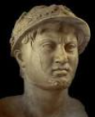
We saw that the King of the South came in two parts, we already understood that Pyrrhus typified the King of the South. We looked at many more Kings of Epirus than just those two, that gave extra weight to seeing Stalin and Putin. So if it's Stalin and Putin, it gives us the history of World War II—Stalin Hitler. From there we can actually look into their histories. The Macedonian War we mark the fourth Diodochi war and this is where Pyrrhus becomes involved in world affairs at about 15 years of age. We marked the end in Italy, 272 BC where our KS dies at the end of our line in 272 BC. So we mark it from 307 to 272 and this is his whole life. Then when we bring this history and make application and we can see the whole life of the King of the South. We understand with Pyrrhus in the middle of this history he was defeated, totally and completely. Then he had to resurrect in a totally different country. First he's fighting in Macedonia, then he dies so to speak and when he resurrects he’s in a different battle against a different nation, in a different country. So we can see Pyrrhus comes in two parts.
Pyrrhus
Ω
Macedonia
Italy
=
Ω
1939
WW2
USSR
WW3
Russia

Slide 6
Then we consider the King of the South in our history we see that he does the same thing. He comes to life prior to 1939, then he becomes in involved in world politics and then he fights Hitler in World War II. But when we get to the history of 1989-1991, we can see that he dies he's defeated totally and completely. He's going to resurrect with the new body, he looks different, this is Soviet Union and this is Russia.
b
KN ªKS
war
1989
1991
resurrection
Alive
USSR
Deadly wound
Dies
Alive
Russia

Slide 7
All we have to do is bring our knowledge of how the beginning typifies the end, which we use all the time when we speak of Millerite History. If we wanted to do this we could call this Acts 27 and the ship of Alexandria, and it could go from 1798 to Sunday law as one long line of Adventism. If we want to do that this is the ship of Alexandria that begins in 1798 and ends at Sunday law and it's just one long history of Adventism but we can see but if we go into this history we can divide it into two parts. We can call one the millerite history and one the history of the hundred forty-four thousand, an alpha and omega. Then we cut our line and we say that the millerite history typifies our history. All that we're doing here saying that World War II typifies World War 3. Now that gives us license or permission to instead of treating it as one line we can split it and overlay our line. This is what we do when we say millerite history— the hundred forty-four thousand and we draw comparisons.
Alexandria
TOE
1798
SL
M
144
Miller
144

Slide 8
Our next structure is expanded—the same as the structure of the 2 parts of Pyrrhus and KS in two parts. We started with Macedonia over World War II and we saw an alliance and alliance. We saw all the similarities between Macedonia and World War II. Then we did the omega history of Italy. We haven’t done our omega history. Below we have two alpha histories, Macedonia and World War II. So the first and third line is what we're looking. What we've done is insert or omega histories into this concept. Now we have Pyrrhus’s life in two parts and King of the South in two parts: alpha omega & alpha omega. What we would have done if it had worked is left these two lines Macedonia alpha World War 2 alpha and then separately understood Italy and make application. We can understand our history just by understanding Italy most directly typified. That wasn’t working, so we just overlaid the lines .
Macedonia
Pyrrhus
Italy
Ω
Pyrrhus
Stalin
WW2
Putin
Ω
WW3

Slide 9
10 years
Ipsus
301
291
289-288
287
285
317
307
303
Cold War
Macedonia
Athens
Cassander places
dictator in Athens
Demetrius frees
Athens
Pyrrhus & Demetrius
In alliance
Antigonus defeated by 3 allies
Pyrrhus
Invades
Terentum
Demetrius
Invades Epirus
Pyrrhus
Joins allies
East/west
Pyrrhus
Loses all but Epirus
Sanctions
subterfuge
Macedonia
Pyrrhus
280
Heraclea
280
Asculum
279
Beneventum
275
273
272
Ω
285
282
Pyrrhus raids temple
Sicily
Italy
Ω
Pyrrhus
Italy
Thurri appeals to Rome
Tarentum attacks Thurri
Pyrrhus arrives in Tarentum
Elephants
Pyrrhus
R
Elephants
Pyrrhus
R
Elephants
Pyrrhus
ý
Egypt ªRome
Rome ªEgypt
Tar. Falls
Py. dies
Stalin
WW2
Putin
Ω
10 years
WW3
Apr 1
1939
Aug 23
1939
Sept 1
1939
Aug
1940
June 22
1941
East/west
1945
1929
1989-1991
Cold War
WW2
Spanish Civil War
Europe divided
Holocaust
Lateran Treaty
Moltov-Ribbontrop pact
alliance
Pol, Fr, B
Vs
USSR
Germany
Suspends trade
Operation
Barbarossa
USSR joins allies
USSR loses all but Russia
Sanctions
subterfuge
Ω

Slide 10
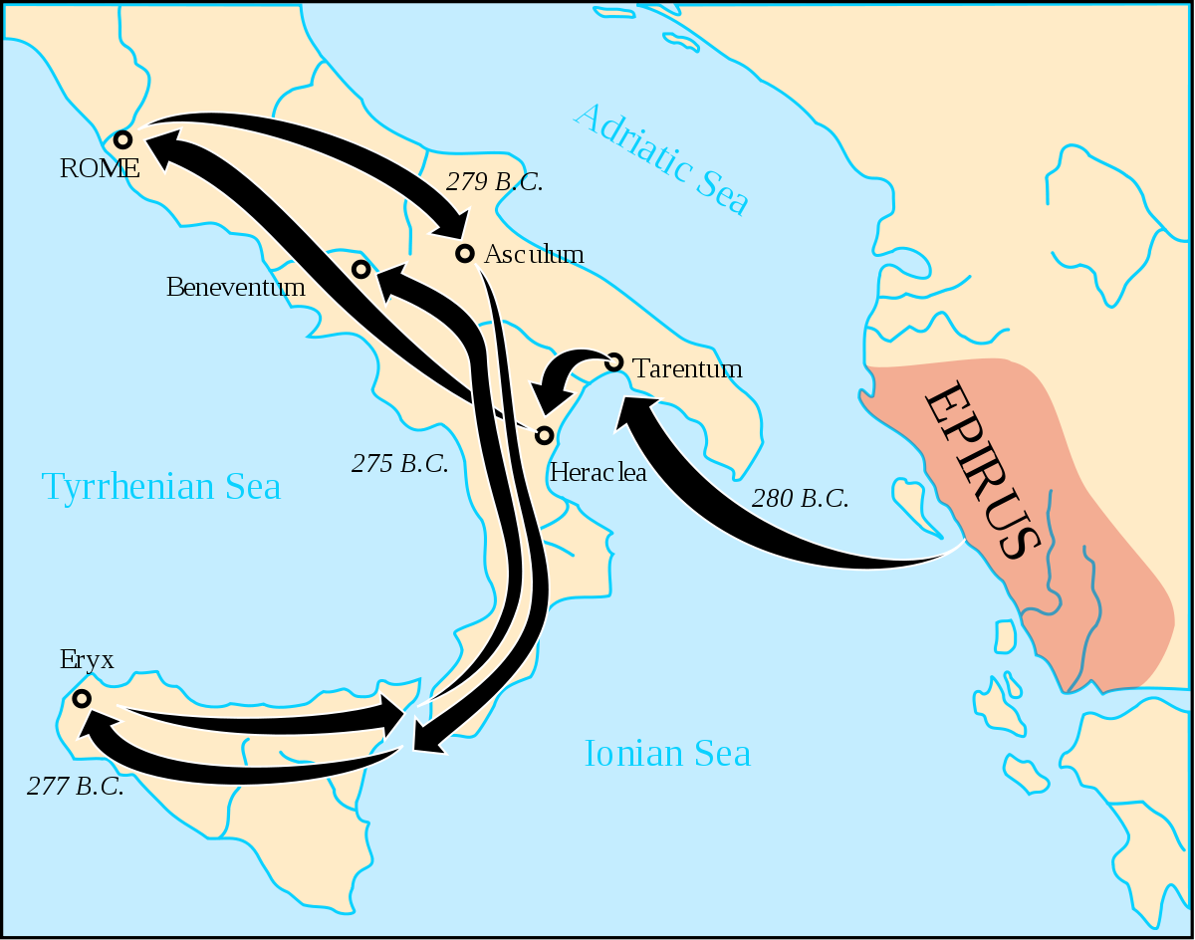
We’ll do a quick review of Italy. We need to make sure that we understand it more clearly. This is where Rome enters world affairs and it becomes famous in the Pyrrich War. The first thing we need to understand is that in Italy there is a war over spheres of influence. Also, Elder Parminder has taught about 1798 and 1840 in relation to Coele Syria. What we need to see is that this is the same story in 285 BC. There's a struggle going on in Italy over spheres of influence. If you were to choose whose influence you came under, what two options did you have? In 285 BC you are Thurri, you're not very strong on your own, you need to come under a stronger nation or power. You have two options, what were they? If we look Italy and Thurri, who's ruling north Italy? Rome. Who rules the south? Tarentum. What two options do you have? Rome or Tarentum, or to keep it simple we have a king of the North and the King of the South. Thurri is torn or divided. Whose authority does Thurri normally come under? Tarentum, because they are relatives. But in 285 they start to make a switch and they move from being under the protection of Tarentum to Rome, and Tarentum resents that. Tarentum tries to take them back by force in 282. This sparks a war between Rome and Tarrentum. They are not strong enough to fight on their own and they ask Pyrrhus to come and fight for them. Pyrrhus comes to Tarentum and he fights against Rome in three battles Heraclea, Asculum, and Beneventum.

Slide 11
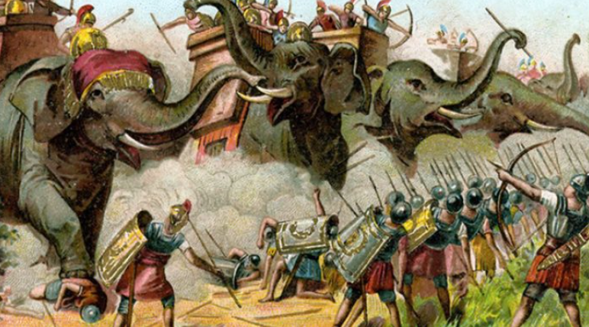
280
Heraclea
280
Asculum
279
Beneventum
275
273
272
Ω
285
282
Pyrrhus raids temple
Sicily
Italy
Thurri appeals to Rome
Tarentum attacks Thurri
Pyrrhus arrives in Tarentum
Elephants
Pyrrhus
R
Elephants
Pyrrhus
R
Elephants
Pyrrhus
ý
Egypt ªRome
Rome ªEgypt
Tar. Falls
Py. dies
The first two battles he wins. His win at Heraclea is as much smaller battle. He doesn't yet have the full strength of his army. How does he win that battle? With elephants. They go their separate ways over the winter and prepare for war. They fight again at Asculum, the next spring. Pyrrhus again wins because of his elephants. It's a larger battle and it goes for two days. So we can mark a doubling here. Pyrrhus makes a decision to leave the war in Italy for a while, he makes an armistice with Rome and he leaves for Sicily. He has this great plan that he will take Sicily, then Carthage, build up an incredible army and navy, and then sail back around and take Greece, Macedonia and then back around and take Rome. He has a very ambitious plan. He has a problem when he gets to Sicily, he starts to run out of money. He raids the temple of their goddess and he loses all of that money. He raids the temple but he hasn't benefited by it because all the ships carrying the treasure are shipwrecked. He also demonstrates that he's a dictator in how he takes over Sicily. He put Sicily under such subjection that they regret asking him to come and help free them from Carthage. And they sail back to Carthage and ask the Carthaginians to free them from Pyrrhus. The people that they wanted to be free from, they preferred as masters instead of Pyrrhus, and Pyrrhus leaves. He's forced to leave because of the conditions in Sicily but also because Rome is marching south. They have broken the armistice but are marching on Tarentum. He sails back and fights Rome one last time at Beneventum. He loses this battle. Why does he lose this battle? Elephants. Who has elephants in this battle? It's Pyrrhus against Rome, who has the elephant's? Pyrrhus had the elephants, elephants decided who won, so why did Pyrrhus lose? Rome won because of Pyrrhus’s elephants, why did Rome win? Pyrrhus is marching and he has all of his elephants marching in front of him and he's coming against Rome. Rome has no elephants. One of the baby elephants was injured and cried out. The mother of the baby elephant heard its cries and turns to find her baby. Then all the elephants turn and follow her, they end up charging Pyrrhus’s army. Pyrrhus loses Beneventum because of his own elephants, his own method of warfare. Pyrrhus flees and goes back to Epirus. Between 275 and 272, Rome is slowly taking control of the south, this is a process. They have defeated Pyrrhus but this is full of Greek city-states, there are treaties they have to go in to, other battles and sieges that they have to win. Even though in 275 the King of the South is mortally wounded it's not dead, it still continues on.
His name is famous for the term "Pyrrhic victory" which refers to an exchange at the Battle of Asculum. In response to congratulations for winning a costly victory over the Romans, he is reported to have said: "If we are victorious in one more battle with the Romans, we shall be utterly ruined"

Slide 12
Though his western campaign had taken a heavy toll on his army as well as his treasury, Pyrrhus went to war yet again. Attacking King Antigonus II Gonatas (r. 277–239 BC), he won an easy victory at the Battle of the Aous and seized the Macedonian throne.
In 272 BC, Cleonymus, a Spartan of royal blood who was hated among fellow Spartans, asked Pyrrhus to attack Sparta and place him in power. Pyrrhus agreed to the plan, intending to win control of the Peloponnese for himself, but unexpectedly strong resistance thwarted his assault on Sparta. On the retreat he lost his firstborn son Ptolemy, who had been in command of the rearguard.
Pyrrhus had little time to mourn, as he was immediately offered an opportunity to intervene in a civic dispute in Argos. Since Antigonus Gonatas was approaching too, he hastened to enter the city with his army by stealth, only to find the place crowded with hostile troops. During the confused battle in the narrow city streets, Pyrrhus was trapped. While he was fighting an Argive soldier, the soldier's old mother, who was watching from a rooftop, threw a tile which knocked him from his horse and broke part of his spine, paralyzing him. Whether he was alive or not after the blow is unknown, but his death was assured when a Macedonian soldier named Zopyrus, though frightened by the look on the face of the unconscious king, hesitantly and ineptly beheaded his motionless body.
Antigonus had him cremated with all honours and sent his surviving son Helenus back to Epirus. That same year, upon hearing the news of Pyrrhus's death, the Tarentinians surrendered to Rome.
https://en.wikipedia.org/wiki/Pyrrhus_of_Epirus#Last_wars_and_death
Tarentum itself held out against Rome for three years until 272 BC. If we considered Tarentum as a symbol of the king of the South its death is inevitable, there was no way they can hold out against Rome. The defeat was gradual until 272. We also looked at Pyrrhus in this history, he went back to Epirus. There are a couple other details we need to look at regarding how he died. We looked at the city of Argos which gave us the meaning of harvest time, the appearance of rain when it's ready to harvest. What Pyrrhus does when he gets back to his country, is immediately go into another war. He finds himself fighting in the city of Argos. We need to look at who he was fighting in this history after he leaves in 275, who kills Pyrrhus? We know it was a soldier, but who was that soldier fighting on behalf of? The soldier belonged to the army of Antigonus Gonatas. Antigonis was the father of Demetrius and Demetrius had a son, he named that son after his father. The son who killed Pyrrhus was the son of Demetrius. Even though Pyrrhus dies in this history he's not killed by just another random power. We can still see the link from Antigonus to Demetrius, he's Demetrius's son.
280
Heraclea
280
Asculum
279
Beneventum
275
273
272
Ω
285
282
Pyrrhus raids temple
Sicily
Italy
Thurri appeals to Rome
Tarentum attacks Thurri
Pyrrhus arrives in Tarentum
Elephants
Pyrrhus
R
Elephants
Pyrrhus
R
Elephants
Pyrrhus
ý
Egypt ªRome
Rome ªEgypt
Tar. Falls
Py. dies

Slide 13
280
Heraclea
280
Asculum
279
Beneventum
275
273
272
Ω
285
282
Pyrrhus raids temple
Sicily
A Pyrrhic victory (/ˈpɪrɪk/ ( listen) PIRR-ik) is a victory that inflicts such a devastating toll on the victor that it is tantamount to defeat. Someone who wins a Pyrrhic victory has also taken a heavy toll that negates any true sense of achievement or damages long-term progress.
Italy
Thurri appeals to Rome
Tarentum attacks Thurri
Pyrrhus arrives in Tarentum
Elephants
Pyrrhus
R
Elephants
Pyrrhus
R
Elephants
Pyrrhus
ý
Egypt ªRome
Rome ªEgypt
Tar. Falls
Py. dies
Antigonus Ganatas, related to the most powerful of the Diodochi, the Antigonid Empire. His father was Demetrius, his grandfather Antigonus the one eye from the Battle of Ipsis. When it comes to the city of Argos Antigonus and Pyrrhus had a quarrel, Pyrrhus tries to take the city because he hears that Antignous is marching against him. Pyrrhus make some poor decisions any leads his army into Argos. This is a large army fighting in the alleyways of this ancient town. When they realized it was a bad idea they couldn't even leave because they brought elephants in with them. It wasn't a place to fight a battle. When they're fighting in the streets, he's fighting against the army of Antigonus and one of those soldiers that killed him. It said that Antigonus gave him a good burial and sends his surviving son to Epirus with the remains of Pyrrhus. He treated him in a respectful way. When Tarentum heard of Pyrrhus’s death they surrendered to Rome. Even If Pyrrhus’s death we can tie him back to that previous King of the North.
Demetrius by this time had died and had gone into captivity shortly after Pyrrhus defeated him. He spent his last years under house arrest and his son continues the work.
Beneventum is marked as a deadly wound. But we're not marking 1945's as that wound, the history of Pyrrhus is a little more complex. It's one of the reasons we need to identify 1989 to 1991 as a period of time. So when we make our application when we get to this history we’ll break those bits down.
That is the history of Pyrrhus in Italy. And we got to this history by going to 273 and understanding it because of the Pyrrhic War. Egypt visited Rome and opened up a diplomatic relationship. Then we applied 272, the death of Pyrrhus, the fall of Tarentum and also Rome returns to Egypt.

