Slide 1
Brazil SOTP
Failure and Success part 2
Tess Lambert
3/22/19

Slide 2
The Russia investigation on President Trump began May 17th 2017 and ended Friday, March 22, 2019
Washington (CNN) Robert Mueller is done.
After a 22-month investigation, charges against 37 defendants, seven guilty pleas and one conviction at trial, the Justice Department announced Friday that the special counsel's office has wrapped up its probe into Russian election interference, possible Trump campaign collusion with Moscow and obstruction of justice.https://www.cnn.com/2019/03/22/politics/robert-mueller-report/index.html
Also on March 22, 2019, the last town holding the Islamic State was defeated. It was proclaimed that the caliphate began in 2014 is now over.
The Trump White House has declared that the Islamic State no longer holds any territory inside Syria, but the claim was disputed by Kurdish-led forces on the ground who said clashes were continuing.
Sarah Sanders, the White House press secretary, told reporters that the acting defense secretary, Patrick Shanahan, had briefed Donald Trump and that the Pentagon had confirmed that the last vestiges of the Isis “caliphate” had been eliminated.https://www.theguardian.com/world/2019/mar/22/white-house-isis-syria-caliphate-eliminated-sdf
As we go through today’s study one of the things we want to see is that these waymarks that we look forward to are not so much battles, but invasions. An invasion can be a more insignificant item of war. We have Germany crossing the line into the Soviet Union, but then you have the siege of Stalingrad, that occurred in the middle of that process in the war. We have to be vigilant before November 9, we should be watching for fulfillment now in tracing what leads up to November 9th. We are living in a fascinating time.
3 parts to MC: date, what to expect, and get rid of all protestant thinking
How to know what to look for and expect? By looking at and understanding the previous battles.

Slide 3
In looking at our battles we've already looked into Ipsus and now we're going to begin to look at Heraclea, the point where the relationship between the King of the North the king of South has gone bad. We discussed the three elements of Hitler's alliance with Stalin - (1) non aggression, (2) spheres of influence and the division of Eastern Europe, (3) payment to the King of the South, payment for help from the KS. We tracked Pyrrhus in Macedonia, we had Ipsus and then his invasion of Thessaly where they fought over Macedonia.
Next we come to his history in Italy, there is no first battle where their in an alliance, but then there is the battle of Heraclea with Rome. Then we combine the lines but like Pyrrhus gives us, the battles are going to look the same.
1. Non-aggression
2. Spheres of influence
3. Payment ➔Russia sanctions
Invasion of Thessaly
Pyrrhus in
Macadonia
Ipsus
Eleph
Heraclea
Pyrrhus in
Italy
X
Eleph

Slide 4
Invasion of Thessaly
We come to the history of World War II we have the invasion of Poland, beginning of war on the western front. They’re in an alliance that begins to go bad because of payment and spheres of influence. That relationship is broken up in August 1940. What we're suggesting is that these two battles, Ipsus and Heraclea have already occurred. If we know what the first two battles look like, then we have two witnesses and Raphia is established then we can say we know what Raphia looks like and equally important what it doesn't look like. Based on our two witnesses (1), the connection of the elephants (2), and the fact that we've been tracing our history since 1945 (3),connecting the thread, we have three evidences to show what this battle looks like.
Pyrrhus in
Macadonia
Ipsus
Eleph
Heraclea
Pyrrhus in
Italy
X
Eleph
F
WW2
Poland
Aug. 1940

Slide 5
In reading about August 19, 1940, the Soviet Union suspended its deliveries because they were disagreeing with Germany over policy in the Balkans. The Soviet Union had gone to war with Finland, Germany had fallen behind with its deliveries under the pact and there were issues over drawing the borders between Hungary and Romania. They met together in secret, redrew those borders, and settled their differences. When that alliance was repaired at the end of August, the Soviet Union began sending much more aid into Germany than it had been before.
We can trace the issue with these two begin to happen in this history, we understand that they were in an alliance. In this history it’s the KS that initiates the conflict against the KN. It's the KN that wins it. But we have to remember this is a history of failure. When we come to understanding Heraclea in our time, they have been in an alliance, Trump and Putin, which is what the Russia investigation was all about. We can expect to see that relationship go bad. The issues are sanction and spheres of influence. Towards the end of 2018 we should see that conflict heightened and then repaired. Then their alliance becomes stronger than it was before.
Invasion of Thessaly
Pyrrhus in
Macadonia
Ipsus
Eleph
Heraclea
Pyrrhus in
Italy
X
Eleph
Failure
WW2
Poland
Aug. 1940
KN + KS
KSªKN
R
WW3
2016
2018
KN + KS
KNªKS
R

Slide 6
In our previous study we studied the Internet Research Agency, the IRA and the role that they played in the 2016 election. We looked at how Vadimir Putin had set up this agency in 2013, really as a type of an information weapon. Its role is to send out disinformation and play with public perception. They began that work in 2014, particularly working with the issue in Ukraine. They are supported by Concord Management Consulting. (https://en.wikipedia.org/wiki/Concord_Management_and_Consulting) This business was set up by Putin to fund the IRA and is currently under sanctions for the role it played in the 2016 election. Another thing they do is set up alternative news sites. We see online or people share with us all these different sites that are coming up that claimed to have alternative news that they say mainstream news won't share with you. Not all of these have been set up by Russia, but many have. People don't realize that these western alternative news sites often take their information from the Russian ones. And the Russian alternative news sites are set up to look like the western new sites, or Ukrainian or whatever country they're trying to work in. People are still promoting these sites, for example one of these sites proposed a story on Clinton. Obviously western alternative news sites propagate that story and share it. We could see that happen through 2016 tell me where news sites like Infowars took their information from Russian sources without realizing it and then mixed in their own conspiracy theories. There is this working together of east and west even if it's not intentional. There are those in this movement that still follow those websites and think that we need to be doomsday prepping because there's going to be a blackout. Many people are being led astray by following these alternative news sites. They completely warp our perception of what has happened and what is coming. That is what they were designed to do in the first place.
We began to look at what the Internet Research Agency did in 2016 and whether or not Trump was aware of that activity, we're saying he was. Then what we would expect him to do is begin to strengthen the United States in a way that Putin could not do that again. He must be aware that if Putin can help him get into power which we would suggest he couldn't have become president without Putin, then he also knows the power that Putin would have to remove him.

Slide 7
Special Counsel investigation (2017–2019)
Scope | Russian interference in the 2016 United States elections Dismissal of James Comey Links between Trump associates and Russian officials Trump–Russia dossier (Steele dossier)
Timelines | 2016 election interference 2017 investigations 2018 investigations 2019 investigations
Personnel | Robert Mueller Rod Rosenstein William Barr Legal teams
Direct indictments (list of charges) | At large: Yevgeny Prigozhin Concord Catering Internet Research Agency (IRA) Fancy Bear Konstantin Kilimnik
Criminal referrals | Maria Butina Michael Cohen Sam Patten Greg Craig
Outcome | Mueller Report Barr letter Reactions Special Counsel counter report
Related | Operation Crossfire Hurricane Carter Page Democratic National Committee cyber attacks Guccifer 2.0 WikiLeaks Jerome Corsi
Pled not guilty:
Concord Management and Consulting
Paul Manafort
trials – found guilty
Roger Stone
Pled guilty:
George Papadopoulos
Michael Flynn
Alex van der Zwaan
Rick Gates
Michael Cohen
Trump Tower meeting
Rinat Akhmetshin
Rob Goldstone
Ike Kaveladze
Jared Kushner
Paul Manafort
Donald Trump Jr.
Natalia Veselnitskaya
Presidency of Donald Trump
Special Counsel Independence and Integrity Act
Russian interference in the 2018 United States elections
Elena Khusyaynova
https://en.wikipedia.org/wiki/Concord_Management_and_Consulting

Slide 8
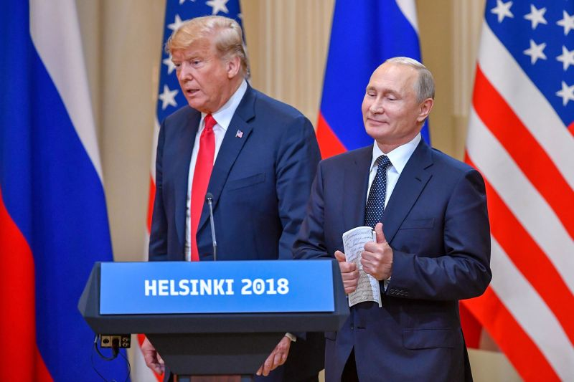
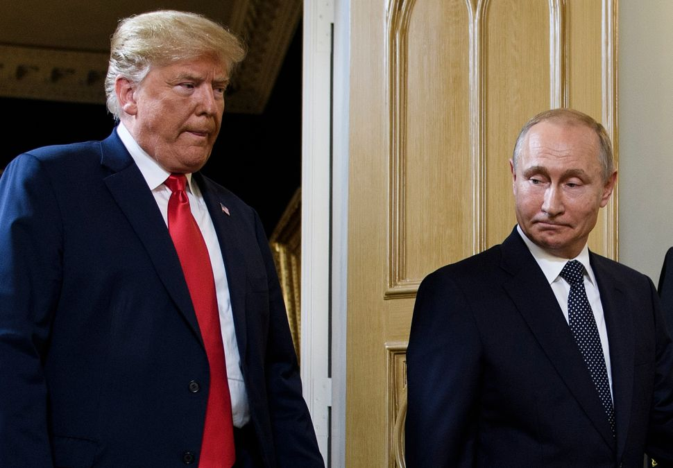
When we come to 2017 the number of bills and resolutions in the US government is more than double of that of 2016. What Donald Trump is pushing through is trying to strengthen cyber security within the United States.
May 11, 2017 Donald Trump signs executive order 13800 and he’s beginning of process of strengthening the cybersecurity networks, those were the beginning stages.
Next we come to July of 2018, the relationship is still strong. This is 18 months after the 2016 election, more than 18 months and the relationship is not weakened. Trump and Putin meet in Helsinki. Prior to the meeting Trump engaged in some very suspicious behavior. He attacked and criticized all of the United States allies. He's particularly attacking NATO which was set up at the end of World War II, led by the United States to restrain the Soviet Union. It's an alliance that was formed specifically to hold back the KS. When he attacks NATO, and says we don't need it anymore, those are words that are very friendly to Putin. Because the presence of NATO in Eastern Europe is one of the thorns in the side of Vladimir Putin. He also fought with his other allies - with Canada and the European Union. He attacks everyone, until he comes to Russia and then he has only praise. In Helsinki he meets with Putin.
May 11, 2017 Exec Order 13800
July 2018 Helsinki meeting➔Trump & Putin
(read here https://en.wikipedia.org/wiki/2018_Russia–nited_States_summit)
Watch video: https://www.realclearpolitics.com/video/2018/07/15/watch_live_coverage_of_helsinki_summit_as_vladimir_putin_and_trump_meet.html

Slide 9
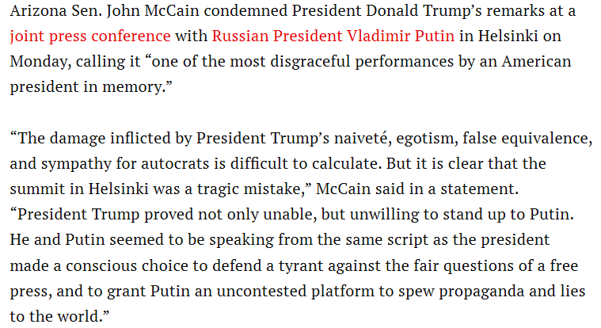
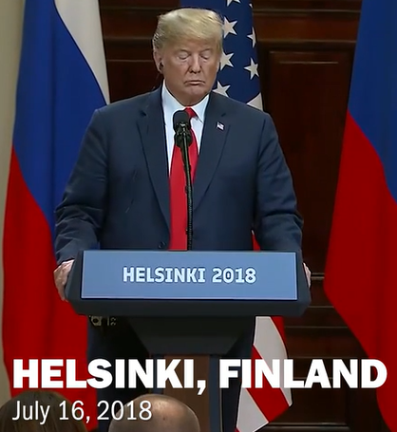
When they came out of that meeting, we read from John McCain a Republican senator who has since passed away, he's fought with Trump way back in the 2016 election. He was a prisoner in the Vietnam War, quite a war hero. He was offered to be exchanged in a prisoner swap and he said no, there's prisoners weaker than I am, send them and I will stay here. In that time he was tortured. Trump's response to all that is heroes don't get captured in the first place. So the relationship did not go very well but he’s of the same political party and his words about the meeting in Helsinki was that it was a terrible mistake. He says we've never had a president that would submit himself before a dictator in that way. After attacking all of his allies Trump was not able or willing to be strong in front of Putin.
There's two things we need to research in that meeting - someone asked around the same day/time of the meeting, the intelligence agencies released a report that confirmed that Russia had interfered with the election. A reporter stands up and asks Trump, you've heard two different opinions, you've heard Putin's and your own intelligence agency, which one do you choose to believe? And Trump said Putin’s. He also announced that Putin had made him a generous offer, he called it generous that Vladimir Putin would allow Robert Mueller in the Russia investigation to interview the Russians suspected in interfering with the election as long as Donald Trump gave Putin access to one man, Bill Browder. We've already looked at Bill Browder, not by name, we talked about him in previous study when we talked about the meeting in Trump Tower. What did we say the meeting in Trump Tower was about? The head of Trump’s campaign team and his son-in-law discussing adopting Russian babies before Trump has even been elected. Why were the Americans not allowed to adopt Russian children? Because of the Magnitsky Act, sanctions. The United States had passed the Magnitsky Act that same month, not in 2016 but the same month that Putin banned the adoptions. Who invented Magnitsky Acts? Bill Browder. Sergei Magnitsky was the lawyer for Bill Browder, Vladimir Putin had Magnitsky killed and now Bill Browder travels the world lobbying foreign governments to Institute Magnitsky Acts They are a type of sanction on the on the Russian government. Whether it's the Trump Tower meeting or Helsinki, these are the things that are on Vladimir Putin's mind - sanctions. It's the only thing we know of in that meeting that he asked Trump for, access to Bill Browder. And Trump thought that was generous. This was July 2018.
https://time.com/5339932/john-mccain-statement-trump-putin-meeting/
John McCain
William (Bill) Browder
Magnitzky Act

Slide 10
Remember when we're talking about 2018, we're talking about what way mark in our history? the Midnight Cry. That was a camp meeting in the school in the United States that began towards the end of September and we can mark it as a period of time. In the United States October 3, and in France October 13th, the message of time. Around September October November December it's our internal way mark for the Midnight Cry. We need to note that in July 2018 there's no problem with their alliance.
September 21, 2018 Trump unveils a new cyber strategy, National Cyber Strategy, it's what this executive order was set up to do. He’s been working on it all that time. It's the first new Cyber strategy since 2003. It's been 15 years since it's been updated. The forward is a couple of pages written by Donald Trump and he says a couple of very interesting things. He says they are taking action to address cyber threats, we want to note one sentence that would have run into ears of Vladimir Putin. He says the rise of the internet, the growth of cyberspace are all characteristics of the modern world and they correspond with the rise of the United States as the world's only superpower. So if we were to draw that what would it look like? An increase of knowledge. If we were to draw that it looks like there's this point where two things according to him corresponded, the first is the rise of the internet and this centrality of cyberspace, the second is the rise of the United States as the world's only superpower. So what date would we put here? 1989. What Trump is saying is two corresponding things rose at the same time. One is the World Wide Web, what was known or written about in Time Magazine as the Big Bang. Second of 1989 corresponding with it is the United States is the world's only superpower.
May 11, 2017 ª Exec Order 13800
July 2018 ª Helsinki meetingªTrump & Putin
Sept 21, 2018ª National Cyber Strategy
https://www.whitehouse.gov/wp-content/uploads/2018/09/National-Cyber-Strategy.pdf

Slide 11
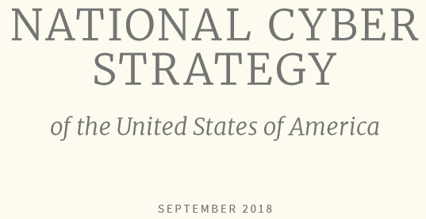
Why is Trump saying it's the world's only superpower? The Soviet Union had fallen. In this history were saying there's two - the United States and the Soviet Union. From 1989 and forward which is the increase of knowledge, which Donald Trump is recognizing, the United States becomes the world's only superpower and that corresponds with the invention of the World Wide Web. He reminds the people that America invented it which is true of the internet but not of the World Wide Web. He also says that America has taken for granted their supremacy over the internet. He says that supremacy is being challenged and he names four countries that are challenging the United States supremacy online. The first country he names is Russia then China, Iran and North Korea. He says that these four countries beginning with Russia all challenge the United States with the recklessness they would never dare in any other domain. He says they undermine our economy and democracy. He particularly marks the Democratic process which is the election. He says that the risk is growing that these countries will use cyber attacks during a crisis that is not war but still peace time which reminds us of that Russian general that said there is no division now between war and peace. So Donald Trump has released the National Cyber Strategy to protect against four main countries beginning with Russia and defend this dynamic, the United States as the world's only superpower which he thinks it still is and the authority or control over the internet. This was the first cyber strategy update in 15 years.
In K
1989
cyber
USA
WWW

Slide 12
Next we'll discuss John Bolton, what is his official role in the US government? John Bolton said more about this cyber strategy then Donald Trump did. What he said the cyber strategy enabled them to do was fight offensively instead of defensively. Now they weren't going to wait to be attacked, they were going to attack first in anticipation of an attack. Offensively instead of defensively. The minute you hear that at the end of September we know some type of dynamic in their alliance is changing. Remember what is about to happen in early November? We are 6 weeks away from the midterm elections so this is released just in time. John Bolton said, a paraphrase, it's part of our way of deterring foreign countries. They’re making it public now at the end of September that they should expect we're going to now attack offensively.
May 11, 2017 ª Exec Order 13800
July 2018 ª Helsinki meetingªTrump & Putin
Sept 21, 2018ª National Cyber Strategy offensively
White House authorizes ‘offensive cyber operations’ to deter foreign adversaries
https://www.washingtonpost.com/world/national-security/trump-authorizes-offensive-cyber-operations-to-deter-foreign-adversaries-bolton-says/2018/09/20/b5880578-bd0b-11e8-b7d2-0773aa1e33da_story.html

Slide 13
The 31st of October and what he says is that the United States is right now undertaking offensive cyber-operations to protect the election. So they're already engaging offensively on the 31st of October. John Bolton ties that to the cyber strategy which he says began with this executive order. John Bolton then meet with Vladimir Putin in Moscow, this was a couple of days before on the 28th of October. Vladimir Putin has a few words for John Bolton, what Putin says is in July I met with Trump in Helsinki, it went really well, there were no problems, which is why I am surprised to see the United States take these steps which I would not call friendly and seems to have come out of nowhere. Vladimir Putin is stating on the 28th of October that the United States is taking steps against him that are not friendly and he’s questioning why that is when the July meeting was such a success. We read October 31 that they are undertaking offensive action right now.
November 9-11 was a memorial in France of the end of the first World War. World leaders including Trump and Putin were to be there to mark the end of World War 1 on its 100th anniversary. On the side of that memorial Trump and Putin where to have a meeting. On the way to France Trump canceled that meeting which was strange. Not sure if it was this meeting of the one after -I think it might have been this one the Russian officials found out via Twitter when Trump cancelled that meeting. (Might be G20 meetings cancelled via Twitter—but this still took them by surprise.)
May 11, 2017 ª Exec Order 13800
July 2018 ª Helsinki meeting ª Trump & Putin
Sept 21 ª National Cyber Strategy offensively
Oct 28 ª ‘not friendly’ (Putin)
Oct 31 ª taking offensive action ‘right now’
Nov 6 ª mid-term elections
Nov 9-11 ª meeting cancelled
Nov 16 ª CISA
Nov 25 ª Ukraine and Russia
Nov 29 ª Trump cancelled meeting

Slide 14
November 16th CISA Trump ties these acts (culmination of what he began in May) together when he creates a new agency within the Department of Homeland Security. A new agency within the US government specifically for cyber security.
November 25 there's a crisis in the Ukraine. Some Ukrainian naval vessels had sailed into Russian Waters without asking the permission of Russia, which wasn't that strange of an act because they sailed through those waters all the time but they usually ask for permission. As far as we have found this has never been denied. This time they do not and those Ukrainian vessels are attacked, they're captured by Russia and all the crew members are taken prisoner. This was seen as a huge escalation toward an open war. Everyone was on edge waiting to see if there would be war. Did Ukraine call martial law or just threatened to? They did.
https://www.washingtonpost.com/news/monkey-cage/wp/2018/11/28/russia-and-ukraine-had-a-short-naval-battle-heres-what-you-need-to-know/
November 29th the end of November - early December there was to be a G20 in Buenos Aires Argentina. And at that G20 Trump and Putin were to have a meeting. On November 29th Donald Trump cancelled this meeting 2 days before they were to meet which was the first of December. The reason Trump said he was canceling the meeting is why? Why did he cancel the meeting? Ukraine, Russia's behavior over Ukraine.
All the way from the 21st of September into October the relationship is going bad. When we come to November, what are they fighting over? Spheres of influence. Trump says because of Russia's behavior towards Ukraine, I'm canceling my meeting with Putin in Argentina. I'd be willing to meet with him again when he resolves that situation. This is the first time where we can see Trump has stood up to Putin. That was the 29th of November
May 11, 2017 ª Exec Order 13800
July 2018 ª Helsinki meeting ª Trump & Putin
Sept 21 ª National Cyber Strategy offensively
Oct 28 ª ‘not friendly’ (Putin)
Oct 31 ª taking offensive action ‘right now’
Nov 6 ª mid-term elections
Nov 9-11 ª meeting cancelled
Nov 16 ª CISA
Nov 25 ª Ukraine and Russia
Nov 29 ª Trump cancelled meeting

Slide 15
December 19th their relationship appears to not be going well. It was a very much like Friday, March 22nd 2019, a great deal happened in one day. Trump announced the troops are withdrawing from what countries? From Syria and Afghanistan. What is peculiar about these two countries? Russia is involved in both these countries. Russia is supporting Syria and the United States is supporting the rebels but in Afghanistan it's the other way around—the United States is supporting government and Russia is supporting the rebels. Just with that dynamic these are both proxy wars between Russia and the United States. Trump announces that Isis has been defeated therefore there's no need for him to be in Syria. I do not believe that he's unaware of why they're in Syria in the first place. He knows that this is a proxy war and we discussed Syria in an earlier class, its strategic location, they didn't enter Syria because of Isis. This was a response against Assad and Russia. In response to this, Jim Mattis, one of the general advising Donald Trump resigned. He's the last General standing that had not already quit or been fired. They would call him the last one standing or the last restraining on Donald Trump. For nearly the first two years of his presidency he had some strong well-known generals advising him, influencing and restraining him. One by one they become either frustrated and quit or he fired them. Jim Mattis was the last one remaining of those old generals. When Trump announces he's withdrawing troops, Jim Mattis has been trying to prevent him from doing this for a long time. He's frustrated and he resigns. He was meant to finish out his term which was still a couple of months, but Trump responded to his resignation by firing him. Trump also removed sanctions on Oleg Deripaska. There are a couple of Russian oligarchs closest to Vladimir Putin that also work with him but not in a way that makes it easy to tie their behavior to the Russian government..
May 11, 2017 ª Exec Order 13800
July 2018 ª Helsinki meeting ª Trump & Putin
Sept 21 ª National Cyber Strategy offensively
Oct 28 ª ‘not friendly’ (Putin)
Oct 31 ª taking offensive action ‘right now’
Nov 6 ª mid-term elections
Nov 9-11 ª meeting cancelled
Nov 16 ª CISA
Nov 25 ª Ukraine and Russia
Nov 29 ª Trump cancelled meeting
Dec 19 ª Trump announces troops withdrawing
Syria
Afghanistan
ª Jim Mattis resigns
ª Remove sanctions: Oleg Deripaska

Slide 16
In 2014 we saw the crisis in Ukraine. The crisis was because they had a president that was tied to Russia. And who helped to get that Russian favoring president elected? Ukraine in 2014 has a president Viktor Yanukovych who's Favorable to Russia. He had been convicted of fraud years previously, specifically rigging an election. But he's able to reinvent his image, he has close ties to Russia, he runs a campaign though pretending to be favorable to the west not to Russia. So he reinvents himself and essentially tricks the Ukrainian people. To make a long story short, he cuts his ties to the west and announces that he's going to build closer ties to Russia. This mixed with evidence of huge corruption, causes of the Ukrainian Revolution. Who was the man behind Viktor Yanukovych to help him get elected? Paul Manafort. He became Trump's campaign manager towards the end of 2016. But in 2014 he's working for Viktor Yanukovych. It's not just Viktor Yanukovych that he's working for, who orchestrated all of this is who Paul Manafort really work for, Oleg Deripaska. So Vladimir Putin works through his oligarchs. And in 2014 Manafort is 19 million dollars in debt to Oleg Deripaska.
https://time.com/5490169/paul-manafort-victor-boyarkin-debts/
Did Manafort Use Trump to Curry Favor With a Putin Ally?
2014
Ukraine ª Russia
Yanukovych
↓
Paul Manafort ª Oleg Deripaska

Slide 17
After that conflict arises because they fought over that debt, you can tie Paul Manafort to Ukraine, but also to the 2016 election. In that election Paul Manafort is updating Oleg Deripaska with private information about Trump's campaign. Oleg Deripaska Is intimately connected to the 2016 election. A proxy for Vladimir Putin. Because of that connection to the 2016 election, sanctions have been placed on him by the US government. On December 19 Trump has those sanctions removed. Those sanctions related to the businesses that Deripaska controlled which was mainly Rusal, the largest private energy company inside Russia. So these sanctions related specifically to Oleg Deripaska. It's Russia's largest Energy company.
Trump Administration to Lift Sanctions on Russian Oligarch’s Companies
By December 19th the relationship is broken down. There's been no payment or relief of sanctions and they are arguing over spheres of influence. But on December 19th these two issues are resolved. Trump announces that he's removing all of his troops From Syria, half of his troops from Afghanistan and he removed sanctions from Oleg Deripaska, causing the last general restraining him to resign.
2014
Ukraine ª Russia
Yanukovych
↓
Paul Manafort ª Oleg Deripaska
Rusal

Slide 18
Vladimir Putin comes out on December 20, he holds his annual news conference. Once a year he speaks to the Russian media and he speaks to them for 4 hours and he praises Trump for these actions. He says Trump has made the right decision in these troop withdrawals, he says he has sympathy for Trump because he says Trump was elected by the US people and his country is not giving him the respect he should have. So it's really this defense of Trump mixed with praise.
By December 20 the relationship is strong again. There are two key pieces of information that did not come out until around January 2019. Two things that we learned. We discussed the Internet Research Agency’s activity in 2014 and that election. October 31st John Bolton says that they are right then taking offensive action to protect the midterm elections. What we became aware of in January and February was that on the day of the midterm elections the United States launched a cyber attack against the Internet Research Agency. Donald Trump personally approved of the cyber attack and shut down the Internet Research Agency on November 6th — the midterm elections. It's believed for some period of time around November 6th. Long enough for them to count the votes.
So November 6th there's a US cyber attack that is not being provoked, it's not defensive, it's offensive. Which is exactly what they said they were going to do. So it's no surprise that a couple of days later Trump didn't want to meet with Putin, considering what he has just done.
May 11, 2017 ª Exec Order 13800
July 2018 ª Helsinki meeting ª Trump & Putin
Sept 21 ª National Cyber Strategy offensively
Oct 28 ª ‘not friendly’ (Putin)
Oct 31 ª taking offensive action ‘right now’
Nov 6 ª mid-term elections
Nov 9-11 ª meeting cancelled
Nov 16 ª CISA
Nov 25 ª Ukraine and Russia
Nov 29 ª Trump cancelled meeting
Dec 19 ª Trump announces troops withdrawing
Syria Afghanistan
ª Jim Mattis resigns
ª Remove sanctions: Oleg Deripaska
Dec 20 ª relationship is strong again

Slide 19
We have the same dynamics that is what was built into World War II. We have the two parts of this alliance, spheres of influence and sanctions. Those two parts cause a strain and Stalin was also concerned with how strong Hitler was looking. So that relationship begins to break down and fully breaks down in August of 1940. We take it to Heraclea, what we’re meant to see is a crisis initiated by the King of the North against the King of the South. Donald Trump initiates this conflict, he is the aggressor. But you should see a secret meeting, they sort out their differences and they're stronger than they were before and whatever they renegotiated is favorable to the King of the South. What also came out in the end of January is that they did meet at the G20 in Argentina but it was kept secret. There was one translator and at the end of the meeting Trump took the notes from her and forbid her from speaking to his own team. So there was a secret meeting at the end of November. Whatever was discussed at that meeting, this is the conditions that led into that meeting, December 19th is the result of that meeting which was a clear win for the King of the South.
Invasion of Thessaly
Pyrrhus in
Macadonia
Ipsus
Eleph
Heraclea
Pyrrhus in
Italy
X
Eleph
F
WW2
Poland
Aug. 1940
WW3
2016
2018

Slide 20
Nov 9
Dec 19
We want to look at another thing that happened December 19th that is relevant for us but not relating to the King of the South. We just want to mark one other the thing - if we were to go back to 2016, to the election what day did Trump win the election? How many elections are there in 2016? Because you can win this vote on November 9th and still not become president. There is one more vote you have to win. This is the people's vote, what else does he have to win to become president? It was not finalized here, Clinton still could have become president. We have the people's vote then the Electoral College which was December 19th. Whatever we want to make of it Ipsus — it’s two dates: it's November 9th and December 19th. Heraclea, December 19th, Asculum is November 9th 2019. Also on December 19th in the history of World War II, December 19th of 1941, Hitler disagrees with his generals one last time then takes over control of the army. The restraint of Hitler's generals was removed December 19th. The same way it was for Trump December 19th 2018.
We need to remember what we're discussing is our strongest evidence is to what Raphia looks like. It’s something we could begin tracing from at least three months before if not six months or for May 11th.
2016
people
Electoral
Ipsus
Heraclea
Asculum
Nov 9
Dec 19
Dec 19
Nov 9
2016
2019
May 11, 2017 ª Exec Order 13800
July 2018 ª Helsinki meeting ª Trump & Putin
Sept 21 ª National Cyber Strategy offensively
Oct 28 ª ‘not friendly’ (Putin)
Oct 31 ª taking offensive action ‘right now’
Nov 6 ª mid-term elections
Nov 9-11 ª meeting cancelled
Nov 16 ª CISA
Nov 25 ª Ukraine and Russia
Nov 29 ª Trump cancelled meeting
Dec 19 ª Trump announces troops withdrawing
Syria
Afghanistan
ª Jim Mattis resigns
ª Remove sanctions: Oleg Deripaska
Dec 20 ª

