Slide 1
Brazil SOTP
Heraclea Review
Tess Lambert
3/25/19

Slide 2
We talked about the two events of Friday March 22nd, when was the conquering of the last ISIS town that was holding out. It's something significant - if you trace the path of ISIS through our way marks you can take ISIS to 1989. You see it in 1996, in 2011 it entered Syria and in 2014 it becomes a caliphate - the Islamic State of Syria and Iraq. They removed it as a caliphate from Iraq and they're in the process of removing it as a caliphate from Syria. Around the end of 2014 they're building a caliphate almost the size of Great Britain. They've been defeated to the point where there was only one city left. That city was taken Friday March 22nd. So if you thread ISIS through our way marks from 1989 where it’s found it was radicalized you see it entered into Syria in 2011. It becomes a state in 2014, has no state in 2019. Those events become significant for us. As we've been discussing through these classes, radical Islam becomes something that we need to investigate further.
White House Says ISIS’s Last Bastion Fell. So Why Is There Still Fighting?
https://www.nytimes.com/2019/03/22/world/middleeast/trump-isis.html
The president’s drive to announce an end to the four-year campaign against the Islamic State was underscored by his unexpected announcement in December that he would withdraw all troops from Syria. That decision came against the advice of most of his national security officials and prompted the resignation of Defense Secretary Jim Mattis. As a candidate for president, Mr. Trump had promised to end the United States’ long wars that followed the terrorist attacks of Sept. 11, 2001.
Military officials and lawmakers who opposed the troop withdrawal in Syria insisted that an enduring presence of American forces must remain to ensure the defeat of the Islamic State and counter Iranian and Russian influence. Late last month, the White House announced that roughly 400 American troops would remain in Syria for the foreseeable future.
Islamic State of Iraq and the Levant
The Islamic State of Iraq and the Levant, also known as the Islamic State of Iraq and Syria, officially known as the Islamic State and also known by its Arabic language acronym Daesh, is a Salafi jihadist militant group and former unrecognized proto-state that follows a fundamentalist, Salafi doctrine of Sunni Islam.
https://en.wikipedia.org/wiki/Islamic_State_of_Iraq_and_the_Levant

Slide 3
The other event that we marked on Friday March 22nd was the end of the Russia investigation. Since around early 2017 there had been an investigation between Trump and Russia, particularly into whether or not there's been known collusion between Trump and Russia. For 20 months some of the best FBI agents worked on this case. Why are we saying there was collusion? Why do we say that they had at alliance? We took the two lines of Pyrrhus and we saw that there was an alliance between Pyrrhus and Demetrius that caused them to be allied in the first of those four battles. Then we took the history of the alpha of the King of the South in our history and we saw that there was an alliance between Hitler and Stalin that led up to the first invasion of that history. Then we cut our lines and we overlaid them and we saw in our history that there would be an alliance between the King of the North and the King of the South, leading up to the first battle in 2016. We said that this alliance happened in 2014. Why do we say that it was 2014? We have three lines that we're drawing from. These two gave us an alliance then what did this line give us? Pyrrhus in Italy, what did this line give us? His arrival we saw in 2016 what about the way mark before you can mark his arrival? There's an ongoing conflict but you can trace from the beginning of the reform line - you could actually trace it before then. Right from the beginning there’s a conflict between Rome and Tarentum or the chief town of southern Italy. What was the problem? The problem between Rome and Tarentum, what does Rome want? Rome has just conquered the north and taken all of this area but they don't have the south. What does Rome start to do? They want dominion over the south. Rome wants to take all of Italy which is composed of independent city-states under the sphere of influence of Tarentum. There's one city-state in particular that they're fighting over and that is Thurri. Rome places a garrison in Thurri because Thurri is torn between an alliance with their relatives, Tarentum and an alliance with Rome which promises greater economic benefit. There's two factions inside Thurri, one is for Rome and one is for Tarentum. The faction that wants to ally with Rome wins known as The Aristocats. Thurri appealed to Rome for aid and what does Tarentum do? Why did they ask Pyrrhus to help?
Py & Dem
arrival
H & S
2014
T & P
2016

Slide 4
At the time of the end we have Thurri appealing to Rome, so they start to change their allegiance from Tarentum to Rome, from the traditional boss to a new boss. This promises them greater economic benefit, so they choose Rome over Tarentum. They appeal twice, later on they appealed to Rome again. This time Rome responded by placing a garrison inside Thurri. They take military control and this is more than to Tarentum is willing to accept, so Tarentum attacks Thurri, expels the garrison and takes control of the city. We don't know much about Thurri after that event except that they fell back on Rome and were forever after completely dependent on Rome. Because of this event Rome declares war on Tarentum. Then Tarentum appeals to Pyrrhus for help, Pyrrhus arrives and began preparing Tarentum for war. So This Is War preparation. Then you have the first battle, Heraclea. This was the history that led up to war between Pyrrhus and Rome - The King of the North and the King of the South. Instead of teaching us about this alliance it gives us a different perspective where the King of the North and the King of the South are fighting over a sphere of influence. This particular sphere is what you see at the time of the end, changing its allegiance. We mark 1989 to 1991. Then we see this fight continue, they’re threatened by enemies and Rome placed a garrison. There was a place where Rome took more control of the city. Then Tarentum attacked Thurri, and we just mark this as progressive. When we trace this through our history we see the sphere of influence between Russia and the United States.
At the time of the end the Soviet Union began to lose their spheres of influence. There's one in particular that continues to cause them problems. We come into our history and once again the sphere of influence chose the United States, that was Ukraine in 2014. There were two rival factions inside Ukraine — one wanted their traditional boss Russia, and the other wanted the defense of the United States. Partly because it would provide greater economic benefit and also because they had would have the protection of NATO. It begins to look like Ukraine will accept and become part of the NATO alliance. They overthrew their government, the side that wanted to ally with the United States won. We also discussed Viktor Yanukovych in our previous study and his connection with Paul Manafort. We can see the King of the South or Russia did not respond well to that and in 2014 they attacked the Ukraine, Crimea. This sparked a war between Russia and the United States. This is where many of the sanctions placed on Russia came from. Part of the sanctions are directly from the Magnitzky Act and Bill Browder, or human rights abuse. But if you go through the list of sanctions held against Russia the majority of them are because of their behavior to the toward Ukraine. And we marked 2016 and 2018, but it's this 2014 attack of Thurri that we tied into this way mark which was this fight over sphere of influence of Ukraine, where Russia attacked it because it allied with the United States.
1989-1991
TOE
2014
2016
2018
Thurri
Thurri
↓
Rome places garrison in Thurri
Tarentum attacks Thurri
Pyrrhus arrives
Heraclea
ý
Terentum
Rome

Slide 5
It's this way mark that happened with Thurri, when we trace Thurri through our reform line we could place this attack in 2014. It corresponded with this alliance of the King of the North and the King of the South. This is what enabled us to see at alliance between Trump and Putin in 2014. In the history of Italy we don't see an alliance between Pyrrhus and Rome. What was have instead is the spheres of influence. When we looked at our four lines each line has 7-way marks and that wasn't created intentionally, but independently in a study they all had seven way marks and each told us different stories. When it was seen that they could be cut and overlaid we could see a correspondence between them. Pyrrhus in Macedonia showed us an alliance between Pyrrhus and Demetrius which shows us a conflict between the king of the north and south where they never once fought a battle. This line has things to teach us independent of the other three. Where we would place an alliance here, in the history of Italy, there were again seven-way marks and it gave us the history of a conflict not over their own countries but over spheres of influence. We can see that it’s conflict over spheres of influence that sparks this long war. That conflict begins at the very start where Thurri first changes its allegiance, then they change it again, they appeal to Rome again, and you see Rome attack Terentum. When overlaid it corresponds with the alliance.
Pyrrhus in Macedonia
alliance
Proxy war
Pyrrhus in Italy
Rome ªTerentum

Slide 6
Then we come to the history of World War II and again it is the history of an alliance, the Molotov-Ribbentrop Pact. These two lines Pyrrhus and Macedonia and World War II demonstrate a proxy war that begins in this history. We don't see that in the history of Pyrrhus in Italy but these two you do. Then we can trace World War II and it teaches us something different that the other two lines don't. One of the things it's able to teach us is there is a war on two fronts, so it's not just Rome and Thurri or Pyrrhus and Demetrius or Hitler and Stalin, why Hitler has the same problems on another side of his country. We can see that's an internal struggle with the west. So World War II gives us a whole other perspective - the Western Front. Each one adds to our reform line.
Pyrrhus in Macedonia
alliance
Proxy war
WW2
alliance
Proxy war

Slide 7
When we come down to our line and we look at World War 3 we saw it began with the proxy war which was Afghanistan. Then at the time of the end there's a change of allegiance in the spheres of influence. One of those countries continues to give problems and that is the country of Ukraine. It appeals to the United States, defeated their rival faction which made Russia very angry and they came against them in 2014.
For our reform line we take all three histories and the corresponding way mark between Rome attacking Terentum in our history is also the history of this alliance. Our history is very complicated the more we look at it. Only if we try to absorb it all at once but it has layers. So at the same time we're going into battle we're going into an alliance. It's explaining not only what's happening in Ukraine but what is happening between Donald Trump and Vladimir Putin. In 2016 Putin is preparing his country for war at the same time he's protecting and defending Donald Trump. He's fighting for Donald Trump the same time he's preparing for war with Donald Trump. Then we take this history of the Western Front and we see that begin in our history, then we also traced these other battles - Heraclea, Asculum and Beneventum. So we have combined our lines, we've taken from each line different concepts. Each one shows a different perspective of war. In our first line they were at war but they never fight a battle. In the second they fight battles all won by elephants. In the third it isn't battles but invasions on two fronts. Instead of these being conflicting ideas, when we bring them into our history they give us clarity about what is going on.
Pyrrhus in Macedonia
alliance
Proxy war
Pyrrhus in Macedonia
Rome ªTerentum
WW2
alliance
Proxy war
Western front
WW3
2014
2016
Proxy war
Western front

Slide 8
The reason we needed to review this is because there was a headline the night before, the main conclusions of the Russian report were released. After 20 months of research they found no evidence of collusion. That's a problem for people. We can see on our reform lines that we believed in collusion not based on newspapers but history. One thing that can help us to understand this is that Trump tries to fight to gain the three powers so those who know that there was collusion between Russia and him so the conclusion is that there was no collusion would be proving that he's already yet in control of the three. So while he cannot prove collusion he cannot say that there was no crime. These reports are a little like science. To make something scientific law you have to have more than a hunch or suspicion, you can't just smell fish, you have to see it. It's the same thing with this report. There's a lot of respect for Robert Mueller and it was expected that he would not cause conflict in the US government without visible solid evidence. Then observing how Putin has worked in the past under secrecy, the report didn't come as any surprise.
Mueller report sent to attorney general, signaling his Russia investigation has ended
https://www.washingtonpost.com/world/national-security/mueller-report-sent-to-attorney-general-signaling-his-russia-investigation-has-ended/2019/03/22/b061d8fa-323e-11e9-813a-0ab2f17e305b_story.html

Slide 9
We see 2014 as a Sunday law — show me the Sunday law in 2014. How do we know there was one? What happened in the political sphere of the United States? The Patriot Act was passed in 2001, it goes through this history, it’s strengthened, they do more and more with it. You come to 2013, Snowden conducts the largest leak of government documents in known history and the government goes into damage control. So in 2014 Obama is doing the best he can to repeal the Patriot Act. It's a battle between the Republicans and Democrats. Unlike Trump, when he doesn't get his way he doesn't shut down the government, instead they negotiate. What is passed in 2015 is not what Obama wanted, but it's still a restricted Patriot Act. If we talked about Obama or the government, they're fighting the Sunday law in 2014, not passing one. So what is the Sunday law in 2014? We wouldn't immediately bring in the Republican party and tie them to it but it's between Steve Bannon the work of Cambridge Analytica. How do we prove that? If we follow one stream of information we believe that. If we try to follow both streams we believe nothing. If we follow the other one you say this is all a conspiracy in this never happened. We're going to find that problem all through our reform line from 2014 forward. Where's the evidence? Rock hard proven evidence that this is a breakdown of the Constitution designed to elect the next president? What were required to do is observe the external events, take them to a reform line and understand them through prophecy. Because what gave evidence to the Sunday law in 2014, was by comparing and contrasting internal and the external. We can see that it's true regardless of what evidence we might see from a court of law. We can understand what's happening in 2014 with collusion and we can understand that there is collusion partly because it is a subject, and there is, I think everyone understands if you're following one stream of information, that the behavior in this history is suspicious. Not just in this history but we've traced the suspicion all the way till about January February 2019. Without that history, the story of the external events we don't have 2018. So we need that external news source. But to actually place it in prophecy we don't need Robert Mueller's approval because that isn't what makes it away mark, the reform lines make it away mark.
2014
T & P
2001
2016
SL
CA

Slide 10
How do we build a waymark or a correct idea of external events? For sister Tess, she expected this report that however nice it would be to have confirmation, we believed in October based on these reform lines. We believed collusion in October. We can go to good external sources to observe the relationship between Trump and Putin and give us clarity about what that looks like. When it comes into our history what we hang our faith on is the reform lines, our methodology and the repeat of history. One of the reasons we may be disappointed by that report though not surprised, is the test that this creates for us, are we willing to hang our weight on a reform line? Especially when they conflict with our preconceived ideas, are we still willing to give those up when we see the repeat of History?
For a moment we hesitated to venture. Then we exclaimed: "Our only hope is to trust wholly to the cord. It has been our dependence all the difficult way. It will not fail us now." Still we were hesitating and distressed. The words were then spoken: "God holds the cord. We need not fear." These words were then repeated by those behind us, accompanied with: "He will not fail us now. He has brought us thus far in safety." {CET 184.1}
My husband then swung himself over the fearful abyss into the beautiful field beyond. I immediately followed. And oh, what a sense of relief and gratitude to God we felt! I heard voices raised in triumphant praise to God. I was happy, perfectly happy. {CET 184.2}
I awoke, and found that from the anxiety I had experienced in passing over the difficult route, every nerve in my body seemed to be in a tremor. This dream needs no comment. It made such an impression upon my mind that probably every item in it will be vivid before me while my memory shall continue. {CET 184.3}
"What holds the cord?" "God holds the cord. We need not fear."
Isaiah 28:9 Whom shall he teach knowledge? and whom shall he make to understand doctrine? [them that are] weaned from the milk, [and] drawn from the breasts.
28:10 For precept [must be] upon precept, precept upon precept; line upon line, line upon line; here a little, [and] there a little:
28:11 For with stammering lips and another tongue will he speak to this people.
28:12 To whom he said, This [is] the rest [wherewith] ye may cause the weary to rest; and this [is] the refreshing: yet they would not hear.
Cord
Strong's Concordance
chut: thread, cord, line
Original Word: חוּט Part of Speech: Noun Masculine Transliteration: chut Phonetic Spelling: (khoot) Short Definition: thread
NAS Exhaustive Concordance
Word Origin from an unused word Definition thread, cord, line

Slide 11
Question: we consider that the Nethinims use this type of information to know how to proceed, I think this gives us an opportunity to wait a little more because they need this information. So I think it's likely that this information will soon be given to them and then we will also have our confirmation because I think in our lines we have proof enough to sustain this at this point.
1989 to 1991, and 1996-9/11 we see that as our increase of knowledge, formalization, the history of the first angel. We see 2014 to 2016, 2018 then 2019, so we can see the history of the nethanims repeating hours. The concern is that the tests are harder than that. In 2012 we were given the message of time and expected to accept it. In 2014 there's all the Ellen White quotes that reject time. Those have not been explained. So if we're in this movement in 2012 and we see someone completely unknown from a little country put out information predicting time, and then you have all of inspiration telling you you can't do that and then you have the leaders of this movement tell you it's fanaticism, to save yourself and not listen to these studies. We're required to accept that message on time, how easy was that test? Everything is against us. We see in 2018 it’s six years later when Parminder gets up in Italy and explains those quotes, and the movement accepts it, 6 years too late. That test was hard, we had to accept time with all of those quotes speaking against it and Elder Jeff who we've trusted since 1989, those tests are not easy which is why sister Tess expected Robert Mueller's report not to give us a confirmation of collusion. Do we accept the methodology? And the lines? So when we come to 2019, this is one of the reasons we don't expect to see a hot war. The lines will say it's not, but it's also a test. The test is not just November 9. November 9th is the litmus test to show how we've been doing in our past history, which means we decide now, so do the nethanims. They have abundant evidence of what Donald Trump is setting up whether the FBI is going to release a memo and say he's a dictator or not, they have abundant evidence, but it becomes a choice. We don't think that's going to be necessarily made easy for them or for us, because it's a test.
1st angel
1989
1991
1996
9/11
Nethanims
2014
2016
2018
2019

Slide 12
This was a diversion based on the Mueller report released about what this means for the prophetic message. Question is what do you mean, there's a fine line between following external events and becoming a newspaper profit. We need that external history just as much as we need the internal. But we have to combine them. And the reform lines, which are already the external history tell us about Ukraine and an alliance. So the Mueller report is not a big deal, it just makes it harder for some people.
In our last study we discussed the history from 2016 to 2018. We looked at Trump and Putin's relationship, how it went from being strong in the meeting at Helsinki in July of last year, and then in the history of our Midnight Cry it goes from strong to increasingly worse. What really breaks down the allegiance at the end is Ukraine, and also this attack by the KN. We wanted to see a few things in that history, first the KN had to initiate the conflict against the KS. We read that quote Vladimir Putin met with John Bolton and said what is going on, you were friendly in Helsinki, and you’re not friendly now. What Donald Trump had been doing was strengthening America's cyber-security. Then in the mid-term election (Nov 6, 2018) he attacks the Internet Research Agency. The conflict or cyber attack was over Ukraine and we also discussed the role of sanctions. So November 6th there's a Cyber attack against the IRA. Then we saw Ukraine and Russia attacking their ships, Donald Trump began to cancel his meeting with Vladimir Putin particularly at the G20 meeting in Buenos Aires Argentina. But they did meet in secret around December 1st. The relationship had gone from bad to worse, they meet in secret, and on December 19th Donald Trump reverses his previous language, announces the troops will be withdrawn from Syria, half the troops from Afghanistan and he's ending sanctions on Oleg Deripaska, all of which are a victory for Vladimir Putin— which we said we would need to see from the beginning. Then on December 20 Vladimir Putin is in a four hour news conference which he holds once a year where he lavishes Praise on Donald Trump and defends him.
KN ª KS
Nov 6 USA ª IRA
Dec 1 cancels meeting
Dec. 19 Syria, Afghan, Oleg Deripaska sanctions
Dec 20 Putin praises Trump

Slide 13
When we trace the history of World War II we saw the alliance had been strong, started to break down because of an invasion by Germany, so the Soviet Union invaded one of Germany’s allies, their difficulties over spheres of influence and Germany had not been paying. They had a secret meeting, renegotiated, re-drew the spheres of influence, and Germany promised to pay. Then the relationship was stronger than it had been before. That's just a brief review of what we said previously.
Because of Russia's behavior against Ukraine the United States along with other countries introduced these sanctions on Russia only recently. Trump promised to release sanctions on Oleg Deripaska and now there's all new sanctions. Donald Trump hadn't long been president when Congress passed a bill that he had to sign. What they did at the very beginning of his presidency is make it very hard for him to be able to block sanctions on Russia. They recognized that his relationship with Russia was unhealthy for the country. Even these sanctions that he's trying to release on Oleg Deripaska he’s had a great deal of trouble with repealing those sanctions because it has to go through Congress. There have been months of debate and votes since December 19th. Even though he's trying to have them repealed he hasn't been allowed that power.
It’s official: Congress has handcuffed Donald Trump on Russia.
On Wednesday morning, President Trump grudgingly signed a bill into law that imposes new sanctions on Russia and sharply limits his ability to lift them. Since the bill sailed through Congress with a veto-proof majority, his only options were to sign it or to veto it and then endure the humiliation of seeing Congress — controlled by his own party — override him with ease, as lawmakers in both parties pledged to do.
When he signed the bill, he issued a statement calling the law “significantly flawed” and claiming that it contains “unconstitutional provisions” in its restrictions on presidential authority.
https://www.vox.com/policy-and-politics/2017/7/28/16055630/congress-trump-russia-sanctions-veto
The bill is a major blow to Trump’s agenda to warm relations with Moscow, and demonstrates that even in a time of partisan rancor and near-total legislative dysfunction, both parties can agree that Trump simply can’t be trusted to deal with Russia without their input.
Last week, sanctions legislation targeting Russia soared through the Senate by a margin of 98-2, just days after it coasted through the House of Representatives 419-3.
The bill takes Obama-era sanctions against Russia that are in place under executive orders — that is, directives that only the president has authority to enact and rescind — and officially enshrines them in the law. It also establishes a new congressional review process that would allow Congress to block the White House from taking steps to ease sanctions if it wanted to. And it imposes a fresh batch of sanctions on Russia, Iran, and North Korea.

Slide 14
One other thing that happened on December 19th we need to look at, it has as much significance for us even though it's not connected to the KS. What happened in the weeks leading up to December 19th a new budget had been drawn up where Donald Trump wanted five billion dollars for his border wall. The Democrats were not going to allow that. They offered him about 1.6 billion, so there's a fight over the border wall leading up to December 19th. In early December Donald Trump says he will be proud to shut down the government unless they give him money for the border wall. Early on the day of December 19th, he indicates that he will not shut down the government but he'll continue to fund the government to operate even if they do not give him money for his border wall. We need to consider what happened when he said that, particularly from Fox News. These are people who helped get him into power, they communicate between him and his base which for the majority of it is Christian conservative America. They very rarely are criticizing him, it's mostly praise. But the night of December 19th they begin to criticize him in fact they launched an attack. They say through their TV screens that this is a decision that Obama would have made, that his presidency would be a failure, that he's completely betrayed those who voted for him in 2016, that they wouldn't vote for him again. And there is this real attack launched from Fox News. One thing we need to be aware of is the power that news network has and the interaction happening between them and Donald Trump. There's this growing belief inside America that Trump is a prophetic character. Fox News themselves held a poll. The poll was related to Donald Trump's election and whether or not God placed him in power. They found that one in four Americans believed that, the majority of Evangelical Christians in America, something like 67% believe that he's been raised up by God to do work in the country to bring them back to Christianity. These are people that watch Fox News, it's the base that they begin to set up intentionally from 1996 when Fox News began, that they would be a news station for American conservative Protestants, that was their business plan, not a result.
Several days before the partial government shutdown began on December 22, the right-wing columnist and commentator appeared on The Daily Caller's podcast, where she slammed Trump.
Now, 27 days into a government shutdown over Trump's proposed wall, Coulter is ratcheting up the pressure on the president — and she doesn't seem to have much sympathy for impacted federal employees.
"Oh, gosh, they'll have to wait a few months before they know fully well they're going to be paid in full," she said. "Look, I'm not in favor of this, but previous shutdowns have been much more difficult
Ann Coulter doubles down: Trump will be 'dead in the water' if he doesn't build the wall
https://www.businessinsider.com/ann-coulter-doubles-down-trump-will-be-dead-in-the-water-if-he-doesnt-build-the-wall-2019-1

Slide 15
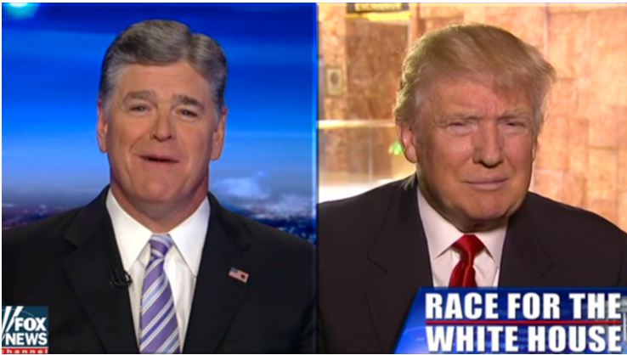
When we came to December 19th they spoke to Trump through his TV screen, December 20th he changes and says he's going to shut down the government and that largest government shutdown in US history began on December 22. Fox’s main news presenter, Sean Hannity talks to Donald Trump everyday. He has more power over Donald Trump then the general Jim Mattis had who quit December 19th. Sean Hannity has more power than Jim Mattis ever have. They talk everyday and make sure their stories are straight, Sean Hannity shares Trump's perspective through his news channel and Donald Trump finds out what his base wants to hear and like the border wall he’s making his decisions based on that. We’re not sure how it’s thought the Sunday Law will get passed, but we know that the people ask for it. So the people tell Donald Trump they want a Sunday law and he passes it. If we trace our way marks that dynamic is already set up, he's being advised to decide his policies in a way that no president ever has before. We observed that in a very special way on December 19th. We need to research that relationship, and particularly how it worked on December 19th, and the people that have power and authority with Donald Trump. His decisions are not being made through the usual mechanisms which would normally be by advisors or generals and people of experience. Instead much of it happens through alternative sources particularly Fox News. What happened on December 19th is a perfect setup for how we expect Sunday law to happen.
We saw December 19th as a way mark in 2016, two votes, first by the people then by the Electoral College. He needed both to become president. Then we also discussed December 19th 1941. Hitler had been arguing with his generals over the policies in the Soviet Union. On December 19th Adolf Hitler took the position of Commander in Chief of the German army. He didn't have the same plans as his generals so he made himself their Commander where he composed the strategies and his officers and generals had to take their orders direct from him. We go back into the history of World War II and we saw December 19th—Hitler was freed from the authority of his generals and took over all the decisions of the army. December 19th 2018 the last of the experienced generals advising Donald Trump resigned, who tried to restrain his policies. As was reported on that day, Jim Mattis’s resignation was the death nail or very end of restraint on Donald Trump. Now there's only Trump making those decisions, there's no restraint.
Nov 9
Dec 19
2016
people
Electoral
Ipsus
Heraclea
Asculum
Nov 9
Dec 19
Dec 19
Nov 9
2016
2019

Slide 16
https://www.businessinsider.com/sean-hannity-donald-trump-relationship-2018-4
Fox star Sean Hannity is one of Donald Trump's fiercest defenders — here's how he and the president became close
Fox News opinion host Sean Hannity was revealed on Monday to be one of the clients of Michael Cohen, the attorney for President Donald Trump, several news outlets reported.
Monday's revelation wasn't the first time Trump and Hannity have been linked. The pair have been close for years, well before Trump announced his candidacy for the presidency.
In fact, Trump and Hannity have benefited from each others' platforms immensely — Hannity lent unwavering support to Trump when other news outlets were critical of him, while Trump's frequent appearances on Hannity's show boosted Hannity to some of the highest ratings in cable news.
Look inside the relationship of Trump and Hannity to see how what they first bonded over and how close they remain today:

Slide 17
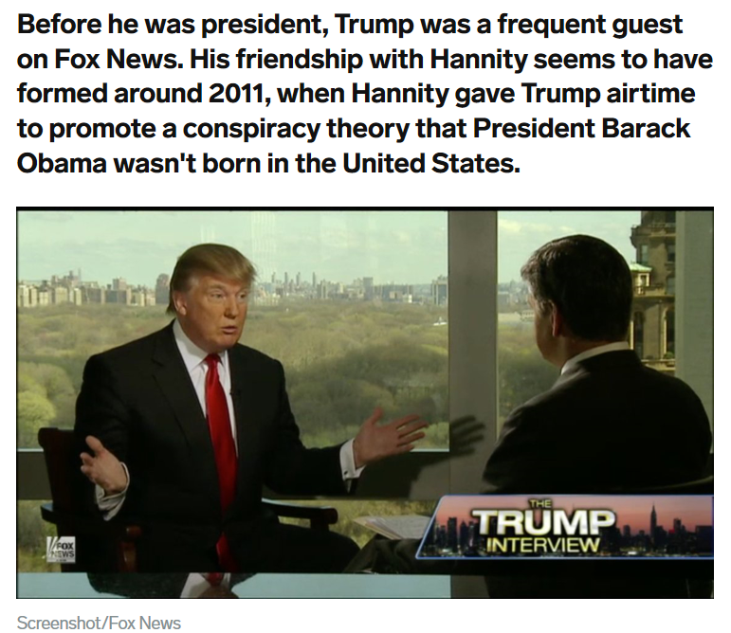

Slide 18
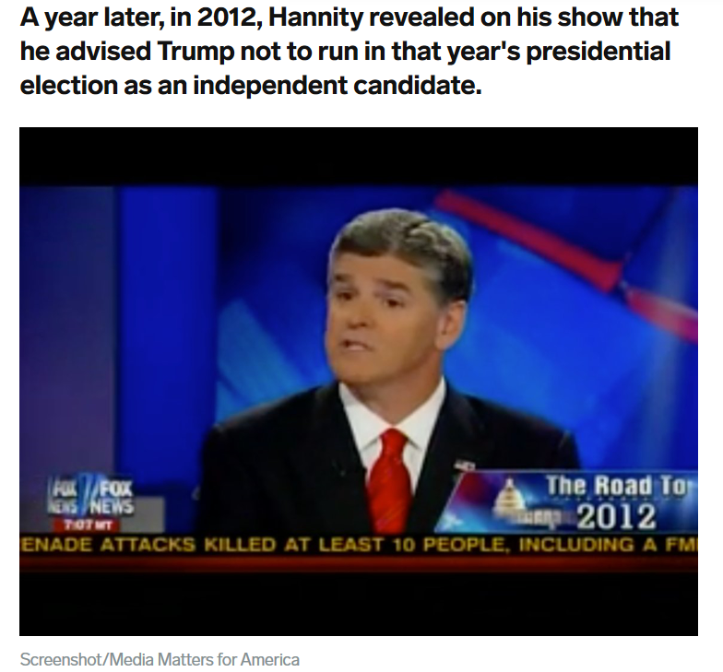
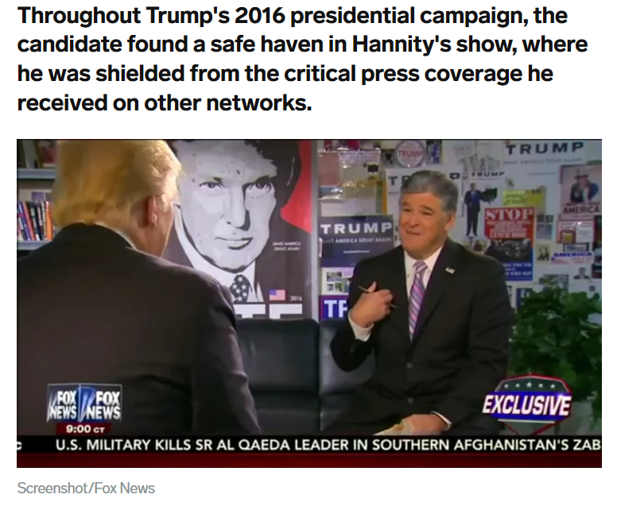

Slide 19
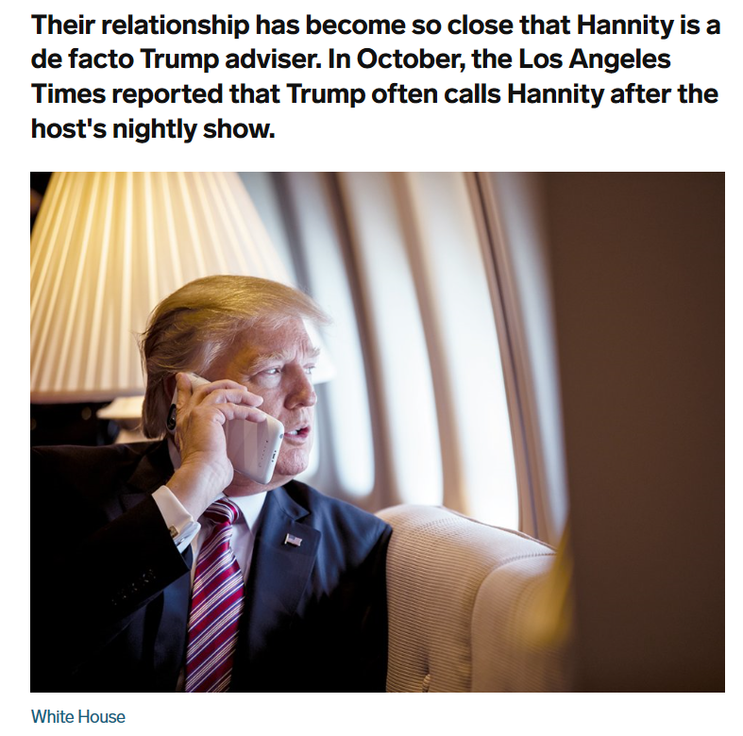
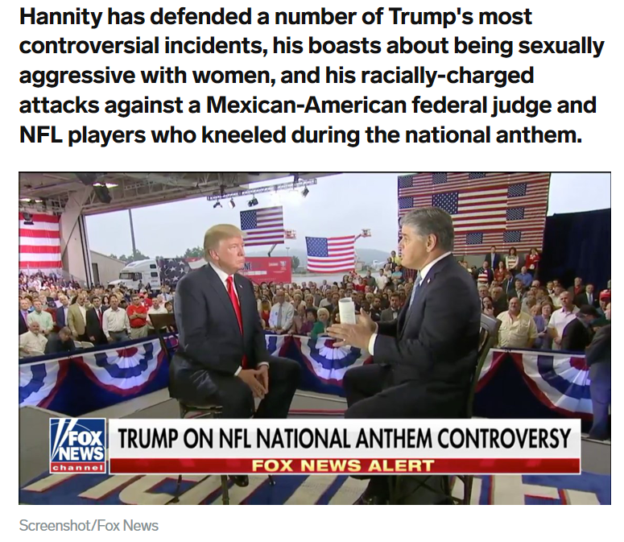

Slide 20
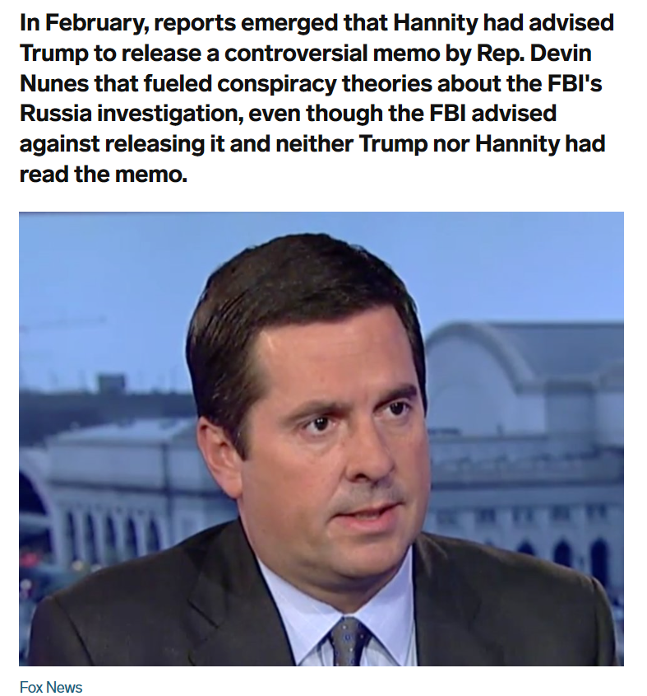
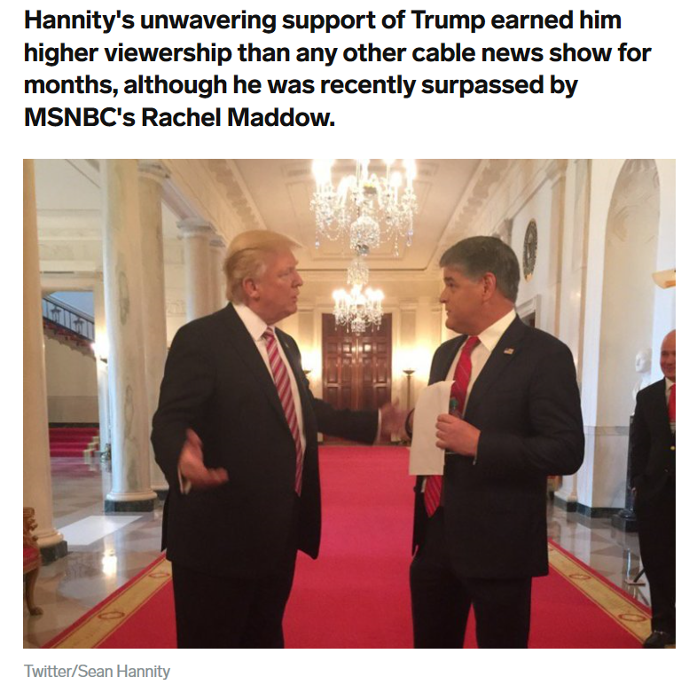

Slide 21
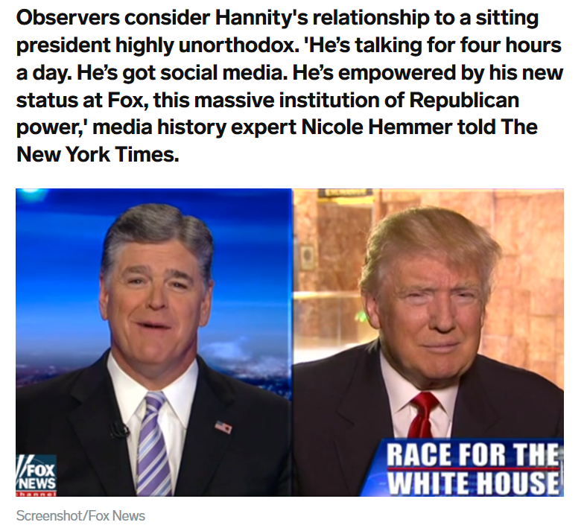
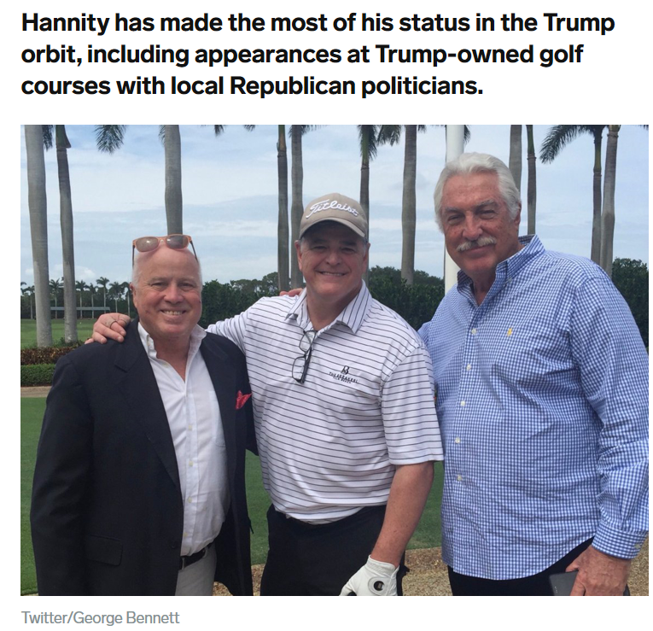

Slide 22
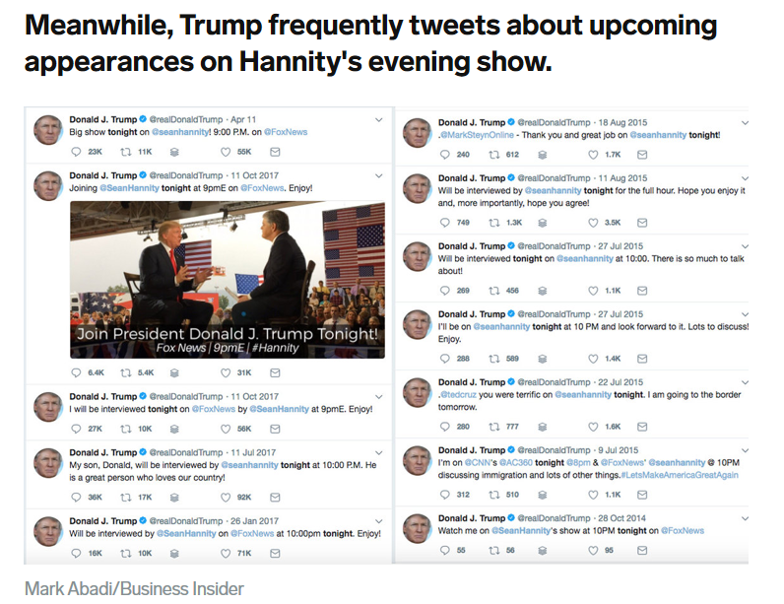

Slide 23
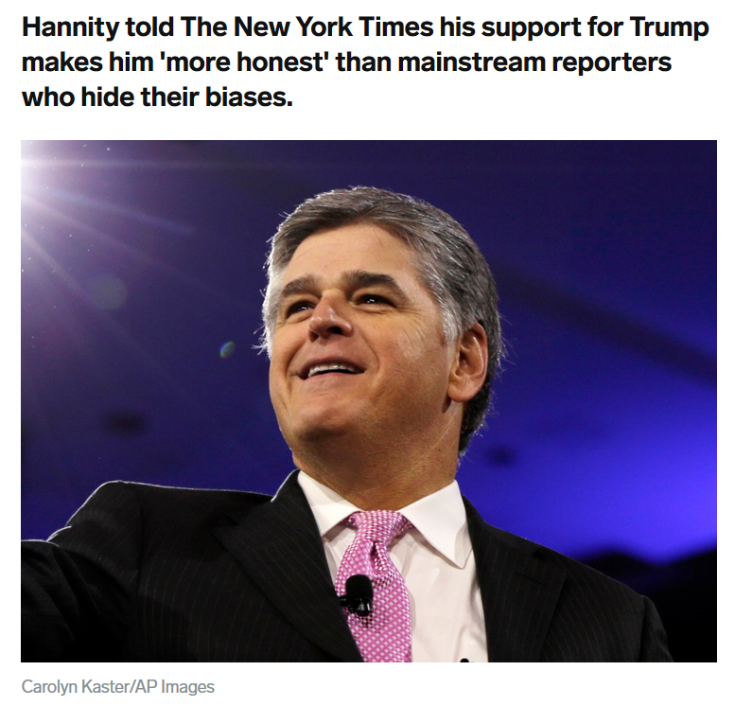
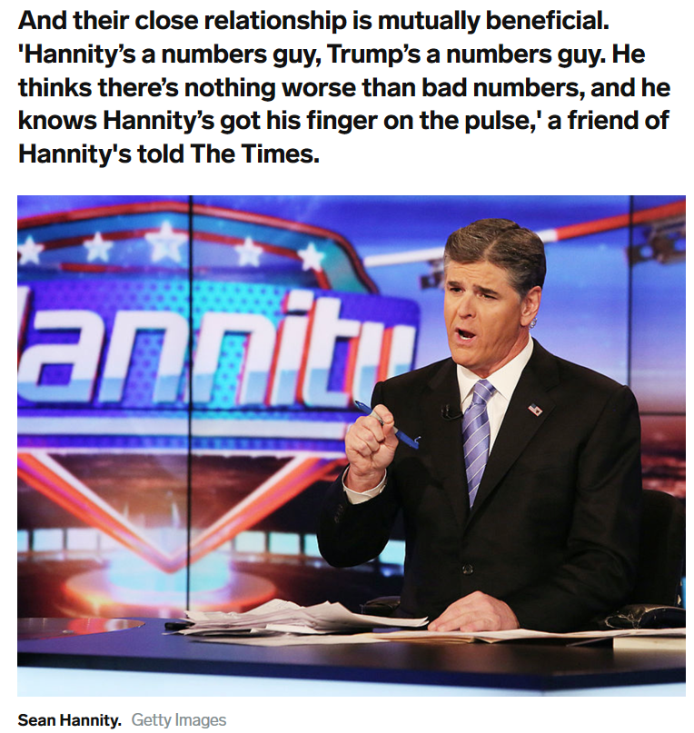

Slide 24
Heraclea
May 11, 2017 ª Exec Order 13800
July 2018 ª Helsinki meeting ª Trump & Putin
Sept 21 ª National Cyber Strategy offensively
Oct 28 ª ‘not friendly’ (Putin)
Oct 31 ª taking offensive action ‘right now’
Nov 6 ª mid-term elections
Nov 9-11 ª meeting cancelled
Nov 16 ª CISA
Nov 25 ª Ukraine and Russia
Nov 29 ª Trump cancelled meeting
Dec 19 ª Trump announces troops withdrawing
Syria
Afghanistan
ª Jim Mattis resigns
ª Remove sanctions: Oleg Deripaska
Dec 20 ª going to shut down government
We just need to remember that this is all Heraclea. We can mark it as a day December 19th, but we can also see its progressive nature, the same way we would with Ipsus. We could see Ipsus, if we're going to see those who fight in unison we can begin that all the way back to 2014. Even though we can see Ipsus as a day it also is progressive in nature. We know it's Ipsus, Heraclea, Asculum elephants elephants elephants. When we come to Raphia it looks like this, because it has the same mode of warfare and the same nature. The conflicts are sanctions and spheres of influence, so it should give us some idea of what we need to be seeing. When we look at the news we can observe what's prophetic from the noise.

