Slide 1
EQUALITY
Knowing our job function
Revelation 13:16 And he causeth all, both small and great, rich and poor, free and bond, to receive a mark in their right hand, or in their foreheads:
13:17 And that no man might buy or sell, save he that had the mark, or the name of the beast, or the number of his name.

Slide 2
THE RIGHTS OF THE PEOPLE
And this is briefly comprehended and nobly expressed in the following words of the Declaration of Independence:— {1893 ATJ, AUSSC 4.1}
"We hold these truths to be self-evident, that all men are created equal; that they are endowed by their Creator with certain unalienable rights; that among these are life, liberty, and the pursuit of happiness. That to secure these rights governments are instituted among men, deriving their just powers from the consent of the governed; that when any form of government becomes destructive of these ends, it is the right of the people to alter or to abolish it, and to institute a new government, laying its foundation on such principles and organizing its powers in such form, as to them shall seem most likely to effect their safety and happiness." {1893 ATJ, AUSSC 4.2}
Thus in two sentences was annihilated the despotic doctrine, which, springing from the usurped authority of the papacy to sit in the place of God, and to set up and pull down kings, and to bestow kingdoms and empires at its arbitrary will, had become venerable, if not absolutely hallowed, by the precedents of a thousand years—the doctrine of the divine right of rulers: and in the place of the old, false, and despotic theory of the sovereignty of the government and the subjection of the people, there was declared, to all nations and for all time, the self-evident truth, the subjection of the government and the sovereignty of the people. {1893 ATJ, AUSSC 4.3}
This self-evident and unalterable truth of the supremacy of the rights of the people in government was set forth as the fundamental principle of the government of the United States when the national Constitution was formed; for the preamble to that document announces that— {1893 ATJ, AUSSC 4.4}
"We, the people of the United States, in order to form a more perfect union, establish justice, insure domestic tranquillity, provide for the common defense, promote the general welfare, and secure the blessings of liberty to ourselves and our posterity, do ordain and establish this Constitution for the United States of America." {1893 ATJ, AUSSC 4.5}
INALIENABLE, a. [L. alieno, alienus.]
Unalienable; that cannot be legally or justly alienated or transferred to another. The dominions of a king are inalienable. All men have certain natural rights which are inalienable. The estate of a minor is inalienable, without a reservation of the right of redemption, or the authority of the legislature.

Slide 3
And this truth became an established and everlasting fixture of this government, when the ninth and tenth amendments were adopted, for Article IX of Amendments says:— {1893 ATJ, AUSSC 5.1}
"The enumeration in the Constitution of certain rights, shall not be construed to deny or disparage others retained by the people." {1893 ATJ, AUSSC 5.2}
And Article X of Amendments says:— {1893 ATJ, AUSSC 5.3}
"The powers not delegated to the United States by this Constitution, nor prohibited by it to the States, are reserved to the States respectively, or to the people." {1893 ATJ, AUSSC 5.4}
It is, however, the rights of the people with respect to religion with which we have here particularly to deal, as religion is the subject of the Supreme Court decision and the acts of Congress that are to be noticed. {1893 ATJ, AUSSC 5.5}
The right of the people of the United States to be religious or not religious, each one for himself alone, without any notice or interference of the government in any way, is a natural, a constitutional, and a divine right. {1893 ATJ, AUSSC 5.6}
This natural right was one which was particularly considered in "the times of seventy-six," and of the establishment of American independence. June 12, 1776, twenty-two days before the Declaration of Independence, a convention of the Colonial House of Burgesses, of Virginia, adopted a Declaration of Rights, composed of sixteen sections, every one of which, in substance, afterward found a place in the Declaration and the Constitution. The sixteenth section, in part, reads thus:— {1893 ATJ, AUSSC 5.7}
"That religion, or the duty which we owe to our Creator, and the manner of discharging it, can be directed only by reason and conviction, not by force or violence, and therefore all men are equally entitled to the free exercise of religion, according to the dictates of conscience." {1893 ATJ, AUSSC 5.8}
July 4 following, the Declaration of Independence was made, wherein this principle is embodied in the statement that governments derive their just powers from the consent of the governed." {1893 ATJ, AUSSC 5.9}
Governments deriving their just powers from the consent of the governed can never of right exercise any power not delegated by the governed. Now religion, pertaining solely to man's relationship to God, to the duty which man owes to his Creator, and the manner of discharging it, in the nature of things can never be delegated to another. {1893 ATJ, AUSSC 6.1}
It is utterly impossible for any person ever, in any degree, to transfer to another any of his relationship to God, or any duty which he owes to his Creator, or the manner of discharging that duty. Man's relationship to God originates not with himself, but with the Lord; it springs not from himself but from the Lord. The duty which man owes to his Creator, and the manner of discharging it, spring not from himself, but from the Lord. These are not dictated nor defined by himself, but wholly by the Lord. Here man is subject, not sovereign. None of these things then springing from himself, but all from the Lord, none of them could he delegate if he would. Even to attempt it would be only to deny God and renounce religion, and even then the thing would not be done—his relationship to God, the duty which he owes to his Creator, and the manner of discharging it, would remain, as firmly fixed and as binding upon himself as ever. Under the Declaration of Independence, therefore, the government of the United States can never have anything to do with religion. {1893 ATJ, AUSSC 6.2}

Slide 4
In 1989….do we know when the
Sunday Law is?

Slide 5
126
1853
1863
1868
1888
1893
1979
1989
2014
2019
151

Slide 6
Possessions to Decrease Rather Than Increase
It is now that our brethren should be cutting down their possessions instead of increasing them. We are about to move to a better country, even a heavenly. Then let us not be dwellers upon the earth, but be getting things into as compact a compass as possible. {CS 59.2}
The time is coming when we cannot sell at any price. The decree will soon go forth prohibiting men to buy or sell of any man save he that hath the mark of the beast.--5T 152. {CS 59.3}
In the last great conflict of the controversy with Satan those who are loyal to God will see every earthly support cut off. Because they refuse to break His law in obedience to earthly powers, they will be forbidden to buy or sell. It will finally be decreed that they shall be put to death. See Revelation 13:11-17. But to the obedient is given the promise, "He shall dwell on high: his place of defense shall be the munitions of rocks: bread shall be given him; his waters shall be sure." Isaiah 33:16. By this promise the children of God will live. When the earth shall be wasted with famine, they shall be fed. "They shall not be ashamed in the evil time: and in the days of famine they shall be satisfied." Psalm 37:19. To that time of distress the prophet Habakkuk looked forward, and his words express the faith of the church: "Although the fig tree shall not blossom, neither shall fruit be in the vines; the labor of the olive shall fail, and the fields shall yield no meat; the flock shall be cut off from the fold, and there shall be no herd in the stalls: yet I will rejoice in the Lord, I will joy in the God of my salvation." Habakkuk 3:17, 18. {DA 121.3}
When the leading churches of the United States, uniting upon such points of doctrine as are held by them in common, shall influence the State to enforce their decrees and to sustain their institutions, then Protestant America will have formed an image of the Roman hierarchy, and the infliction of civil penalties upon dissenters will inevitably result. {GC88 445.1}
The beast with two horns “causeth [commands] all, both small and great, rich and poor, free and bond, to receive a mark in their right hand, or in their foreheads; and that no man might buy or sell, save he that had the mark, or the name of the beast, or the number of his name.” [Revelation 13:16, 17] The third angel's warning is, “If any man worship the beast and his image, and receive his mark in his forehead, or in his hand, the same shall drink of the wine of the wrath of God.” “The beast” mentioned in this message, whose worship is enforced by the two-horned beast, is the first, or leopard-like beast of Revelation 13,—the papacy. The “image to the beast” represents that form of apostate Protestantism which will be developed when the Protestant churches shall seek the aid of the civil power for the enforcement of their dogmas. The “mark of the beast” still remains to be defined. {GC88 445.2}
Our land is in jeopardy. The time is drawing on when its legislators shall so abjure the principles of Protestantism as to give countenance to Romish apostasy. The people for whom God has so marvelously wrought, strengthening them to throw off the galling yoke of popery, will by a national act give vigor to the corrupt faith of Rome, and thus arouse the tyranny which only waits for a touch to start again into cruelty and despotism. With rapid steps are we already approaching this period. When Protestant churches shall seek the support of the secular power, thus following the example of that apostate church, for opposing which their ancestors endured the fiercest persecution, then will there be a national apostasy which will end only in national ruin. {4SP 410.2}
What does no ‘buy or sell’ look like? And when does it happen?

Slide 7
DESPOTISM, n.
1. Absolute power; authority unlimited and uncontrolled by men, constitution or laws, and depending alone on the will of the prince; as the despotism of a Turkish sultan.
2. An arbitrary government, as that of Turkey and Persia.
TYRANNY, n.
1. Arbitrary or despotic exercise of power; the exercise of power over subjects and others with a rigor not authorized by law or justice, or not requisite for the purposes of government. Hence tyranny is often synonymous with cruelty and oppression.
2. Cruel government or discipline; as the tyranny of a master.
3. Unresisted and cruel power.
4. Absolute monarchy cruelly administered.
5. Severity; rigor; inclemency.
The tyranny o' th' open night
BONDAGE, n. Slavery or involuntary servitude; captivity; imprisonment; restraint of a person's liberty by compulsion. In ancient English law, villenage.
1. Obligation; tie of duty.
He must resolve not to be brought under the bondage of observing oaths.
2. In scripture, spiritual subjection to sin and corrupt passions, or to the yoke of the ceremonial law; servile fear. Hebrews 2:15; Galatians 2:4; Romans 8:15, 21.
SLAVERY, n. [See Slave.]
1. Bondage; the state of entire subjection of one person to the will of another. Slavery is the obligation to labor for the benefit of the master, without the contract of consent of the servant. Slavery may proceed from crimes, from captivity or from debt. Slavery is also voluntary or involuntary; voluntary, when a person sells or yields his own person to the absolute command of another; involuntary, when he is placed under the absolute power of another without his own consent. Slavery no longer exists in Great Britain, not in the northern states of America.
2. The offices of a slave; drudgery.

Slide 8
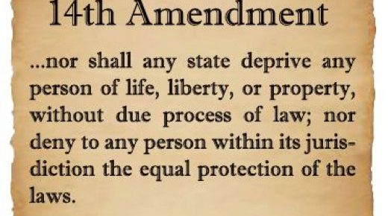
The Fourteenth Amendment (Amendment XIV) to the United States Constitution was adopted on July 9, 1868, as one of the Reconstruction Amendments. Arguably one of the most consequential amendments to this day, the amendment addresses citizenship rights and equal protection of the laws and was proposed in response to issues related to former slaves following the American Civil War. The amendment was bitterly contested, particularly by the states of the defeated Confederacy, which were forced to ratify it in order to regain representation in Congress. The amendment, particularly its first section, is one of the most litigated parts of the Constitution, forming the basis for landmark decisions such as Brown v. Board of Education (1954) regarding racial segregation, Roe v. Wade (1973) regarding abortion, Bush v. Gore (2000) regarding the 2000 presidential election, and Obergefell v. Hodges (2015) regarding same-sex marriage. The amendment limits the actions of all state and local officials, including those acting on behalf of such an official.
The amendment's first section includes several clauses: the Citizenship Clause, Privileges or Immunities Clause, Due Process Clause, and Equal Protection Clause. The Citizenship Clause provides a broad definition of citizenship, nullifying the Supreme Court's decision in Dred Scott v. Sandford (1857), which had held that Americans descended from African slaves could not be citizens of the United States. Since the Slaughter-House Cases (1873), the Privileges or Immunities Clause has been interpreted to do very little.
The Due Process Clause prohibits state and local governments from depriving persons of life, liberty, or property without a fair procedure. The Supreme Court has ruled this clause makes most of the Bill of Rights as applicable to the states as it is to the federal government, as well as to recognize substantive and procedural requirements that state laws must satisfy. The Equal Protection Clause requires each state to provide equal protection under the law to all people, including all non-citizens, within its jurisdiction. This clause has been the basis for many decisions rejecting irrational or unnecessary discrimination against people belonging to various groups.
The second, third, and fourth sections of the amendment are seldom litigated. However, the second section's reference to "rebellion, or other crime" has been invoked as a constitutional ground for felony disenfranchisement. The fourth section was held, in Perry v. United States (1935), to prohibit a current Congress from abrogating a contract of debt incurred by a prior Congress. The fifth section gives Congress the power to enforce the amendment's provisions by "appropriate legislation"; however, under City of Boerne v. Flores (1997), this power may not be used to contradict a Supreme Court decision interpreting the amendment.

Slide 9
Amendment XIV
Citizenship Rights, Equal Protection, Apportionment, Civil War Debt
Passed by Congress June 13, 1866. Ratified July 9, 1868. The 14th Amendment changed a portion of Article I, Section 2. A portion of the 14th Amendment was changed by the 26th Amendment
1
All persons born or naturalized in the United States, and subject to the jurisdiction thereof, are citizens of the United States and of the State wherein they reside. No State shall make or enforce any law which shall abridge the privileges or immunities of citizens of the United States; nor shall any State deprive any person of life, liberty, or property, without due process of law; nor deny to any person within its jurisdiction the equal protection of the laws.
Section 2
Representatives shall be apportioned among the several States according to their respective numbers, counting the whole number of persons in each State, excluding Indians not taxed. But when the right to vote at any election for the choice of electors for President and Vice-President of the United States, Representatives in Congress, the Executive and Judicial officers of a State, or the members of the Legislature thereof, is denied to any of the male inhabitants of such State, being twenty-one years of age, and citizens of the United States , or in any way abridged, except for participation in rebellion, or other crime, the basis of representation therein shall be reduced in the proportion which the number of such male citizens shall bear to the whole number of male citizens twenty-one years of age in such State.
Section 3
No person shall be a Senator or Representative in Congress, or elector of President and Vice-President, or hold any office, civil or military, under the United States, or under any State, who, having previously taken an oath, as a member of Congress, or as an officer of the United States, or as a member of any State legislature, or as an executive or judicial officer of any State, to support the Constitution of the United States, shall have engaged in insurrection or rebellion against the same, or given aid or comfort to the enemies thereof. But Congress may by a vote of two-thirds of each House, remove such disability.
Section 4
The validity of the public debt of the United States, authorized by law, including debts incurred for payment of pensions and bounties for services in suppressing insurrection or rebellion, shall not be questioned. But neither the United States nor any State shall assume or pay any debt or obligation incurred in aid of insurrection or rebellion against the United States, or any claim for the loss or emancipation of any slave; but all such debts, obligations and claims shall be held illegal and void.
Section 5
The Congress shall have the power to enforce, by appropriate legislation, the provisions of this article.

Slide 10
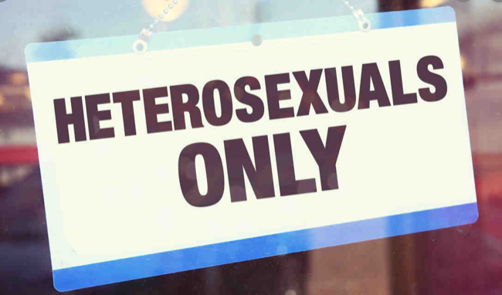
“We Don’t Serve Your Kind Here.”
In the majority of U.S. states, people can be denied service in a restaurant, kicked out of a taxi cab, or denied access to a bathroom — just because of who they are or whom they love. That’s the alarming conclusion of a new report from the Movement Advancement Project (MAP). The report and an accompanying television ad highlight how “public accommodations” laws provide an unequal patchwork of protections for LGBT people across the country. The result is that half of LGBT people face a very real risk of discrimination and harassment in public places. The report outlines clear steps that lawmakers, advocates and business owners can take to help ensure that when businesses serve the public, they serve everybody equally.
Prominent chefs oppose baker in major gay rights case
WASHINGTON (AP) — Prominent chefs, bakers and restaurant owners want the Supreme Court to rule against a Colorado baker who wouldn’t make a cake for a same-sex couple’s wedding.
The food makers say that once they open their doors for business, they don’t get to choose their customers. They say that abiding by laws that bar discrimination based on sexual orientation does not strip them of creative control of a dish or a pastry.
Celebrity chefs Jose Andres, Elizabeth Falkner and Carla Hall, the owners of a popular Washington, D.C., cupcake shop and a small-town baker from Mississippi are among those who are signing onto a legal brief being written by the Human Rights Campaign.
https://apnews.com/50e74fd210cc4567b4fd49d0bea2c335

Slide 11
Supreme court sides with baker who refused to make gay wedding cake
https://www.theguardian.com/law/2018/jun/04/gay-cake-ruling-supreme-court-same-sex-wedding-colorado-baker-decision-latest
The case went all the way to the supreme court and on Monday it ruled 7-2 that the commission violated Phillips’ rights under the first amendment, which guarantees freedom of expression. The court did not address the wider principle of whether a business can refuse to serve gay people, saying this “must await further elaboration”.
Writing for the majority, justice Anthony Kennedy said the CCRC showed “hostility” to Phillips’ religious beliefs in ordering him to undergo anti-discrimination training.
“The laws and the constitution can, and in some instances must, protect gay persons and gay couples in the exercise of their civil rights,” Kennedy wrote, “but religious and philosophical objections to gay marriage are protected views and in some instances protected forms of expression.”
The decision focused narrowly on the handling of Phillips’ case, however, leaving open the question of whether anti-discrimination laws should supersede religious beliefs in future cases.
“The court’s precedents make clear that the baker, in his capacity as the owner of a business serving the public, might have his right to the free exercise of religion limited by generally applicable laws,” Kennedy wrote.
“Still, the delicate question of when the free exercise of his religion must yield to an otherwise valid exercise of state power needed to be determined in an adjudication in which religious hostility on the part of the state itself would not be a factor in the balance the state sought to reach. That requirement, however, was not met here.”
Ruth Bader Ginsburg and Sonia Sotomayor dissented. The two most liberal justices said they would have upheld the finding of the commission, which decided that Phillips violated the Colorado anti-discrimination law that bars businesses from refusing service based on race, sex, marital status or sexual orientation.
Mullins spoke to reporters on a conference call. “I just hope that people can understand that this is not a wide-ranging ruling,” he said, “and that this doesn’t mean that … the Colorado Anti-Discrimination Act has been invalidated in any way. We will continue fighting until no one has to endure the shame, embarrassment and humiliation of being told, ‘We don’t serve your kind here.’”
The attorney general, Jeff Sessions, said: “The first amendment prohibits governments from discriminating against citizens on the basis of religious beliefs. The supreme court rightly concluded that the Colorado Civil Rights Commission failed to show tolerance and respect for Mr Phillips’ religious beliefs.”
Among liberal groups, the Human Rights Campaign, America’s biggest LGBT civil rights organization, noted the limited frame of reference of the ruling. Chad Griffin, its president, said: “In today’s narrow ruling … the supreme court acknowledged that LGBT people are equal and have a right to live free from the indignity of discrimination. Anti-LGBT extremists did not win the sweeping ‘license to discriminate’ they have been hoping for.”

Slide 12
GRAPHIC LANGUAGE: Oklahoma restaurant owner says doesn’t want ‘f*ggot, freak’ customers
ENID, Okla. - A restaurant in Enid is getting heat after one of its patrons posted a pretty strong message on social media about discrimination.
The restaurant and bar has been open for more than four decades and carries quite the reputation.
We want to warn you, this story does feature some graphic language.
Gary James, owner of Gary's Chicaros, said, “I've been in business 44 years, I think I can spot a freak or a faggot.”
He added, “I don't deal with these people walking down the street with no jobs on welfare."
James said, “If I reached over there and slapped the sh** out of you, you should be offended. But to call someone a 'chink' or someone call me a bigot, that doesn't bother me."
Now, a wave of comments on Facebook claim James refuses to serve African-Americans, Hispanics and people with disabilities, like Matt Gard.
Gard said, “He doesn't like certain people of race, color, ethnicity.”
Gard was a regular at Gary's Chicaros restaurant for years.
He said he turned a blind eye to the owner's choice of customers, until recently.
Gard said, “Now, he tried to find a weak excuse not to let me in with my wheelchair or the weak excuse of having loud people with me.”
After getting turned away for a steak dinner, Gard said it's about his disability.
James claimed that's just not the case.
James said “He created an issue. You only have one time here. You create an issue, you're out forever.”
Gard and at least 140 others posted on a Facebook page that said James' attitude has crossed the line to discrimination.
Even the business' t-shirt is viewed as offensive.
The shirt features derogatory slogans against homosexuals, it has the N-word on the front and threatens violence against Muslims, minorities and democrats.
James said he is proud to wear that shirt.
He said, “I really don't want gays around. Any man that would compromise his own body would compromise anything.”
Gard said, “The people who still go back and patronize his business are condoning his behavior in how he treats others.”
James said, “Well if you work, you own a business, pay your taxes, you're more than welcome here. If you're on welfare, stay at home and spend my money, there.”
Strong words in a small town where no one has challenged his business practices.
The Office of Civil Rights Enforcement is a division of the Oklahoma Attorney General's Office which investigates cases of discrimination in employment, housing, and public accommodation based on race, color, religion, sex, national origin, disability and age.

Slide 13
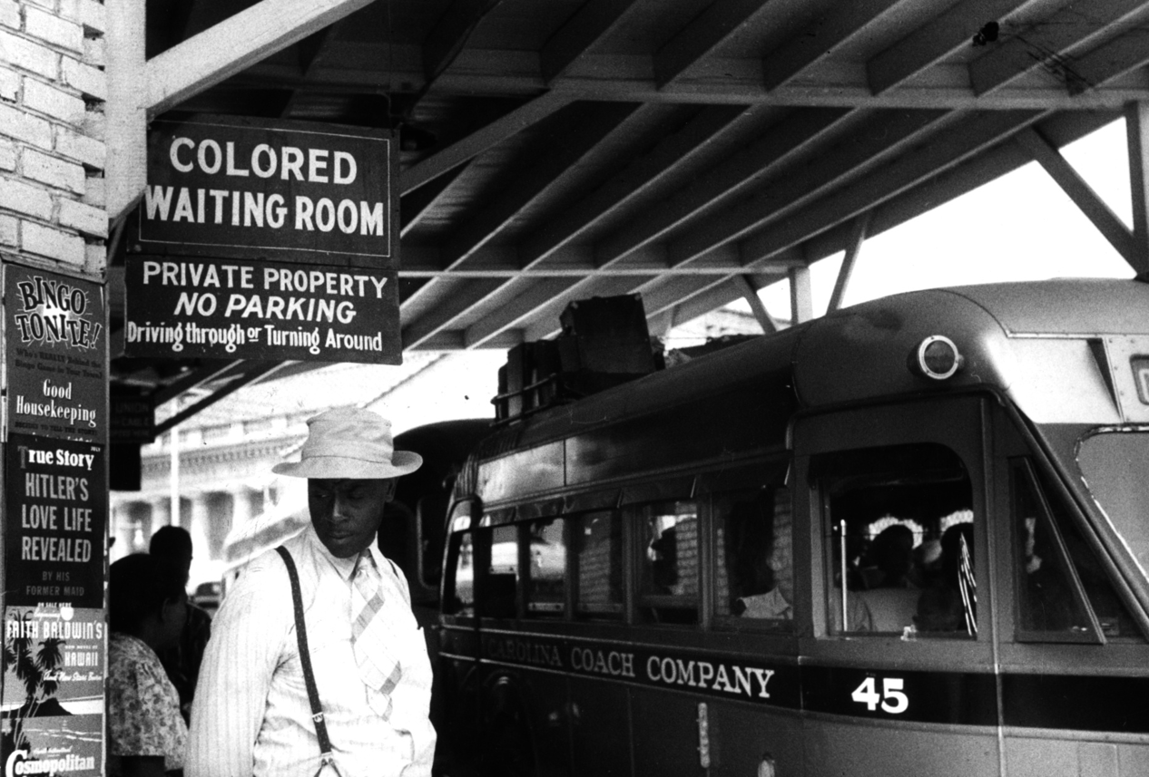
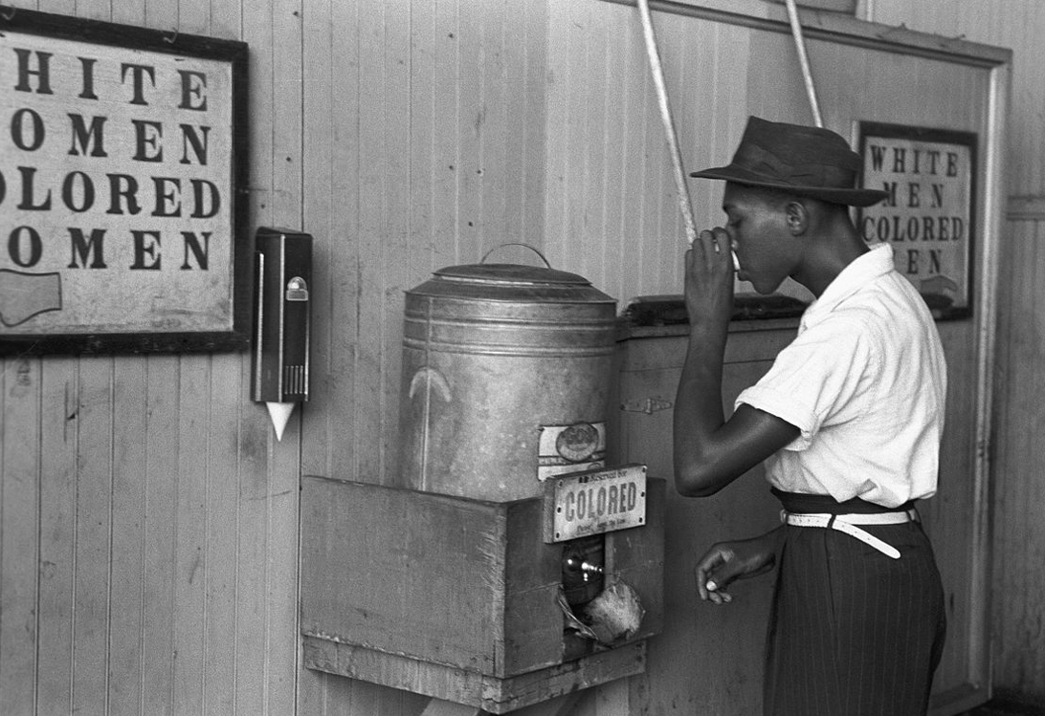
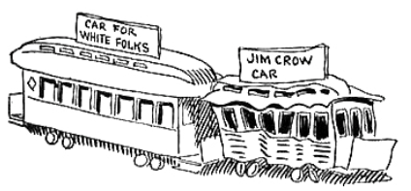
Jim Crow laws were state and local laws that enforced racial segregation in the Southern United States.^{[1]} All were enacted in the late 19th and early 20th centuries by white Democratic-dominated state legislatures after the Reconstruction period.^{[2]} The laws were enforced until 1965.^{[3]} In practice, Jim Crow laws mandated racial segregation in all public facilities in the states of the former Confederate States of America and other states, starting in the 1870s and 1880s, and were upheld in 1896, by the U.S. Supreme Court's "separate but equal" legal doctrine for facilities for African Americans, established with the court's decision in the case of Plessy vs. Ferguson. Moreover, public education had essentially been segregated since its establishment in most of the South, after the Civil War (1861–65).
The legal principle of "separate, but equal" racial segregation was extended to public facilities and transportation, including the coaches of interstate trains and buses. Facilities for African Americans and Native Americans were consistently inferior and underfunded, compared to the facilities for white Americans; sometimes there were no facilities for people of color.^{[4][5]} As a body of law, Jim Crow institutionalized economic, educational, and social disadvantages for African Americans, and other people of color living in the south.^{[4][5][6]}
Jim Crow laws—sometimes, as in Florida, part of state constitutions—mandated the segregation of public schools, public places, and public transportation, and the segregation of restrooms, restaurants, and drinking fountains for whites and blacks. The U.S. military was already segregated. President Woodrow Wilson, a Southern Democrat, initiated segregation of federal workplaces in 1913.^{[7]}
These Jim Crow laws revived principles of the 1865 and 1866 Black Codes, which had previously restricted the civil rights and civil liberties of African Americans. Segregation of public (state-sponsored) schools was declared unconstitutional by the Supreme Court of the United States in 1954 in Brown v. Board of Education. In some states it took many years to implement this decision. Generally, the remaining Jim Crow laws were overruled by the Civil Rights Act of 1964 and the Voting Rights Act of 1965, but years of action and court challenges have been needed to unravel the many means of institutional discrimination.
https://en.wikipedia.org/wiki/Jim_Crow_laws
1904 caricature of "White" and "Jim Crow" rail cars by John T. McCutcheon. Despite Jim Crow's legal pretense that the races be "separate but equal" under the law, non-whites were given inferior facilities and treatment.

Slide 14
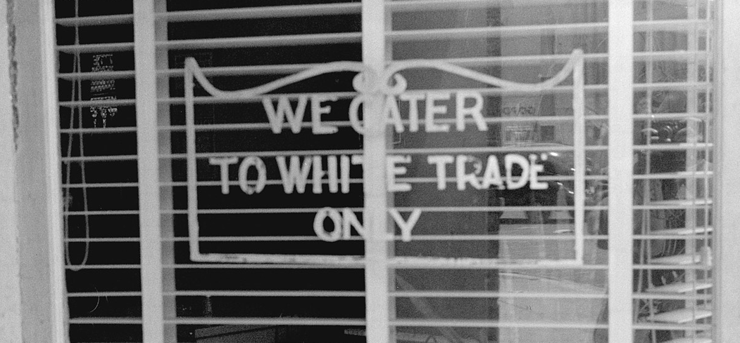
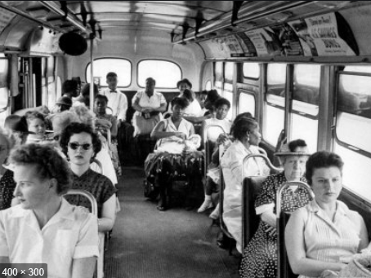
Separate but equal was a legal doctrine in United States constitutional law according to which racial segregation did not violate the Fourteenth Amendment to the United States Constitution, which guaranteed "equal protection" under the law to all people. Under the doctrine, as long as the facilities provided to each race were equal, state and local governments could require that services, facilities, public accommodations, housing, medical care, education, employment, and transportation be segregated by race, which was already the case throughout the states of the former Confederacy. The phrase was derived from a Louisiana law of 1890, although the law actually used the phrase "equal but separate".^{[1][better source needed]}
The doctrine was confirmed in the Plessy v. Ferguson Supreme Court decision of 1896, which allowed state-sponsored segregation. Though segregation laws existed before that case, the decision emboldened segregation states during the Jim Crow era, which had commenced in 1876 and supplanted the Black Codes, which restricted the civil rights and civil liberties of African Americans during the Reconstruction Era.
In practice the separate facilities provided to African Americans were rarely equal; usually they were not even close to equal, or they did not exist at all. For example, in the 1930 census, black people were 42% of Florida's population.^{[2]} Yet according to the 1934–36 report of the Florida Superintendent of Public Instruction, the value of "white school property" in the state was $70,543,000, while the value of African-American school property was $4,900,000. The report says that "in a few south Florida counties and in most north Florida counties many Negro schools are housed in churches, shacks, and lodges, and have no toilets, water supply, desks, blackboards, etc. [See Station One School.] Counties use these schools as a means to get State funds and yet these counties invest little or nothing in them." At that time, high school education for African Americans was provided in only 28 of Florida's 67 counties.^{[3]} In 1939–40, the average salary of a white teacher in Florida was $1,148, whereas for a negro teacher it was $585.^{[4]}
During the era of segregation, the myth was that the races were separated but were provided equal facilities. No one believed it. Almost without exception, black students were given inferior buildings and instructional materials. Black educators were generally paid less than were their white counterparts and had more students in their classrooms.... In 1938, Pompano white schools collectively had one teacher for every 25 students, while the Pompano Colored School had one teacher for every 54 students. At the Hammondville School, the single teacher employed there had 67 students.^{[5]}
The doctrine of "separate but equal" was overturned by a series of Supreme Court decisions, starting with Brown v. Board of Education of 1954. However, the overturning of segregation laws in the United States was a long process that lasted through much of the 1950s, 1960s, and 1970s, involving federal legislation (especially the Civil Rights Act of 1964), and many court cases.
https://en.wikipedia.org/wiki/Separate_but_equal
A restaurant in Lancaster, Ohio, in 1938

Slide 15
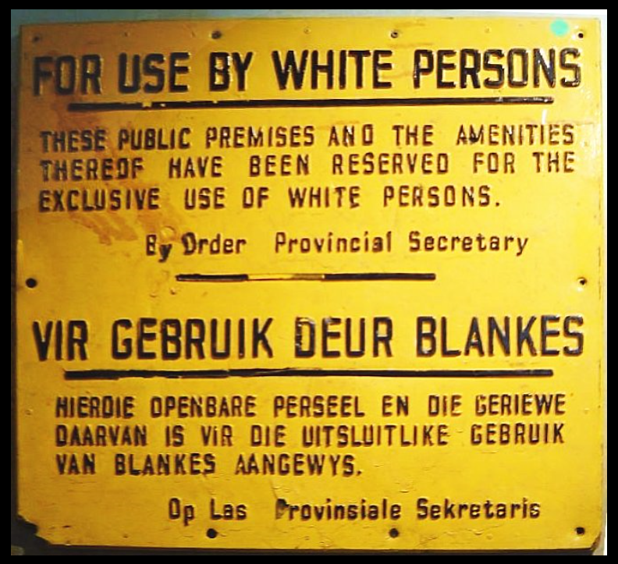
Brown v. Board of Education of Topeka, 347 U.S. 483 (1954),^{[1]} was a landmark decision of the U.S. Supreme Court in which the Court ruled that American state laws establishing racial segregation in public schools are unconstitutional, even if the segregated schools are otherwise equal in quality. Handed down on May 17, 1954, the Court's unanimous (9–0) decision stated that "separate educational facilities are inherently unequal," and therefore violate the Equal Protection Clause of the Fourteenth Amendment of the U.S. Constitution. However, the decision's 14 pages did not spell out any sort of method for ending racial segregation in schools, and the Court's second decision in Brown II (349 U.S. 294 (1955)) only ordered states to desegregate "with all deliberate speed".
The decision involved a case that originated in Topeka, Kansas, where the public elementary schools had been segregated by race since the late 19th century. In 1951, the Topeka public school district refused to enroll the daughter of local black resident Oliver Brown at the school closest to their home, instead requiring her to ride a bus to a segregated black elementary school further away. The Browns and twelve other local black families in similar situations then filed a class action lawsuit in U.S. federal court against the Topeka Board of Education, alleging that its segregation policy was unconstitutional. A three-judge panel of the U.S. District Court for the District of Kansas rendered a verdict against the Browns, relying on the Supreme Court's precedent in the 1896 case Plessy v. Ferguson, in which the Court had ruled that racial segregation was not in itself a violation of the Fourteenth Amendment's Equal Protection Clause if the facilities in question were otherwise equal, a doctrine that had come to be known as "separate but equal". The Browns, then represented by NAACP chief counsel Thurgood Marshall, appealed to the Supreme Court, which agreed to hear the case.
The Court's decision in Brown partially overruled Plessy v. Ferguson by declaring that the "separate but equal" notion was unconstitutional for American public schools and educational facilities.^{[note 1]} It paved the way for integration and was a major victory of the Civil Rights Movement,^{[3]} and a model for many future impact litigation cases.^{[4]} In the American South, especially the "Deep South", where racial segregation was deeply entrenched, the reaction to Brown among most white people was "noisy and stubborn".^{[5]} Many Southern governmental and political leaders embraced a plan known as "Massive Resistance", created by Virginia Senator Harry F. Byrd, in order to frustrate attempts to force them to de-segregate their school systems. Four years later, in the case of Cooper v. Aaron, the Court reaffirmed its ruling in Brown, and explicitly stated that state officials and legislators had no power to nullify its ruling
https://en.wikipedia.org/wiki/Brown_v._Board_of_Education

Slide 16
II. “Bring Back the Death Penalty”
The so-called Central Park Five were a group of black and Latino teens who were accused—wrongly—of raping a white woman in Central Park on April 19, 1989. Donald Trump took out full-page ads in all four major New York newspapers to argue that perpetrators of crimes such as this one “should be forced to suffer” and “be executed.” In two trials, in August and December 1990, the youths were convicted of violent offenses including assault, robbery, rape, sodomy, and attempted murder; their sentences ranged from five to 15 years in prison. In 2002, after the discovery of exonerating DNA evidence and the confession by another individual to the crime, the convictions of the Central Park Five were vacated. The men were awarded a settlement of $41 million for false arrest, malicious prosecution, and a racially motivated conspiracy to deprive them of their rights. Trump took to the pages of the New York Daily News, calling the settlement “a disgrace.” During his 2016 presidential campaign, Trump would again insist on the guilt of the Central Park Five.
yusef salaam: For him to say, You know what? I’m going to take out an ad, and I’m going to call for the state to kill these individuals—it was almost as if he was trying to get the public or somebody from the darkest places in society to come into our homes. Remember, they had published our phone numbers, our names, and our addresses in New York City’s newspapers. So we were pariahs.
c. vernon mason: The defendants were afraid for their own safety and for their families. These were not people who had substantial means to protect themselves with security guards, or who were living in some gated community.
yusef salaam: I think about when they took our DNA and they tried to match it against what they had. And there was no match, and they still moved forward. The spiked wheels of justice continued to roll down the hill and mow us down. And all of this on the heels of what Donald Trump had published. Donald Trump’s ad was vicious. It was very disrespectful of what the law is supposed to be about.
jonathan c. moore: I have children, and I can’t imagine my son being in prison from age 14 to age 21. You’re stealing the most innocent part of somebody’s life. None of these kids had ever had any real interactions with the law before. When they were finally vindicated, there was never any apology from Trump, or even a hint of an apology.
yusef salaam: Donald Trump’s ad ran on May 1, 1989. The crime had happened April 19, 1989. We hadn’t even started trial! That was just a few weeks after we were accused. He put nails in our coffin. He’s continuing to do that by continuing to say that we are guilty, by continuing to say that the police department had so much evidence against us. What evidence did they have that stuck? They had no evidence. They had manufactured false confessions.
c. vernon mason: In 2016—this is 26 years after the case, and 14 years after it had been proved that none of these defendants had anything to do with that rape—Donald Trump said, I still believe they’re guilty. And I guess, in his mind, he would suggest that they still should be executed.
timothy l. o’brien: He trusts his gut on issues surrounding race, because he’s got a simplistic, deterministic, and racist perspective on who people are. I think at his core he has a genetic understanding of what makes people good and bad or successful. And you see it all the time—he talks about people having good genes. He looks at the world that way. He’s got a very Aryan view of people and race.
https://www.theatlantic.com/magazine/archive/2019/06/trump-racism-comments/588067/

Slide 17
"The Power of Sin" The Advent Review and Sabbath Herald 73, 33 , p. 521.
WHERE sin abounded, Romans 5:21 says that "sin hath reigned." And to reign is "to hold and exercise sovereign power;" "to exercise commanding influence; to dominate; to exercise control over; control as by right or superior force;" "to prevail irresistibly; exist widely or to the exclusion of something else." That is what the word of God says that sin does in men and with men as they are of themselves. And until that fact is recognized, no man can be delivered from the power of sin. The word used, and translated "reigned," is a word that signifies and relates to governments and the reign of sovereigns. And when the word of God thus speaks, it wants us to understand that men in sin are under the government and sovereign power of sin, just as men who are in an earthly kingdom are under the power of that government. {August 18, 1896 ATJ, ARSH 521.1}
Again: the Scripture describes the condition of the sinner thus: "I am carnal, sold under sin." In these times a man who was sold was a slave, and was in all things absolutely subject to his master. Why, then, is this statement used with reference to men under sin, unless that is the actual condition of men under sin? Yet more than this: this statement was originally written to the saints who were in Rome. The figure was taken from the Roman system of slavery. And when the brethren in Rome read it, it was the system of Roman slavery that was suggested, and that was intended to be suggested, to their minds as an illustration of the condition of the sinner under the power of sin. {August 18, 1896 ATJ, ARSH 521.2}
Now the Roman government was a sheer despotism of the worst sort. The relation of the government to the citizen was such that he was but a slave. Who has not read or heard these words? "The Roman Empire filled the world, and when that empire fell into the hands of a single person, the world became a safe and dreary prison for his enemies: to resist was fatal, and it was impossible to fly." That was the condition of a citizen under the Roman government; but the figure used in this scripture is not of Roman citizenship but of Roman slavery. And when that was the condition of the Roman citizen, what must have been the condition of the Roman slave! Roman slavery was a system of bondage imposed upon men by a government that stood toward its own citizens as this quotation describes. The slave was confined in the hands of his owner by such a government as this. The master had absolute power in all things, even to life or death, over the slave. The owner could torture his slave to death or kill him out of hand, and no one could question it; for the government, such a government, confirmed the owner in the absolute possession and control of the one whom he had bought with his money. {August 18, 1896 ATJ, ARSH 521.3}
And the figure furnished by that system of government and of slavery, is adopted by the Lord in defining the relationship of the sinner to sin, and the condition of the sinner under the power of sin. And the lesson which we are taught in these words of Scripture, and which we are expected to learn from these words, is not simply the fact of sin, but the power of it. And if people would only see this more and recognize it so, there would be more salvation from sin in the world and among those who profess to be Christian, and there would therefore be much more Christianity in the church. {August 18, 1896 ATJ, ARSH 521.4}
This same thought is expressed in the same way by Jesus, in the following words: "Verily, verily, I say unto you, Whosoever committeth sin is the servant of sin." This is the way the King James Version reads, and so on the face of the text its force is lost; for when people read it nowadays, they know that the position of a servant is such that he can leave it at any time, and cease to be a servant. Looking at it that way, they decide that they can leave the service of sin at any time, by their own power, and by their own power cease to be servants of sin. {August 18, 1896 ATJ, ARSH 521.5}

Slide 18
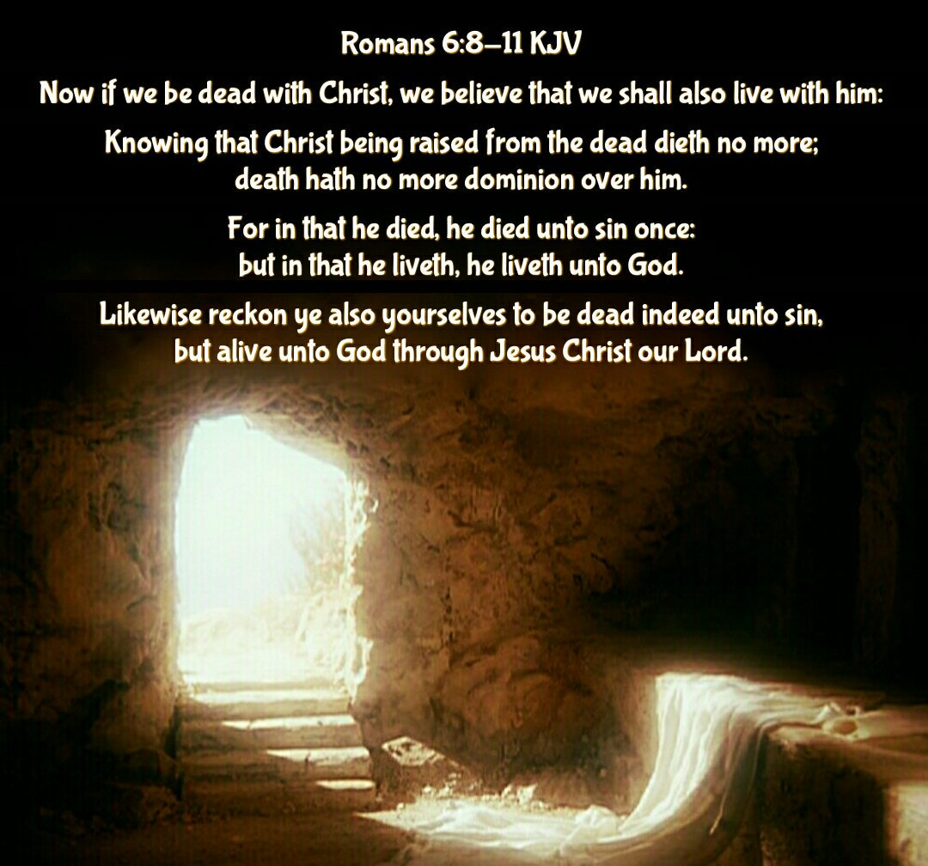
But this is not what Jesus said. What he really said is this: "Verily, verily, I say unto you, Whosoever committeth sin is a slave of sin." The Greek word is doulos, and signifies "properly, a born bondman, or slave." Note, it is not simply one made a slave; but one born a slave. That is what Jesus said; and that is what the word says yet to every one that is under the power of sin. Thus in the words of Christ here, as in the other places, it is the power of sin over the sinner, rather than the fact of sin upon him, that is taught, and that he wants men to understand. And he wants us to understand that this power is properly illustrated only in the system of Roman slavery as it was then in the world. {August 18, 1896 ATJ, ARSH 521.6}
This power is shown to be such that in its reign, in its mastery over the man who knows only the birth to slavery, the natural birth, it keeps him back from doing the good that he would do, and that he loves, and causes him to do the evil that he would not do, and that he hates. For it is written: "I am carnal, that do I not; but what I hate, that do I." "The good that I would I do not: but the evil which I would not, that I do." "For to will is present with me; but how to perform that which is good I find not." {August 18, 1896 ATJ, ARSH 521.7}
But why is this! Why is it that a man does the evil that he hates? Why is it that he does not the good that he would? Why is it that he cannot perform the good that he wills? Oh! "It is not more I that do it, but sin that dwelleth in me." I would not do it; but sin that dwells in me causes me to do it. I would do good, but sin that dwells in me holds me back, and will not let me do it. "For I delight in the law of God after the inward man: but I see another law in my members, warring against the law of my mind, and bringing me into captivity to the law of sin which is in my members. O wretched man that I am! who shall deliver me?" {August 18, 1896 ATJ, ARSH 521.8}
How could the supreme, sovereign, and absolute power of sin be more plainly shown than it is in the scriptures cited in this article? And how could the complete, abject, and helpless slavery of the man who knows the natural birth be more fully depicted than in these same scriptures? O that men would believe it! O that they would recognize it, and confess it, always! Then they could be delivered. For there is deliverance. There is deliverance as complete as is the captivity. There is freedom as absolute as is the slavery. There is the reign of another power, as certainly supreme and sovereign as was ever the power of sin. But until we recognize and confess the power of sin as the word of God declares it, we cannot know the power of God declares it, we cannot know the power of God as the word of God presents it. Until we acknowledge the complete sovereignty of the power of sin, we cannot acknowledge the complete sovereignty of the power of God.
A. T. J. {August 18, 1896 ATJ, ARSH 521.9}

