Slide 1
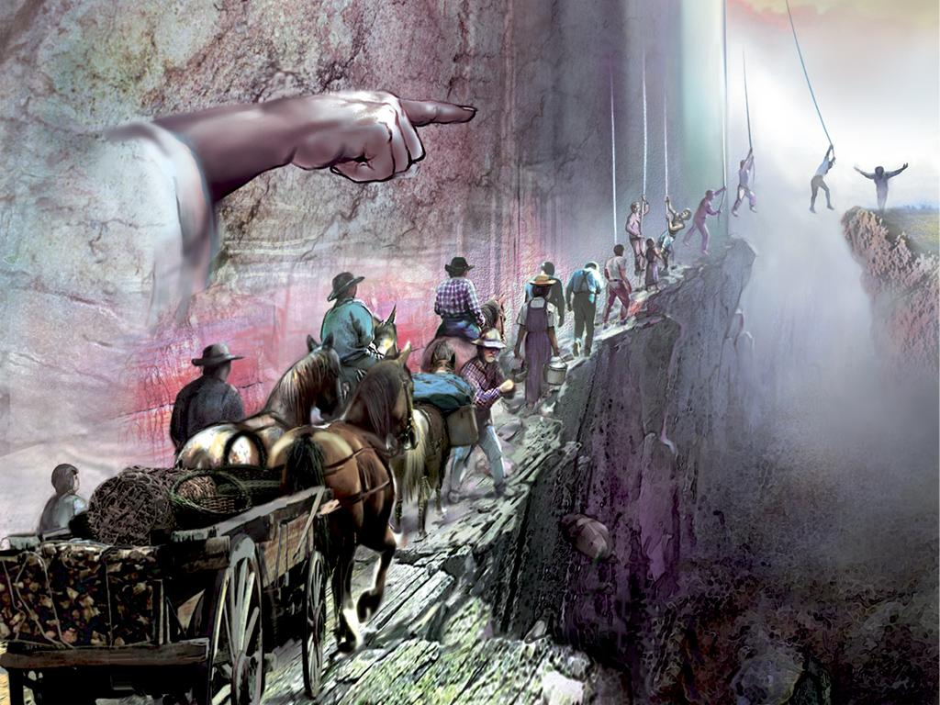
Introduction to Rules and Methodology:
Understanding How to Approach the Study of God’s Word Correctly
“We need to study the word of God in order to see Christ; and, in order to study the word properly, we need to use the correct methodology.”
~ Parminder Biant
Methodology = Rules
The correct methodology is the only mechanism to understanding the truth. Truth without rules borders upon spiritualism. The better we become in our understanding in how to use the rules, the more truth we’ll accept. When you understand the rules, you can understand the truth.
~ Parminder Biant

Slide 2
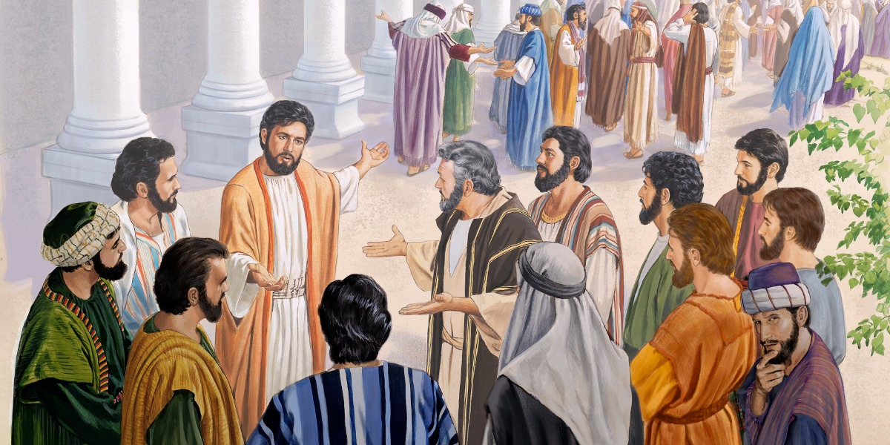
Importance of Understanding the Correct Methodology
Why did the 70 disciples choose to walk no more with Jesus?
John 6 King James Version (KJV)
⁴⁵ It is written in the prophets, And they shall be all taught of God. Every man therefore that hath heard, and hath learned of the Father, cometh unto me.
⁴⁶ Not that any man hath seen the Father, save he which is of God, he hath seen the Father.
⁴⁷ Verily, verily, I say unto you, He that believeth on me hath everlasting life.
⁴⁸ I am that bread of life.
⁴⁹ Your fathers did eat manna in the wilderness, and are dead.
⁵⁰ This is the bread which cometh down from heaven, that a man may eat thereof, and not die.
Luke 10 King James Version (KJV)
10 After these things the Lord appointed other seventy also, and sent them two and two before his face into every city and place, whither he himself would come.
² Therefore said he unto them, The harvest truly is great, but the labourers are few: pray ye therefore the Lord of the harvest, that he would send forth labourers into his harvest.
³ Go your ways: behold, I send you forth as lambs among wolves.
¹⁷ And the seventy returned again with joy, saying, Lord, even the devils are subject unto us through thy name.

Slide 3
Importance of Understanding the Correct Methodology Cont’
⁵¹ I am the living bread which came down from heaven: if any man eat of this bread, he shall live for ever: and the bread that I will give is my flesh, which I will give for the life of the world.
⁵² The Jews therefore strove among themselves, saying, How can this man give us his flesh to eat?
⁵⁷ As the living Father hath sent me, and I live by the Father: so he that eateth me, even he shall live by me.
⁵⁸ This is that bread which came down from heaven: not as your fathers did eat manna, and are dead: he that eateth of this bread shall live for ever.
⁵⁹ These things said he in the synagogue, as he taught in Capernaum.
⁶⁰ Many therefore of his disciples, when they had heard this, said, This is an hard saying; who can hear it?
⁶¹ When Jesus knew in himself that his disciples murmured at it, he said unto them, Doth this offend you?
⁶² What and if ye shall see the Son of man ascend up where he was before?
⁶³ It is the spirit that quickeneth; the flesh profiteth nothing: the words that I speak unto you, they are spirit, and they are life.
⁶⁴ But there are some of you that believe not. For Jesus knew from the beginning who they were that believed not, and who should betray him.
⁶⁵ And he said, Therefore said I unto you, that no man can come unto me, except it were given unto him of my Father.
⁶⁶ From that time many of his disciples went back, and walked no more with him.
⁶⁷ Then said Jesus unto the twelve, Will ye also go away?

Slide 4
Importance of Understanding the Correct Methodology Cont’
The teaching of the prophets made plain the deep spiritual lesson in the miracle of the loaves. This lesson Christ was seeking to open to His hearers in the synagogue. Had they understood the Scriptures, they would have understood His words when He said, “I am the bread of life.” Only the day before, the great multitude, when faint and weary, had been fed by the bread which He had given. As from that bread they had received physical strength and refreshment, so from Christ they might receive spiritual strength unto eternal life. “He that cometh to Me,” He said, “shall never hunger; and he that believeth on Me shall never thirst.” But He added, “Ye also have seen Me, and believe not.” {DA 386.2}
Christ had spoken a sacred, eternal truth regarding the relation between Himself and His followers. He knew the character of those who claimed to be His disciples, and His words tested their faith. He declared that they were to believe and act upon His teaching. All who received Him would partake of His nature, and be conformed to His character. This involved the relinquishment of their cherished ambitions. It required the complete surrender of themselves to Jesus. They were called to become self-sacrificing, meek and lowly in heart. They must walk in the narrow path traveled by the Man of Calvary, if they would share in the gift of life and the glory of heaven. {DA 391.2}
“Whose fan is in His hand, and He will throughly purge His floor, and gather His wheat into the garner.” Matthew 3:12. This was one of the times of purging. By the words of truth, the chaff was being separated from the wheat. Because they were too vain and self-righteous to receive reproof, too world-loving to accept a life of humility, many turned away from Jesus. Many are still doing the same thing. Souls are tested today as were those disciples in the synagogue at Capernaum. When truth is brought home to the heart, they see that their lives are not in accordance with the will of God. They see the need of an entire change in themselves; but they are not willing to take up the self-denying work. Therefore they are angry when their sins are discovered. They go away offended, even as the disciples left Jesus, murmuring, “This is an hard saying; who can hear it?” {DA 392.2}
In the words, “They shall be all taught of God,” Jesus referred to the prophecy of Isaiah: “All thy children shall be taught of the Lord; and great shall be the peace of thy children.” Isaiah 54:13. This scripture the Jews appropriated to themselves. It was their boast that God was their teacher. But Jesus showed how vain is this claim; for He said, “Every man therefore that hath heard, and hath learned of the Father, cometh unto Me.” Only through Christ could they receive a knowledge of the Father. Humanity could not endure the vision of His glory. Those who had learned of God had been listening to the voice of His Son, and in Jesus of Nazareth they would recognize Him who through nature and revelation has declared the Father. {DA 387.5}

Slide 5
Progression VS Line Upon Line
Word 1
Word 2
Word 3
Event 1
Event 2
Event 3
Theme
Theme
Progressive
Sentence
History
Act 3
Point 1
Point 3
Theme
Theme
Act 1
Act 2
Point 2
Progressive
Storyline
Dispensation
1AM
2AM
3AM
Step 1
Step 2
Step 3
Theme
Theme
Progressive
Message
Path/way
Notes:
In the previous study on the introduction to parables, we learned that behind every word is a thought. Therefore indicating that in approaching the word of God and SOP, (any literature at that) we enter into the mind of the author. So in every form of communication, as simple as a sentence and paragraph; or as complexed as a storyline and history, each allows us the ability to enter into the mind of the one communicating. God’s type of communicate is an expressed line of thought. Or, in other words, the type of communication He uses to reach us can be placed upon a line.
It is a great privilege to know the mind of God and be able to understand His ways. However, what’s of greater importance is knowing the method by which we are able to interpret His thoughts concerning us. He says in Isaiah, My thoughts are not your thoughts, neither are your ways my ways. For as the heavens are higher than the earth, so are my ways higher than your ways, and my thoughts higher than your thoughts. Okay, here God is telling us that we do not think as he does, neither do we behave as he does. He thinks and behaves on a higher level than us. So, if we don’t think as He does or behave as He does, how do we come to know His thoughts and ways? He says, “Let this mind be in you, which was also in Christ Jesus.” By beholding, we become changed into His image. He offers His mind to us to have as our own, and by accepting the mind of Christ, we come to know His thoughts and ways. To process those thoughts and interpret them correctly, we need to know and understand the rules and methodology to do so. The concepts of progression and line upon line (aka repeat and enlarge) helps us to accomplish that very thing.
Side note: Thought=word=action=habit=character(ways)=destiny. Your character is a reflection of your mind.
In progression, what do we see? TIME. In line upon line, what do we see? TIME. In God opening up His mind to us, He has revealed to us the subject of time. The concept of progression is self-explanatory. It progresses forward step by step. The lines are sequential, one following after the other. Progression can be a lot for us to handle because it’s many words/points/waymarks to process and comprehend. So there has to be order in which He is expressing His thoughts to us: one following the other. The other is a theme, which connects this thought together.
Each step comes with a different experience that is uniquely different from the other. Step 1 is not Step 2. So, we know that one waymark is not the other. That they are uniquely different.
How are the lines the same? They repeat. The fact that they repeat indicates that they must be similar or have some similarity. The second has similarities to the first. All histories have an occurring pattern. Line upon line or story upon story help us to further break down the mind of God (or His thoughts) to give addition insight behind what He is actually saying that applies to us in our dispensation. It’s like we’re stopping God in mid-sentence/paragraph/event asking, “What did you say? Can you repeat that?” Then He repeats and expands on His thought so that we can better understand Him. It’s a larger scale broken down to see it in greater detail. We are able to zoom in on that first step and see that it has a sequence of steps in itself. Line upon line helps us to put God’s thoughts into proper context in a way that we can clearly see where His word and counsel applies to us.
In this illustration you can note that each line is a form of communication or line of thought. Each waymark is a point of that thought that we use to make sense of what is being communicated. The theme is what helps us to accomplish this. Otherwise you have random thoughts that would be difficult to follow if they did not have a theme connecting them. It would be like putting words in God’s mouth. Place things where He did not say and getting an entire different interpretation than what he actually meant, and thereby misunderstanding Him.
We have to understand that God has a message for us. He wants to communicate to us the things on His mind. He is not talking to Moses, Joseph, or any messenger of His, He is talking to us. They are a living vessel He uses to communicate His thoughts to His people. We have to figure out how His word applies for us today, in which creates new information and new waymarks that causes us to understand what it means presently—present truth. Their life and their message becomes a parable for us to understand our history—the time we are living in today. It is history that we refer to in order to understand our own. We are to understand God through parables both progressively and line upon line. It is His method for teaching us complex things.
3 steps in the method to understand the word/mind of God correctly.
Line of progression
Repeat and enlarge (line upon line)
When you see the repeat and enlarge, sometimes, you can compare and sometimes contrast. In comparing and contrasting, you see similarities and differences. Then you can explain it in the concept of dispensations. There is an overlap in dispensations.

Slide 6
Progression VS Line Upon Line Cont’
When approach studies, think about themes. It helps us to see the symbology of what we are studying. Stories then become a living reality
Point 1
Point 2
Point 3
Theme:
Topic
Theme: The subject of talk, a piece of writing, a person’s thoughts, or an exhibition; a topic
Theme in a story is its underlying message; or a critical belief about life the author is conveying.
Period
 | α
Ω
Dispensation
Unique and the same
1989
9/11
MC
SL
Parable:
Waymark:
Additional information
Line:
Historical events. Some have past and some are in the future but all are historical events.
Marks along the way
The way or path
Parable:
This reform line can be understood by varying themes.
Additional information
When we begin to look at reform lines, we should begin to understand them by themes/models.
Alpha and Omega:
Isaiah 46:10 Declaring the end from the beginning, and from ancient times the things that are not yet done, saying, my counsel shall stand, and I will do all my pleasure:
Marks the beginning and the end. The middle is the period of everything that happens in between that leads to the next mark.
Three themes/models are used repeatedly…
Notes:
You need to be able to connect waymarks together. If you don’t, you are liable to make mistakes.

Slide 7
The Three Themes
Three Themes/Models:
1. Marriage
2. Building
3. Agriculture
Theme
1.Bride
2. Boat
3. Field
Right
Right
Right
Will take you all the way through a reform line.
Symbols
No defect all the way through
The structure is perfect to the beginning, middle, and end.
1. Marriage
Bride
2. Building
Boat
Ex 40:2
Rev 19:7
Wife being made ready. When is the wife ready? Marriage
Ezra 6:14 building
Line upon line–
What is the theme of line upon line? Building. Isa 28:17 gives us this clue.
Plummet, in the olden days, was a string with a weight at the end. We now use a level. It is used to check if the wall is vertical.
What is a line for? It’s for measuring. Rev 11—reed= measuring stick– to measuring a building.
All the stories that deal with houses, walls, foundations are dealing with construction. Think about what those stories are teaching us symbolically on a reform line.
Three plummets—vertical lines checking to see if these walls are upright.
Being built by both good and bad people.
Individual is separate from structure
What is it a symbol of? Judgment. Judgment is measuring 1SA 28:17 judgment will I put upon this line. The work of judgment begins at the TOE.
The theme of building teaches a very important principle, which is that righteousness is expected at every single waymark
We need to keep our eye upon the structure not the individual.

Slide 8
The Three Themes Cont’
2. Building
Boat
3. Agriculture
Field
Waymark:
--Speaks about a way
--Speaks about a path
Isa 28:17
Rest and Refreshing
This is the rest
This is the refreshing
PS. 77:13
Thy way is in the sanctuary.
Sanctuary is connected to the reform line.
There is an experience at every way
Justification, Sanctification, glorification: First, second, third
Rest=Refreshing=LR=Message
If you’re in the path, you will find rest.
Jer6:16 Message
They said, they will not walk
They will no hearken—listen =repeat and enlarge
Message
Mill
144k
1AM
3AM
No 2AM history in this concept, which is why the 2nd angel is brought to view here and repeated in our history
1,2,3: E. Gospel
Rev. 14:9-11

Slide 9
Dispensationalism
Dispensationalism:
Is an approach to biblical interpretation which states that God uses different means of working with people during different periods of history.
A belief in a system of historical progression, as revealed in the Bible, consisting of series of states in God’s self-revelation and plan of salvation.
It considers biblical history as divided by God into dispensations, defined periods or ages to which God has allotted distinctive administrative principles. According to dispensationalism, each age of God’s plan is thus administered in a certain way, and humanity is held responsible as a steward during that time.
Start
End
OT
NT
2000 years
Jews
Christians
LI
SI
Some kind of system or order of religion that comes about in a certain history or time.
~Parminder Biant
AI
MI
Parable = Dispensationalism
Dispensation:
A general state or ordering of things; specifically, a system of revealed commands and promises regulating human affairs.
In theology, one meaning of the term dispensation is as a distinctive arrangement or period in history that forms the framework through which God relates to mankind.
When you start realizing the concept of dispensationalism, everything becomes clearer.
It’s not because you read things differently. It’s because each of us understands it in a certain dispensation.
Notes:
You begin to understand the truth relevant to the dispensation you are in. We are not living in the time of Christ, so we do not see the truth revealed in their dispensation as those who did live during that dispensation did. We understand that truth differently as it applies to our dispensation.
History repeats. So what you see in one dispensation, it has to be a repeat from the previous dispensation.
i.e. The seven churches

Slide 10
Reform Lines are Prophetic
How is a reform line prophetic?
History:
Tale, Story
Chronological record of significant events (such as those affecting a nations or institution) often including an explanation of their causes.
History repeats or history is repetitive. You can look at a particular history to predict/know what the future history will look like.
The identifying of patterns, helps us to recognize similarities of various histories.
History = Parable
A Living parable: One’s life history can be used to explain a complex difficult situation for others to learn from.

Slide 11
Progression VS Line Upon Line Cont’
Progression: The process of developing or moving gradually towards a more advanced state.
In other words, progression means step-by-step (1,2,3). Knowing this, you cannot have individual waymarks; (they do not stand on their own) because there has to be a connection. Therefore, the story has to be threaded together, which is what a theme/model does.
Any line; i.e. 144
Rule: If you have a line,
You can have no typology
On a line there is no typology
1
2
3
4
= Progression
Theme:
Step #2 is not a type of Step #4.
Reform Line
1989
9/11
SL
COP
1
2
3
4
= Progression
Stepping Stones
You CANNOT have line upon line/repeat and enlarge in progression
9/11 cannot be a type of SL. 9/11 is just the 2nd step to get to the COP

Slide 12
Line Upon Line: Breaking the Line
Isaiah 28:10 For precept must be upon precept, precept upon precept; line upon line, line upon line; here a little, and there a little:
1798
1844
1989
C0P
1
2
ML
144K
You cannot say that 1989 is a type or antitype of 1798. It is a complete line.
Line upon Line = Typology
TOE
TOE
1798
1844
1989
C0P
Repeats are typology/line upon line.
T
AT
How do we build upon a line?
We break the line to create two different histories. Then place them underneath the other.
When we divide lines and set them on top of one another, we are cutting them/breaking the line in order to get additional light.
Rule/Instruction: Read a passage, check all the words, then check if a parable.
When noting if a parable, think in terms, such as compare and contrast; natural or spiritual; juxta-positioning; alpha and omega; chiasm; or repeat and enlarge
The whole purpose of doing line upon line is to show that they are the same and not different.
EX. RUN ON SENTENCE
I love to write papers I would write one every day if I had the time.
One sentence is not the same as the other. Both sentences express two different thoughts. You can break up the sentence to better understand the thoughts expressed. However it is important to know where to place the punctuation to break up the sentences correctly.
Depending on the kind of parable used to approach each line of thought gives you additional information.
Notes:
History 1 is the story of church 1. Break connection and bring church 2 down and you have a repeat and enlarge.
This is the methodology of dispensationalism, which is also parable teaching.

Slide 13
Progression and Typology
Ellen G. White, in her writings, mixes the concept of line upon line with the concept of progression. When she does a history and then a progression, the combination of these two opens up light for us to understand our own history.
1
3
Our history
History
Upon the testimony of 2
2
History
Ellen G. White combines both typology and progression. We are required to, not through the words, but through: structure, patterns, or parables, identify similarities to procure information for our time/dispensation.
Something is established
Natural & Spiritual
Compare & Contrast
Repeat & Enlarge
Alpha & Omega

Slide 14
Structure of Line Upon Line
 | a. | b. | c.
1. | Says not now | Jacob | Corners
2. | Not night | Israel | Children
Bible Verse
Ex. Numbers 24:17
a 1
b 1
c 1
STORY 1
Same story repeated. It becomes a perfect line upon line
a 2
b 2
c 2
STORY 2
a 3
b 3
c 3
STORY 3
Notes:
For my thoughts are not your thoughts, neither are your ways my ways, saith the Lord.
⁹ For as the heavens are higher than the earth, so are my ways higher than your ways, and my thoughts than your thoughts.
¹⁰ For as the rain cometh down, and the snow from heaven, and returneth not thither, but watereth the earth, and maketh it bring forth and bud, that it may give seed to the sower, and bread to the eater:
¹¹ So shall my word be that goeth forth out of my mouth: it shall not return unto me void, but it shall accomplish that which I please, and it shall prosper in the thing whereto I sent it.

Slide 15
The Z-rule
Z-Rule:
Going from symbol to person, which then points to the ultimate spiritual manifestation.
Note that this star is not a type of this star. It can’t be a typology, but it can be a sign/harbinger.
The wise men understood Balaam's prophecy. As we read the prophecy, we too could understand the prophecy
Harbinger:
A person or thing that announces or signals the approach of another
Something that foreshadows a future event: Something that gives an anticipatory sign of what is to come.
A forerunner of something
Is something that comes before and that shows what will follow in the future.
Ex. Word study on star
Numbers 24:17
Natural
Spiritual
Step #1
David
KEY NOTE
Is pointing to
Not the same star—They do not equal one another
One points to the other one; It tells you that this is about to come.
They look the same even though they are not the same thing.
What you see is what you read
Step #2
David
Step #3
What you have to see with your eyes is a harbinger/sign that looks identical to what you read in inspired statements.
We can’t just jump from the star to Christ. If you don’t do it properly, somewhere, sometime, you can make a mistake.
Is pointing to
The sign has to be identical to the object it is pointing to.
Symbol is identical to the spiritual

Slide 16
Summary
Does a line/reform line ever stop?
No. A line does not stop because time (history) does not stop. It’s progressive. However, a line can be broken because there are set parts/dispensations in every line that tells something about a particular event(s) on a line (or in time), which in turn indicates a beginning and a end of various times on a line.
Ellen G. White, in her writings, mixes the concept of line upon line with the concept of progression. When she does a history and then a progression, the combination of these two opens up light for us to understand our own history.
In order to apply this concept correctly, we need to understand:
Progression and line upon line
The Z-rule
Harbinger/Sign
Parables, patterns, or structure provide addition information, depending on the kind of parable used, to help us see similarities of histories to identify what another or future history will look like.
Those reform lines (histories) can be built perfectly one upon another to reveal information about future events to come pertaining to other lines (or history)

